Slide 1
Outcomes-Based Financing for Outdoor Recreation
Provincial Summit | October 2023
Notes:
Hi, My name is Risa Hiser. Thank you for having me. I am honored to be included with an incredible group of presenters and to share about the work our firm, Quantified Ventures, to deliver social and environmental outcomes, specifically our approach to nurturing sustainable economic development solutions. This session will highlight our outcomes-based economic development work with a closer look at our outdoor recreation financing models. Glad you are here. And let's get started.

Slide 2
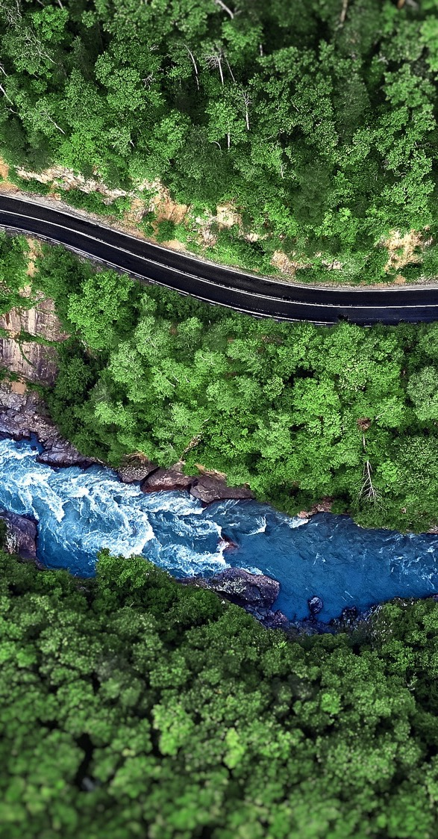

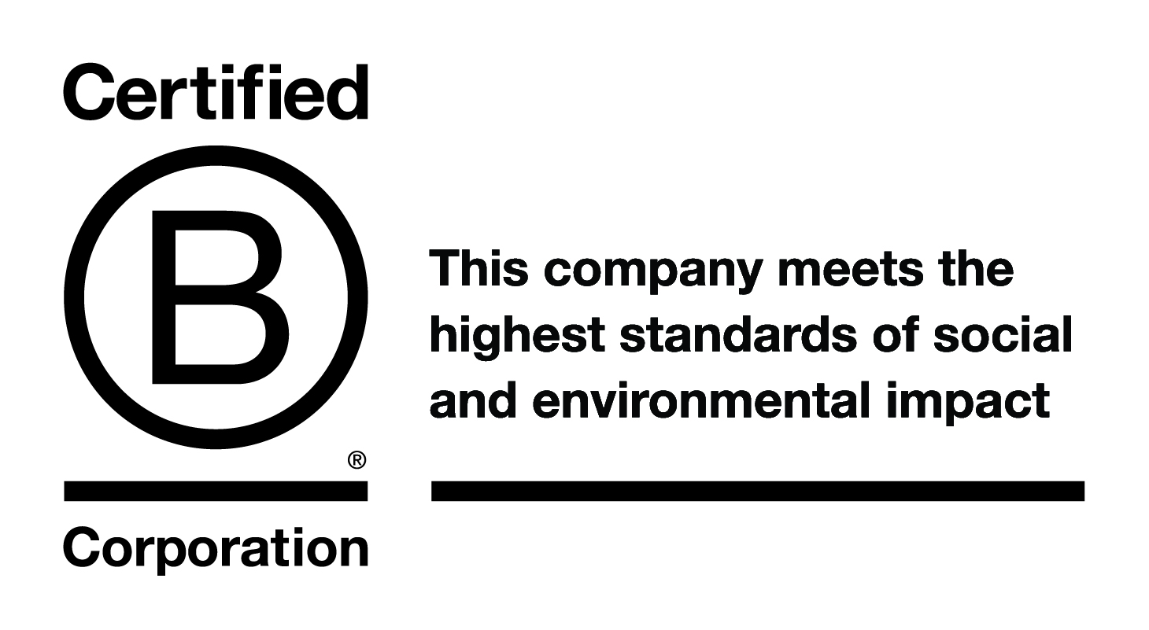
Quantified Ventures works with pioneering organizations to
design, capitalize, and scale investible solutions that improve the wellbeing of people and planet.
Risa Hiser
Senior Associate
rhiser@quantifiedventures.com
Notes:
A little bi tabout are firm? Who are we? Our company, Quantified Ventures:
Founded in 2014, we are proud to be a certified B Corp
We have the tremendous honor of working with pioneering organizations and companies to design, capitalize, and scale investible solutions that improve the well being of the people and planet
We have 33 employees, with diverse backgrounds in finance, management consulting, health and environmental policy, housing, economics, and law
We are based in DC, with additional staff across the country and several outside the US

Slide 3





About Quantified Ventures
Our team works across the country on environmental and social challenges.
Our Role
Environment and Resilience
Health and Human Services
Climate change mitigation & adaptation
Transition to a resilient economy
Developing sustainable infrastructure
Food security
Healthy aging
Mental health & substance abuse
Environment & health
Economic resilience
Housing & homelessness
Impact Assessment
Build Local Capacity
Strategy and Planning
Support Decision-making
Secured Funding & Financing
About
Outcomes-Based Financing
Outdoor Recreation
Notes:
What do we actually do? We work very hard to
Deliver ROI (return on investment) and impact to address environmental and social challenges
Work across two teams: Environment & Resilience and Health & Human Services
We have more than 30 active client projects across the continental USA with comprehensive approaches and solutions that can be customized for new geographies

Slide 4






































We work with innovators, risk takers, pragmatists, and optimists
Governments
Environmental Organizations
Heath & Human Services
Foundations
Corporate Partners
About
Outcomes-Based Financing
Outdoor Recreation
Notes:
What do I enjoy most about our approach and working for Quantified Ventures? We work with incredible partners. Our strength lies in our ability to partner with a wide range of constituents, to deliver social and environmental outcomes across public, private, and philanthropic sectors.
We could not do the work we do without our dedicated partners.
We work with governments, environmental organizations, human and health services, foundations and corporate partners.
Our diversity of partners supports our continued learning and innovation

Slide 5



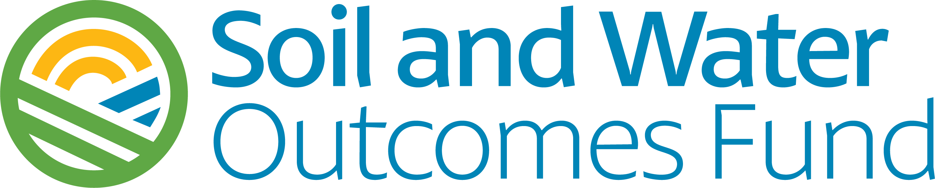
Design innovative and scalable solutions for people and planet
Structured in Washington, D.C. the first-ever EIB
Provides financing for urban green infrastructure
Delivers social & environmental outcomes
Environmental Impact Bond
Launched subsidiary:
Pays farmers to implement conservation ag best mgmt. practices
Stacks carbon and water quality outcomes
Developed innovative family-focused fund structure
Provides improved recovery health outcomes and lowers costs
Sustainably scales capacity to provide SDOH & health-related social services
Recovery Health Outcomes Fund
About
Outcomes-Based Financing
Outdoor Recreation
Notes:
Why am I here? We've advanced some incredible projects. Our mission is to improve the wellbeing of people, communities, and the planet and we do so by developing investible, outcomes-based solutions that drive verifiable results. What does this approach yield? It leads to the design of innovative and scalable solutions. Three quick examples before we dive into the meat of outcomes-based financing for the outdoor recreation economy.
For environmental outcomes in the urban water context, we have structured an:
Environmental Impact Bond
In EIB is a type of municipal bond label which signals to investors that the issuer has market-leading ESG transparency and accountability in their bond.
In 2016, QV pioneered the Environmental Impact Bond with DC Water to fund…
$25MM for green stormwater infrastructure projects.
Through subsequent issuances, we have worked with municipalities to refine the model and drive additional value to cities (Buffalo, NY; Hampton, VA; Atlanta, GA)
EIB commit to the prediction, evaluation, and disclosure of environmental outcomes of funded projects. *Theme repeated in outcomes based finance
EIB is compatible with ICMA Green Bond Principles and UN Sustainable Development Goals
IF TIME: Why do an EIB ?
Expand a bond’s potential investor base to include leading ESG funds and ESG-influenced accounts (brings in private capital)
Demonstrate commitment to innovation and transparency to peers and the community
Fund nature-based solutions, which drive additional environmental, health, and workforce development benefits
Enable smarter capital spending decisions using project outcomes data
For environmental outcomes in agriculture:
2. Soil and Water Outcomes Fund
- When managed sustainably, agricultural landscapes provide much more than just food
Our agriculture practice focuses on improving water quality, enhancing soil health, sequestering carbon, using water more efficiently, supporting wildlife habitat connectivity, and bolstering rural economies and livelihoods.
With the Iowa Soybean Association, we launched an innovative, multi-payor financing vehicle to provide farmers with financial incentives to implement conservation practices
We use investor capital to provide financial incentives and the conservation practices farmers implement generate verifiable environmental outcomes
Stacking of multiple environmental outcomes together (water quality, carbon sequestration) within a single transaction allows each beneficiary to pay only for the outcomes they desire rather than the full cost of program implementation *another theme
While at the same time improving economic and ecological resilience for American farmers
The fund started in Iowa with 9000 acres, and now has enrolled more than 240,000+ acres across 9 states, including Chesapeake Bay watershed, Illinois, Indiana, Iowa, Maryland, Minnesota, Missouri, North Carolina, Ohio, Pennsylvania.
The environmental outcomes include the following: ***211,000 metric tons of greenhouse gas equivalents, which is equivalent to removing 46,000 cars from the road for a year; 3,240,000 lbs of nitrogen prevented from leaving enrolled farms; and 206,000 lbs of phosphorus prevented from leaving enrolled fields
In 2023 the fund is expanding to 12 Midwestern states
We are able to do so as we received $95 million in funding from US Dept. Agriculture Partnerships for Climate-Smart Commodities Initiative to support this expansion to the 12 Midwest states
For social and health-based outcomes, we developed an innovative:
3. Recovery Health Outcomes Fund

Slide 6
There is need for more & new sources of capital for solutions
1
The challenges are complex: Most challenges involve multiple stakeholders. Both public and private sectors need bold solutions to solve big and complex health, social, and environment challenges.
2
But budgets are strained: Resources are finite and funding for services and infrastructure has been flat or declining. In the United States, there is a $2.6 trillion gap between what we currently spend and what we need to spend during the next 10 years to keep our country’s infrastructure in good repair.*
3
Investors are motivated: They are increasingly looking for opportunities to deploy capital to solutions that yield both financial and social returns. Impact capital is estimated at $715 billion and growing worldwide.**
* 2021 Infrastructure Report Card, American Society of Civil Engineers
** Global Impact Investing Network (GIIN)
About
Outcomes-Based Financing
Outdoor Recreation
Notes:
The why. Why is our work important? How did we get here? Why are we talking about outcomes-based financing? Why does it matter?
Challenges are more and more complex. There is not one party, there are multiple. It is more than two partners in the same sector. Both public and private sectors need solutions that can solve our massively complex social, health and environmental challenges.
And We don’t have the funding to tackle this. Budgets are already strained. In the United States there is a $2.6 trillion gap between current spending and spending need to repair our infrastructure. I saw data that reported in 2013, Canada’s infrastructure gap was upwards of $150 billion, a sizeable gap.*
Investors are ready. They are motivated and are looking for opportunities to deploy capital to solutions that offer more than financial returns, they are looking for environmental and social returns as well. Impact capital is estimated at $715 billion and growing worldwide.
*Source: theconversation.com. “Federal budget 2023: Long-term investments are needed to fix Canada’s infrastructure gap.” March 23, 2023. Date accessed September 30, 2023, https://theconversation.com/federal-budget-2023-long-term-investments-are-needed-to-fix-canadas-infrastructure-gap-202894#:~:text=Canada's%20infrastructure%20gap,-A%202013%20report&text=Canada's%20infrastructure%20deficit%20is%20at,climate%20change%20mitigation%20and%20adaptation.

Slide 7


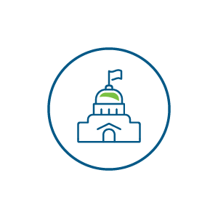


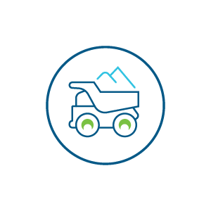



What is outcomes-based financing?
2
Additional Capitalization
Grants, appropriations, etc.
1
Investors
Provide up-front capital to & receive repayment
Public Entity or Service Provider
Launches projects or programs that achieve desired outcomes
Evaluator
Verifies that project outcomes are achieved
Impact
Results in direct or indirect environmental, health and economic benefits due to the primary or secondary objectives
Quantified Ventures
Develops outcomes-based solutions and performance metrics; aligns and coordinates partners; delivers new sources of capital
Project Implementors
Construct projects
3
4
Payor
Repays investors based on achievement of outcomes
About
Outcomes-Based Financing
Outdoor Recreation
Notes:
What is outcomes based financing? Every transaction looks different however this graphic provides a model for how outcomes-based financing can be structured.
Outcomes based financing is a way to unlock financing from the private sector and deliver on verifiable results and positive outcomes or impact.
Develop outcomes-based solution (what are the outcomes, who benefits, who will pay, who will invest, how will results be verified)
Investors provide capital (they also are repaid by the payors for their upfront investment)
Public Entities or service providers launch program or projects (this could be a government or service provider – sometimes these are funded by additional capital, which could include grants, federal appropriations, PRIs)
Support from project implementors (often times additional capacity or experts are brought in if infrastructure is being built, for example)
Outcomes are delivered and evaluated (the projects are completed, results and impact is delivered and results are evaluated)
Payors repay investors based on achieved outcomes (Payors, could be government ,private companies, those who benefit and are often saving money in the process of this solution versus another, pay for the outcomes)
What does this mean and what does this look?
For QV, we strive to add value as a growth catalyst through several channels to our partners: design, capitalization, scaling
We design.
We listen and take ideas, help them become actions, and support successful implementation.
We do this through comprehensive feasibility analyses (will it work?), problem assessment (is it solving the right problem?), and outcomes valuation (are the outcomes verifiable? Are they real?)
2. We capitalize.
We ensure engagement from partners and investors.
We help structure transactions (the nuts and bolts of how it all works)
We develop models for outcomes-based financing and identify funding
We identify payors who will pay for these valuable outcomes**these may be different payors for different outcomes, both supporting the same project
We ensure that outcomes are verified and the verification process is transparent
We scale solutions.
We take what we have learned and grow it. Replicating verified impact and outcomes
This includes programs, services, enterprises, financial products or funds

Slide 8
Benefits of outcomes-based financing
Transfer performance risk
of innovative projects to investors
Establish external accountability structures
that foster commitment and support sustained partnerships
Access new sources of investment capital
Benefits of outcomes-based financing
Showcase partners
and their projects, attracting internal and external support
Measure and track outcomes through embedded performance evaluation
Engage diverse & new stakeholders benefiting from projects
About
Outcomes-Based Financing
Outdoor Recreation
Notes:
Why does it work? Why is it a solution?
There are multiple benefits to outcomes-based financing.
Establishing external accountability structures that foster commitment and support sustained partnerships
Transfer performance risk of innovative projects to investors
Access new sources of capital
Measure and track outcomes through embedded performance evaluation
Engage diverse and new stakeholders benefitting from projects (these could be payors across sectors, often stacking outcomes or pursuing various outcomes for the same project, e.g. recreation offers benefits across sustainable tourism, health, and environmental)
Showcase partners and their projects, attracting internal and external support

Slide 9
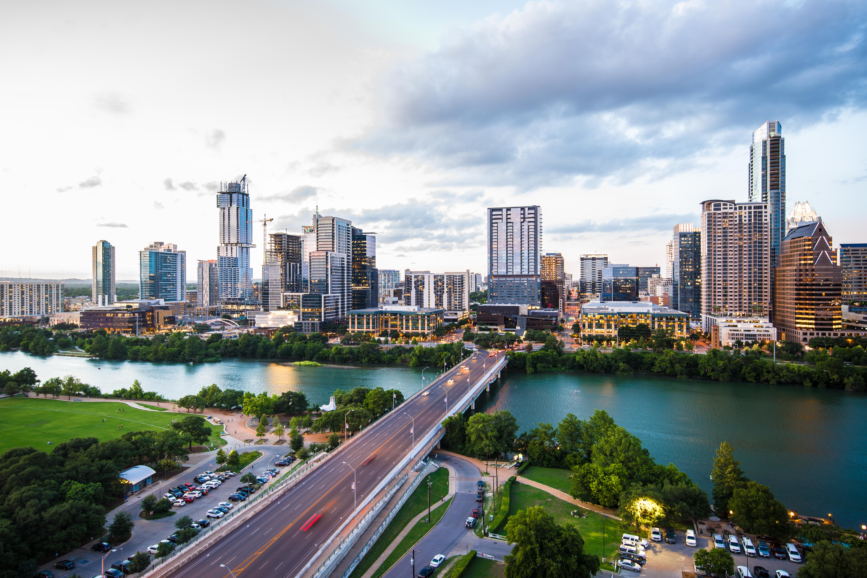
The Quantified Ventures Playbook
CONSOLIDATE the project and impact narratives
Quantify impacts, using existing reports and data
Streamline the narrative to its core components
Produce a technical memorandum and summary sheet
STRATEGIZE on the quickest path to your goals
Build on existing strengths and incorporate creative and innovative approaches
Be vigilant and pivot quickly towards new opportunities
CONNECT to our network of capital providers and partners
Find the partners that play the roles needed in a new strategy – technical expertise, investment, grants, etc.
Workshop capital strategy
SUPPORT your deal team and project team
Build knowledge and capacity with typical service providers to incorporate innovative approaches
Create documents that enable getting creative capital
About
Outcomes-Based Financing
Outdoor Recreation
Notes:
How do we support developing outcomes based financing models? We generally follow this playbook.
We help define the project and narratives by
Calculating environmental, health, and economic project outcomes
Determining the potential to borrow based on anticipated future project revenues and deploy that capital to pay a portion of the upfront costs
Sharing our findings in a consolidated format for our partners and stakeholders
We help identify the quickest way to get to the overall goals and project outcomes.

Slide 10



Creating solutions for delivering outcomes
Cultivate trusted partnerships across sectors and involve agencies, investors, private and nonprofit institutions, philanthropies, and community groups that share our vision to be at the forefront of creating healthy and vibrant communities.
To make positive health, social, and environmental outcomes both financeable AND profitable, leverage the strengths of all sectors.
Build robust, accountable, and sustained structures that bring needed resources to solve stuck problems.
About
Outcomes-Based Financing
Outdoor Recreation
Notes:
We've learned some things along the way in our 10 years of working on outcomes based financing transaction. In the end, outcomes-based financing is only successful if outcomes are delivered. Part of the value of our company and those similar is the approach to creating and then importantly, delivering upon those outcomes. What does it mean to deliver outcomes? How can success be ensured for outdoor recreation projects? The following are necessary and important:
Trusted partnerships
Positive health, social and environmental outcomes that are financeable and profitable. Give people multiple reasons to come to the table. It not only produces outcomes but it pays for itself, and multiple sectors can benefit and be involved.
Robust, accountable and sustained structures that bring resources to solve stuck problems. Why isn't something working and how can we innovative and find a solution and scale it? Our CEO will often say we take stuck problems and “unstuck them”. He also will tell you that our colleague, Seth, camped in the woods in Ohio for 6 months, growing a long beard, to see one of our recreation trail projects through to completion. Our colleague did not camp. He is also clean shaved, most of the time, and lives outside of DC (and is not often living in the woods for months on end). However, the project was successfully completed and it involved a lot of engagement in Ohio to ensure the above rang true. On that note, let’s talk recreation examples!
¹2017 Infrastructure Report Card, American Society of Civil Engineers
Investors are increasingly seeking to deploy capital to solutions that yield both financial and social returns
Impact Capital estimated at over $500 billion and growing worldwide*

Slide 11
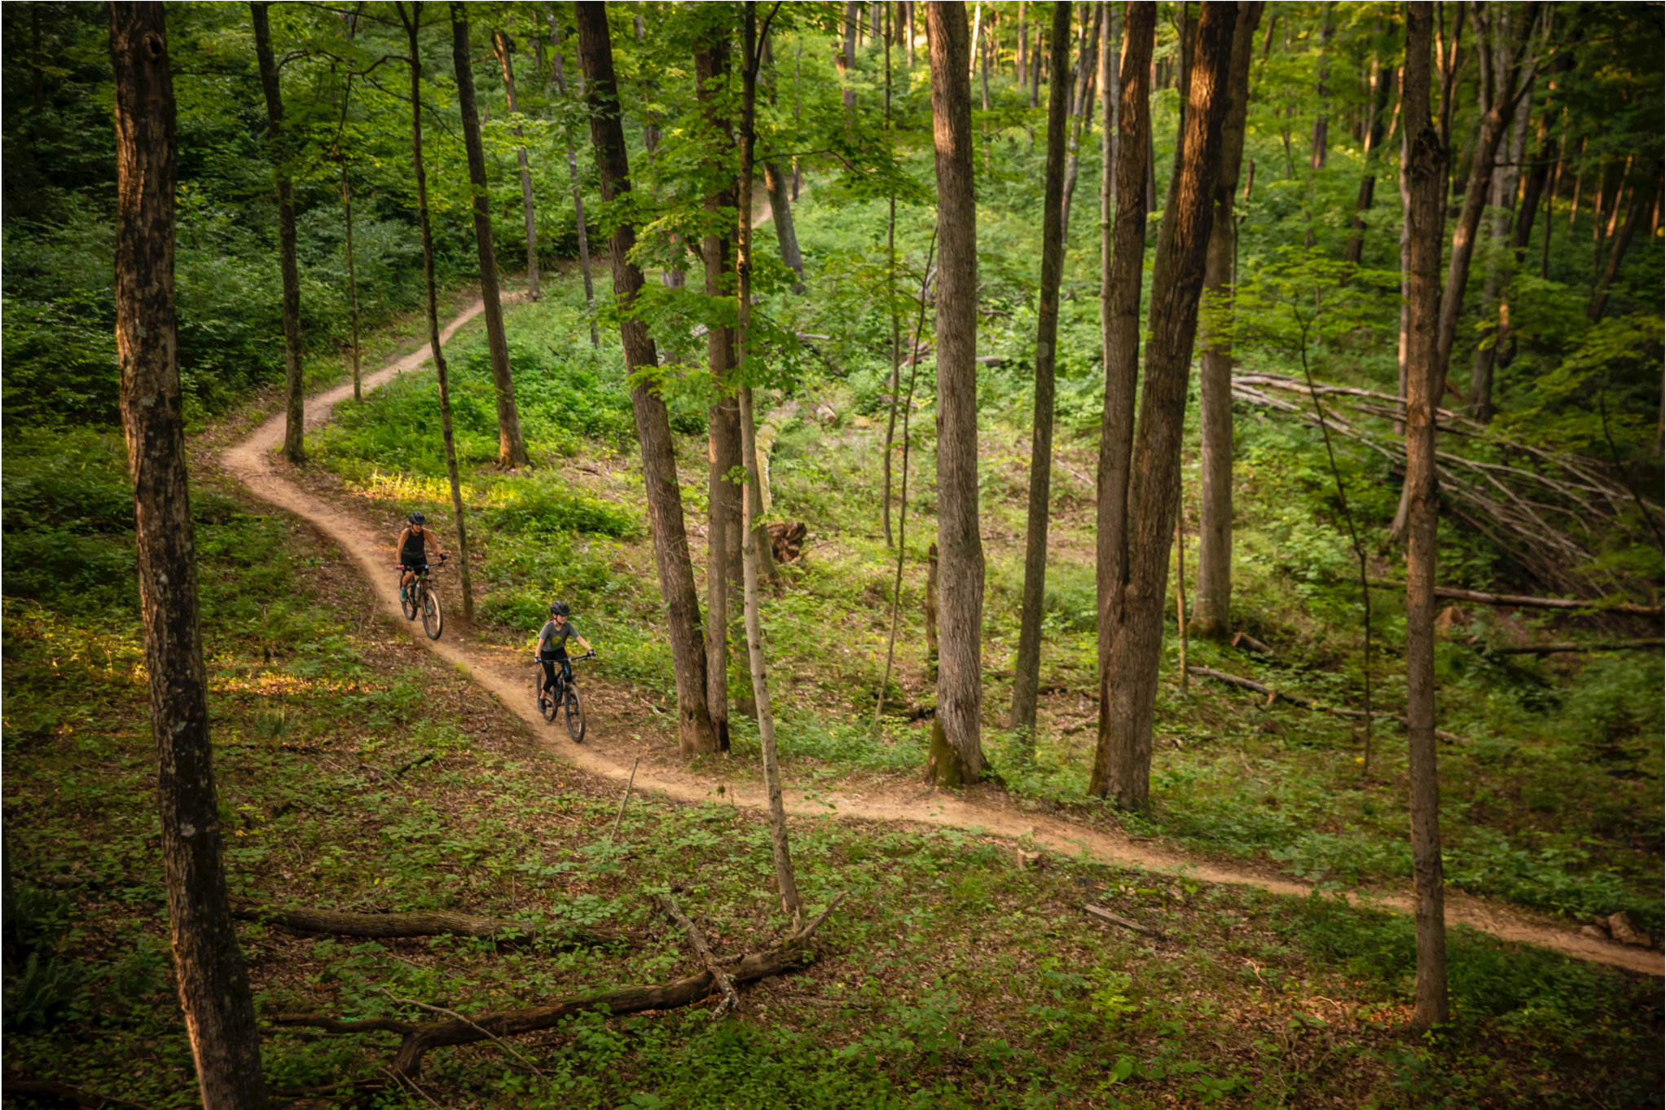
Recreation Case Studies
About
Outcomes-Based Financing
Outdoor Recreation
Notes:
This is the trail, Baileys Trail, where my colleague Seth (did not camp for 6 months), a project we successfully completed in Ohio that created 88 miles of new trails.

Slide 12

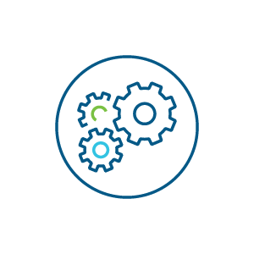
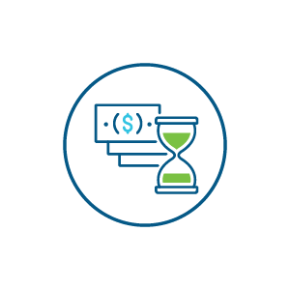
Barriers to developing outdoor recreation infrastructure
Public funding is limited and competitive
Pre-development process can be long and expensive
Communities have limited capacity
Construction costs are high
Land managers, local municipalities, and community organizations struggle to secure sufficient funding for their projects and compete for limited funds.
Master plans, community approval, and other regulatory requirements can take a long time to secure. And, it can be expensive to navigate.
Often, several community groups, federal and state agencies, tribal governments, and other partners are all involved, not everyone has the capacity, nor is there sufficient collaboration.
Rural settings cover large geographies, cross boundaries, and may have complex historical land uses to contend with. Recreation infrastructure itself can be costly.
Technical Assistance
Flexible $$$
About
Outcomes-Based Financing
Outdoor Recreation
Notes:
What does this look like specifically for outdoor recreation? And that of rural outdoor recreation? What makes outcomes based financing a good fit for outdoor recreation?
In the recreation world, we see some of the following challenges:
Public funding restrictions, such as eligibility criteria that often restrict access for projects spread across multiple jurisdictions and limitations on use of funds, match, and reimbursement rules create undue burdens for communities with limited means.
Limited pre-development funding.
Higher development costs in rural areas due to topography, geography, and impacts of historical resource extraction.
Recreation Infrastructure is siloed into resource constrained land management agencies.
These challenges point to the need for technical assistance and flexible funding, both of which can effectively addressed with outcomes-based financing and have!

Slide 13



Private Capital in Recreation Infrastructure Development
Private capital is a flexible source of upfront capital that is supplemental to public funding
Flexible and upfront capital can address many problems
Allow projects to focus their efforts more strategically, and enable investments in revenue generation
Meet matching requirements for private funds or addressing timing challenges with reimbursable grants
Overcome challenges with grant restrictions based on demographics and geography
Having commitments of co-investment increase competitiveness for public funds
To benefit from private capital, organizations first needs to:
Structure that enables financing and authority to secure public funds
Ability to capture project revenues to repay financing
Capacity to manage fundraising, pre-development, planning, and permitting, construction, and operations
Notes:
Speicifcal for outcomes based financing, leveraging private capital has many benefits.
When we talked earlier about designing and structuring outcomes based financing, part of that means having the right people at the table and the right structure in place to allow a deal to go forward. For local governments or partner this means, the correct funding and authority to secure certain types of funding
We have a few case studies where we have successfully deployed outcomes based financing approach to capture project revenues, quantify and leverage project outcomes, and create the appropriate governance authorities to capture additional funding deliver outcomes.

Slide 14
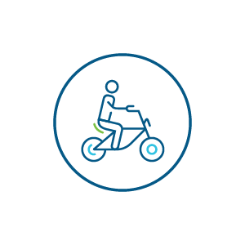





Producing multiple project & organizational outcomes
Project Outcomes for Outdoor Recreation
Sustainable Tourism
Service
Economic Development
Health Benefits
Conservation
Connectivity and Access
Climate Resilience
Stewardship
Improved Infrastructure
Organizational Outcomes
Stronger Governance
Capacity to capture revenues from projects and public funding sources
New Sources of Funding Payors for project outcomes and sustainable project revenues
More Competitive
Leverage project revenues to unlock public funds
About
Outcomes-Based Financing
Outdoor Recreation
Notes:
The outcomes are numerous both from project outcomes and organizational outcomes for outcomes-based financing projects. Outdoor recreation specifically is a strong use case of outcomes-based financing as it delivers the following outcomes:
Project based outcomes include:
Sustainable Tourism –
Service –
Economic Development –
Health Benefits –
Conservation –
Connectivity and Access –
Climate Resilience –
Stewardship –
Improved Infrastructure –
Organizational outcomes include:
Stronger governance – meaning stakeholders have the capacity to capture revenues from projects and public funding sources
New Sources of funding – various payors, repay for specific project outcomes creating sustainable project revenues
More competitive – with sustainable project revenues, these can be leveraged to unlock additional funding, including public funds

Slide 15
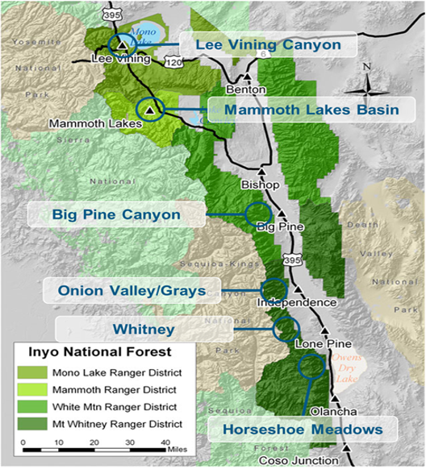
Inyo National Forest Project Overview
Our goal was to create a structure that can finance campground improvements and other projects that benefit the Eastern Sierra by drawing on the broader benefits those projects provide to other stakeholders.
Notes:
On the Inyo National Forest, which is located in California , there are an estimated 2,308,758 visitors per year to the Forest
For this project we prepared a business plan that set up outcomes based financing and identified six priority campground areas (including Lee Vining Canyon, the Mammoth Lakes Basin, Big Pine Canyon, Onion Valley/Grays Meadow, Whitney Portal, and Horseshoe Meadows.
Based on the work to be done or outcomes desired from each investment, the Project Team estimates that the total costs for improvements in these six campgrounds will total between $19.9M and $36.2M.

Slide 16
Inyo NF Project Context
Scope of the Problem
Project Activities
Existing infrastructure not designed for current demand
Infrastructure not designed to meet the preferences of modern visitors
Climate change impacts have inflicted damage to campgrounds
Gateway communities suffer as a result
Sites and access must be redesigned, enhanced, and expanded to meet current and projected demand
Costs will range between $19.9 million and $36.2 million
Design will need to mitigate climate change impacts
Given range of stakeholders, approach needs to be jointly-funded, jointly-managed, and replicable

Slide 17
Key Outcomes to Make Case for Investment
Economic Impacts
Social Impacts
Environmental Impacts
Number of Campers
Total Direct Spending
Total Income Increase
Jobs Supported
Total Lifetime Value of Camper Spending
Annual Taxes (Mono / Inyo / Mammoth Lakes / CA)
Increase campground capacity to manage expected future increases in visitation
Create uniform demand at popular sites to mitigate strain on local communities (traffic, trash, etc.)
Reduced risk of wildfires
Address problems with erosion and impacts on water quality
Better manage precipitation and reduce runoff
Economic, Social, and Environmental benefits provide justification for private financing, public funding, and philanthropic giving

Slide 18
Mapping Key Local Actors / Payors
Towns
The towns of Bishop and Mammoth Lakes are key stakeholders who work closely with the counties and public land managers on regional issues.
Public Land Managers
In addition to the Inyo NF, the National Park Service and Bureau of Land Management manage an enormous amount of the Eastern Sierra region.
Counties
The Eastern Sierra region is comprised of three counties (Mono, Inyo, Alpine) that have 35,000 total residents – but the area gets millions of visitors per year.
Regional Utilities
LADWP owns most of the private property in the region and has significant interest in the region as a watershed for Los Angeles’ water supply.
Tribes
As original stewards and residents of this region, Tribes should be part of any solution for it to be truly effective in the long term.
Concessionaires
Campsites on the Inyo NF are managed through private concessionaire on a Special Use Permit. QV is working with Inyo NF to renegotiate the concessionaire permits.

Slide 19




Implementing this architecture can unlock public funding
Regional Asset
Local Collaboration
Intentional Development
Public & Private Investment
American Rescue Plan + BIL + BBB
Building Jobs and Local Wealth
Tribal Engagement
Eastern Sierra Council of Governments (ESCOG)
Federal
Funding
Eastern Sierra Council of Governments (ESCOG)
Local Government
4 local political subdivisions
Private Sector
Investment
Eastern Sierra Sustainable Recreation Partnership (ESSRP)
State
Funding
State of California Policy + Funding CALREC Vision
Private Sector and Advocacy Engagement
Notes:
project a better fit for funding or financing? Both? Describe why (consider project scale, the value of borrowing funds upfront, how financing might be repaid, etc.)

Slide 20
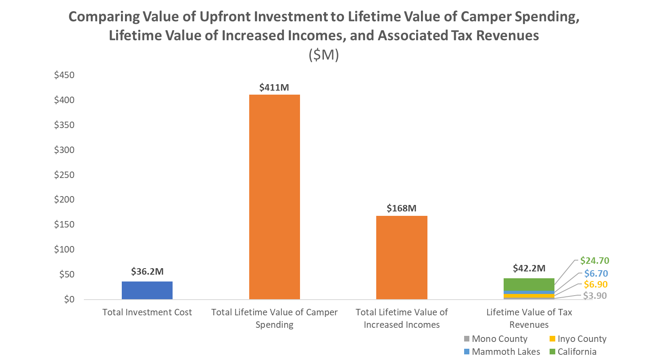
Importance of Target Campgrounds for Regional Economy
The Project Team evaluated the needs of each site and estimated the total costs for all projects to be between $19.9 to $36.2M
This is dwarfed by the lifetime value these campgrounds provide.
Notes:
QV FEASIBILITY ASSESSMENT Business plan:
On the Inyo NF, there are an estimated 2,308,758 visitors per year to the Forest that have a total visitor spending of $391,371,6991 according to Region 5’s 2020 data.
The numbers: A total investment cost of $36.2M (using the upper bound of our assumptions to be conservative) represents only 8.8% of the campgrounds’ total lifetime value of $411M and is less than the total lifetime value of incomes supported by the campground areas ($168M) and the lifetime value of the campground areas’ tax revenues ($37.2M).

Slide 21

CASE STUDY:
Baileys Trail System
Developing Recreation Infrastructure in Ohio
Project Summary
Provided much-needed up-front capital to construct new community recreation assets (88-mile bike trail system)
Aggregated payors who benefit from the project to share in financing costs
Based financing on economic development benefits from tourism to region
Outcomes
Economic development (job opportunities + tax revenue)
Health
Connectivity
Environmental restoration and conservation
Transaction Structure
$11 million multi-payor transaction to fund trail development and maintenance and enhance local infrastructure
Currently identifying and helping secure sustainable revenue sources for long-term operations and maintenance
Notes:
Sent to Seth for review

Slide 22
Sustainable Recreation: Baileys Trail System
Status Aug. 2021
$9+ Million Raised
Executive Director Hired
Mine Land Remediation
~30/88 Miles Open
State Budget Line Item
Brand/Website/Media
QV Role
10,000’s of Users
3 Trailheads in Towns
3 Events Scheduled
Impact Assessment
Built Local Capacity
Strategy and Planning
Political Decision-making
Secured Funding & Financing
Jointly Governed
USFS
ORCA (local governments) & advisory board (various stakeholders)
AWOADC (non-profit partner)
Needs: amendment to Ski Permit Act for SUP
Jointly Funded & Privately Financed
Local – membership fee to ORCA
State – State line Item and ODNR AML Pilot
Federal – USFS funding, ARC
Private Finance – Revenue Sharing Agreement to AWOADC
Sustainable & Expandable
TA for Business Strategy & revenue streams for O&M
Engage neighboring counties to join ORCA and develop
Potential next projects: a) Water feature on Hocking River b) Hut System on Marietta Unit

Slide 23
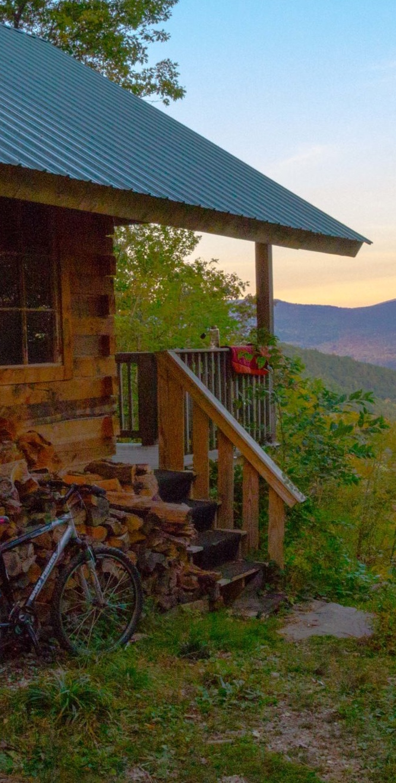
CASE STUDY:
Velomont Huts
Developing Hut Infrastructure in Vermont
Project Summary
45+ new hut structures along trail to create the largest hut to hut network in the United States
485 miles of new, improved, and/or connected mountain biking trails, connecting Massachusetts to Canada
330+ young adults trained during hut construction
Potential to conserve up to 214,000 acres of land related to project corridor
Key Details
Secured ~ $7M from Congressionally Designated Spending (Leahy)
Secured $200K in PRI financing alongside $200K in grant funding to construct huts
Launched capital campaign among partners
Trail intentionally routes through 27 rural communities creating connectivity and local access
Connects 23 different mountain biking chapters
Notes:
Quantitative Outcomes to Drive Storytelling –For this project we quantified the economic, social, and environmental impact of the 400+ mile trail trail system, supported by ~45 huts, enabling conservation outcomes, workforce development opportunities, greater connectivity, and more
Strength in Formalized, Clear Partnerships -

Slide 24
Once completed, this project’s impact is far greater than the assets we’re building
Sustainable Tourism
Service
Economic Development
485 miles of contiguous trail
30 new hut facilities along trail corridor
65,000 annual visitors to the trail system (estimated)
26,000 visitor nights in huts
330 young adults trained through huts construction program
$1.1MM in estimated wages earned
2,340 weeks of employment
$31MM in total new spending
$11MM in increased earnings
$2MM in state taxes
112 new jobs
Health
Conservation
Connectivity
Trail provides healthy activities for both local and out of state users
Huts create new points of access for families, beginners, and experts alike
Up to 84,000 acres of private and public land conserved by project
Alignment with, protection of, and sustainable use of a climate resilience corridor
Hut to hut trail system connects 12 counties, 27 communities, and 23 trail organizations
*Cumulative economic impacts and visitation at Year 15

Slide 25
Strategic partnerships and appropriate governance unlock capital and drive transformative value to Vermont
Joint Venture between Vermont Huts Association and Velomont Trail Collective ​
For joint planning, shared project cabinet and staffing, and long-term operations maintenance​
​ Formal partnership between Vermont Huts Association and Vermont Youth Conservation Corps
For construction of all huts by young adult professional crews​
​
Formalized Strong Partnerships with other key players including state and federal partners to address diverse impacts of project .
Economic Development
Conservation
Sustainable Tourism
Holistic Value
Health
Connectivity
Service
Notes:
Created a Joint Venture between two key partners: Vermont Huts Association and Velomont Trail Collective, enabling key fundraising strategies
Formalized partnership structures with other key partners, such as the Vermont Huts association and vermont youth conservation corps to support hut construction by young adult professional crews.

Slide 26
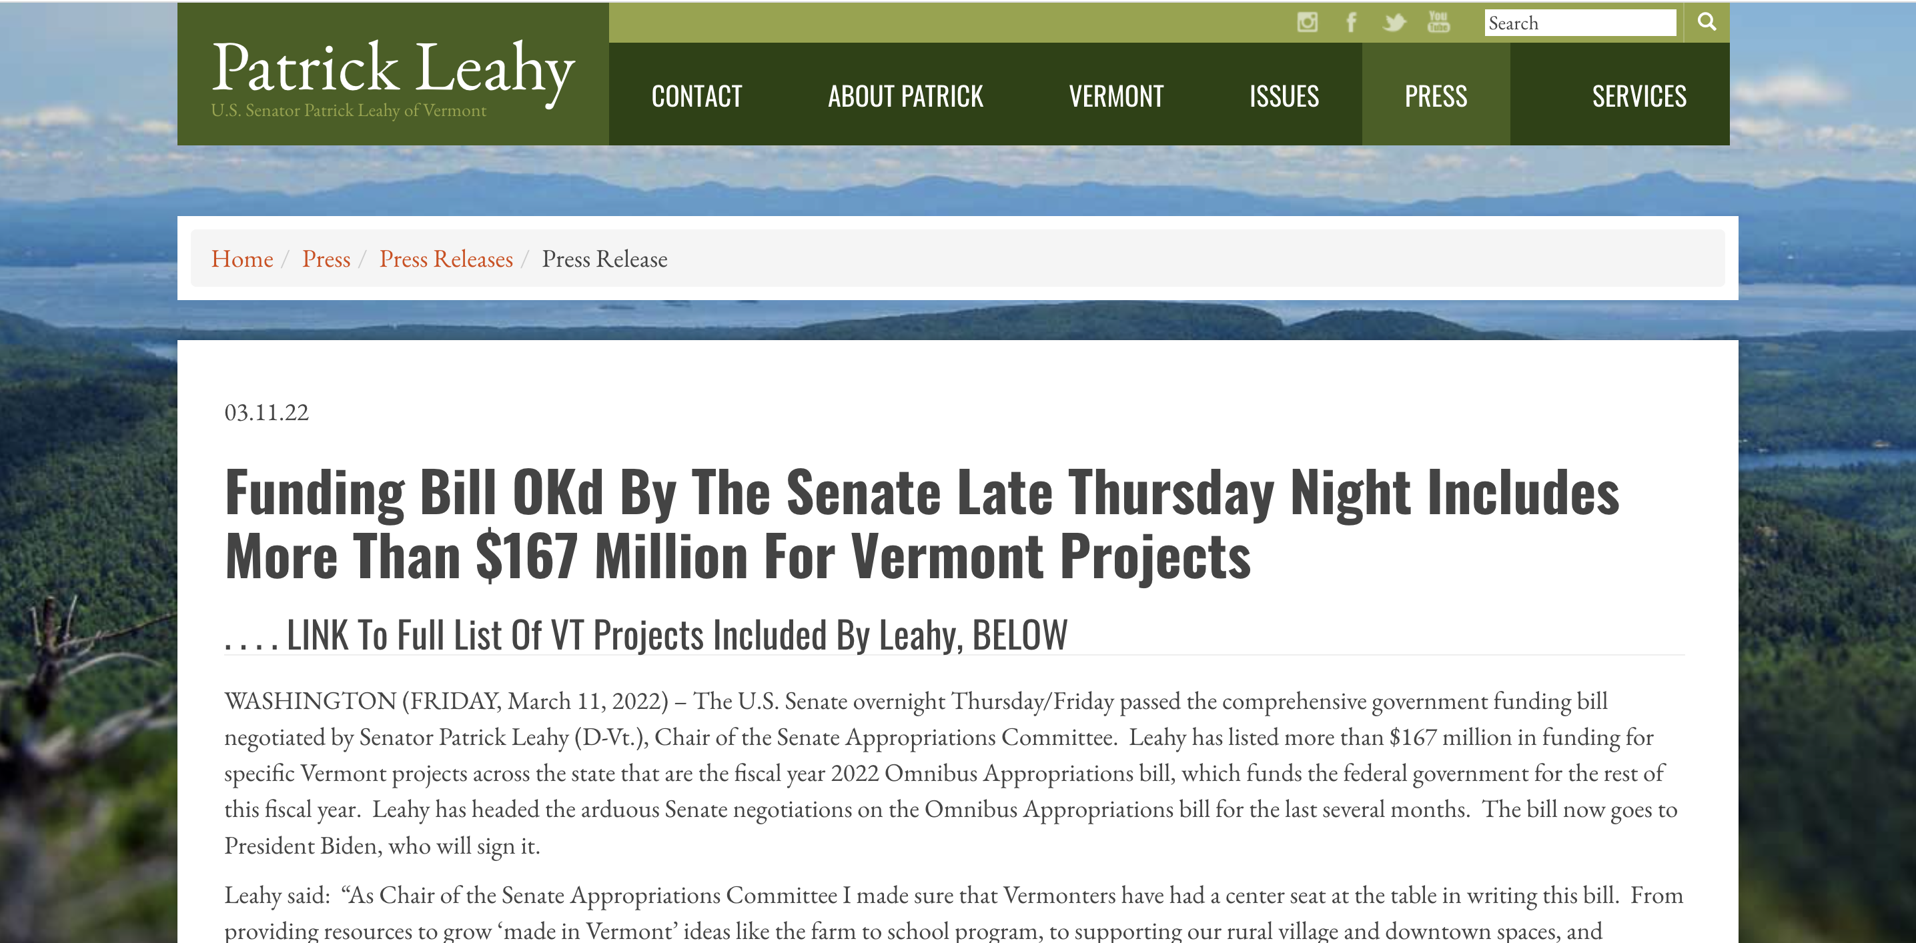
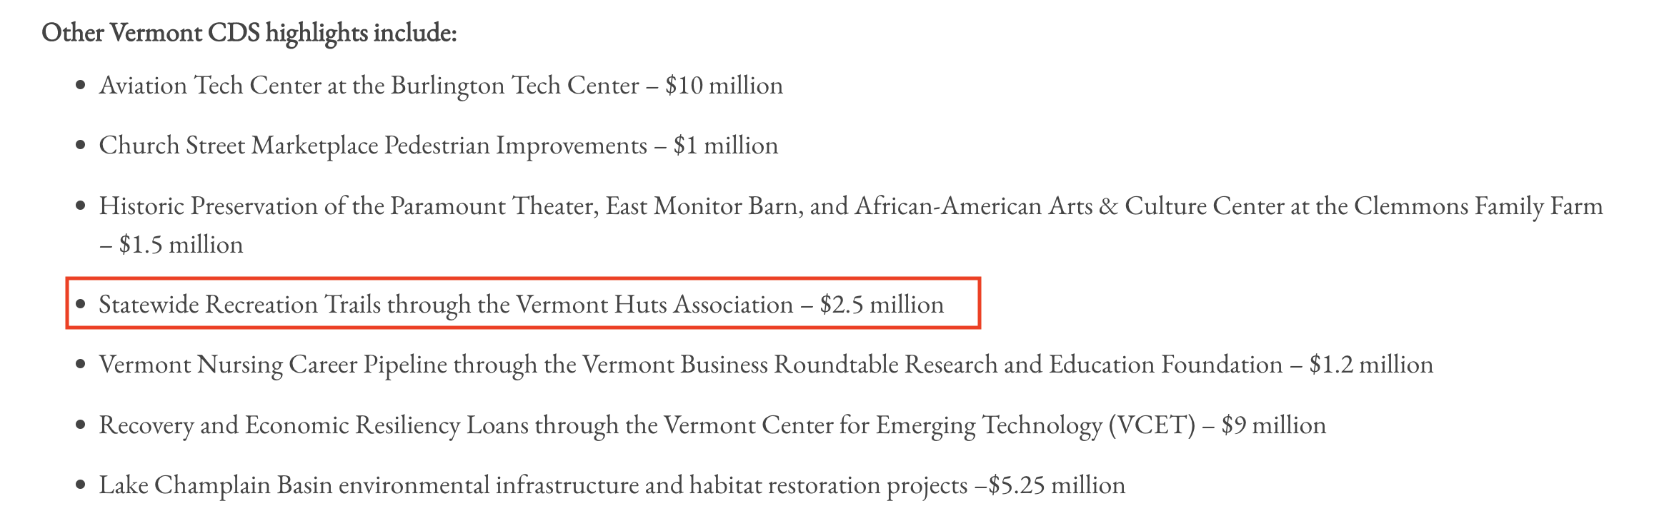
Over $6M in Congressionally Directed Spending funding is a HUGE win!
First award of $2.5M in funding for trails, staffing, and project management over three years, second for $4M
Leverages partnership with Forest Service to enable large funding/project development
Validates joint venture model by enabling small project with big vision
Codifies federal support through USFS
High profile recognition of project’s impact, opens door for another round
$200K in PRI financing alongside $200K in grant funding to construct huts
Notes:
There were some very big funding and financing wins for this project.
Created different plans for funding and financing strategies
Secured ~ $6.5M from Congressionally Designated Spending (Leahy), the first awarded noted above. A second award for nearly 4 million was received, and they're building hostels with these funds
Secured $200K in PRI financing alongside $200K in grant funding to construct huts
Launched capital campaign among partners.
We continue to consult and they are re-evaluting their partnership structures as they look to expand their current funding opportunities.

Slide 27
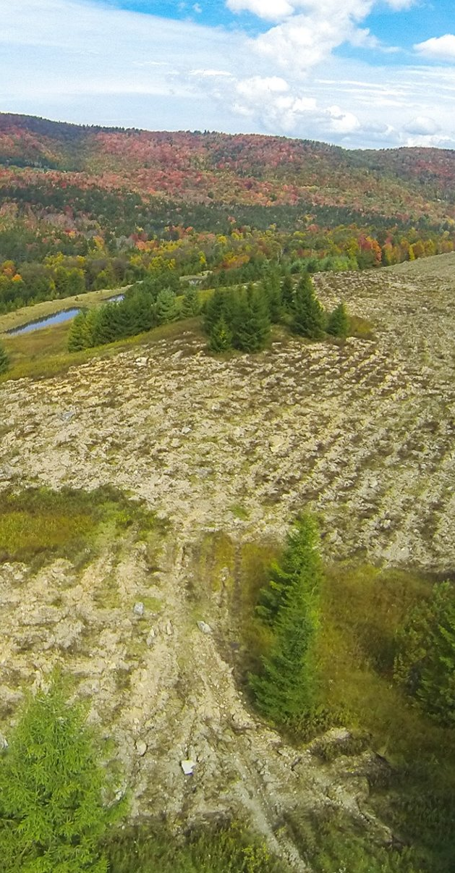
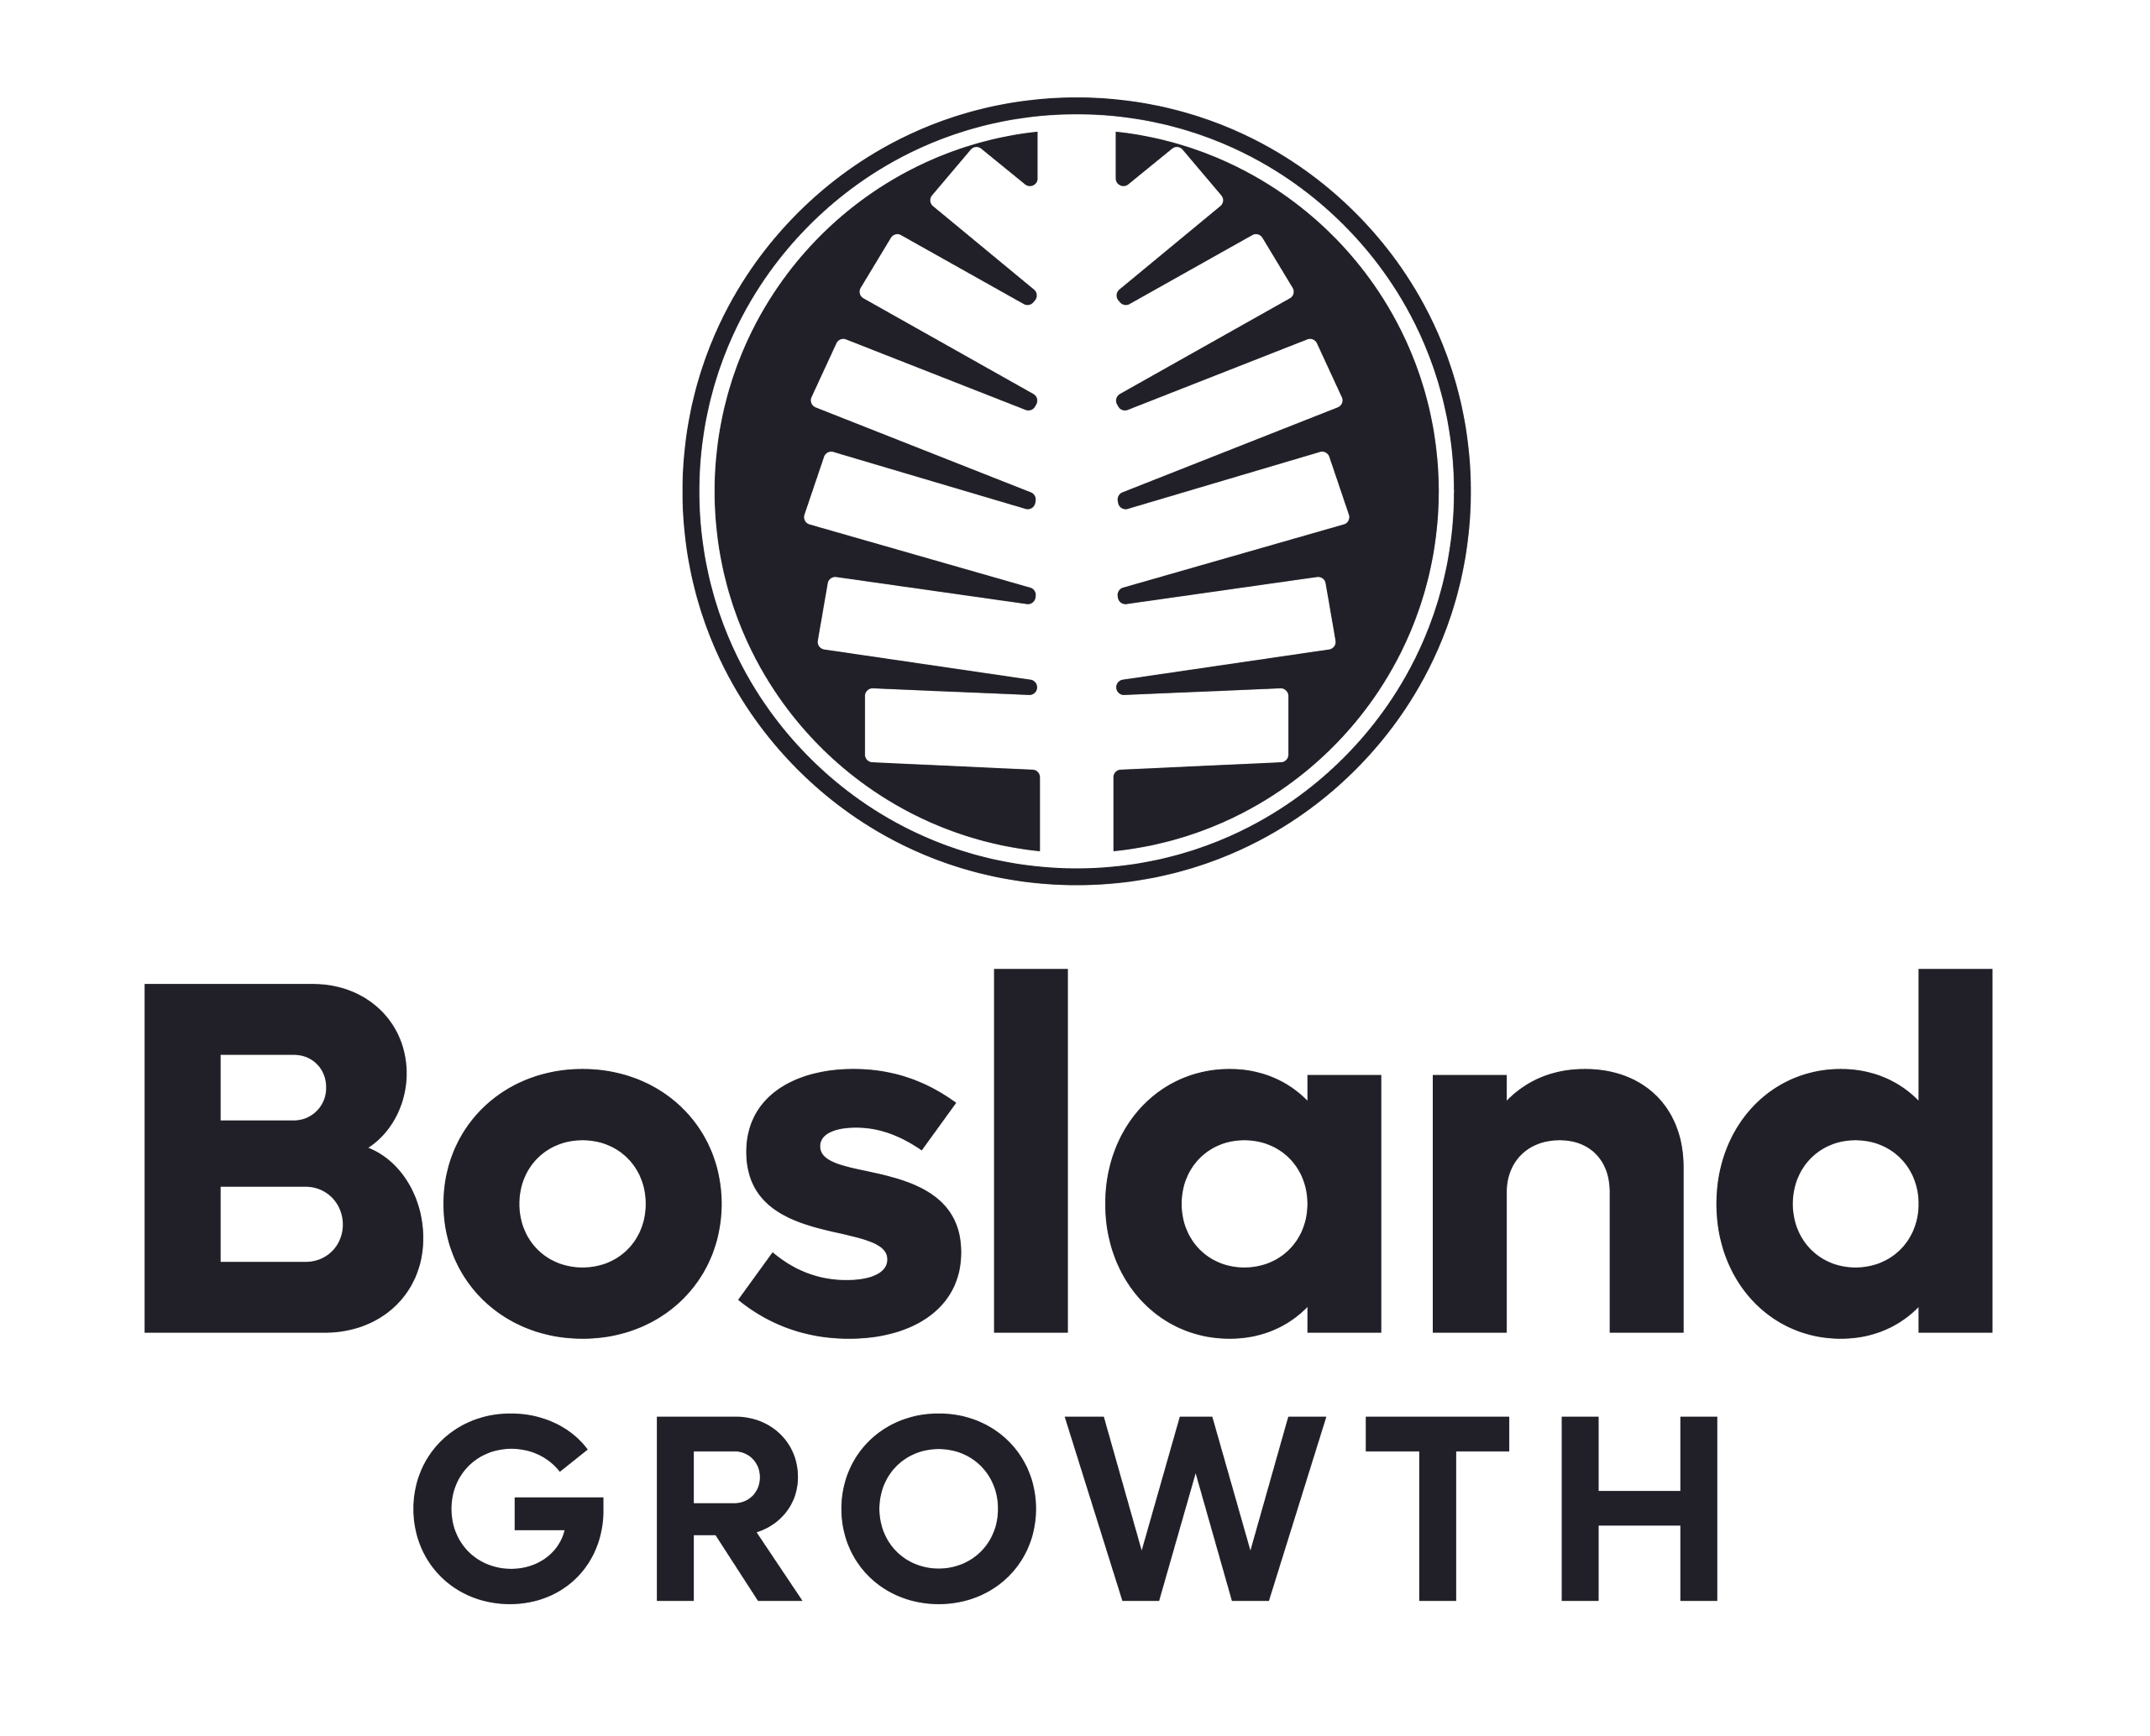
CASE STUDY:
Bosland Growth
Establishing a carbon-based reforestation program in Appalachia
Project Goals
Former mine lands that have met federal reclamation requirements lack full ecological restoration to meet forested condition pre-mining
Reforestation produces significant carbon sequestration benefit overtime, creates key habitat for migratory bird species in need of early successional forest habitat, and reduces sediment runoff of formerly mined areas
Leverage private finance as a new funding stream for expanding and accelerating reforestation using carbon offset sales as a repayment stream
Current Status
Secured RCPP AFA funding to develop a 1,130 acre pilot project in northern Appalachia (PA, OH, WV)
Secured additional NFWF funding to support bird benefits
Launched subsidiary of QV (Bosland Growth) to house reforestation activities:
Working with carbon developer/broker to secure buyer
develop specific carbon buyers
Working to secure landowners across Appalachia

Slide 28
Recreation Funding & Governance in Canada
Funding & Financing Examples
Saskatchewan Dedicated Lands Account from in lieu fees and sale, lease, or sublease of dedicated lands
In British Columbia: $10-million Outdoor Recreation Fund of BC, managed by the Outdoor Recreation Council of BC. Purpose: Boost volunteer stewardship projects (2023)
Governance, Advocacy, Planning
Governance: Local Government Committee (LGC) - A municipality must apply for approval from the LGC before they start the local improvement project (including parks and recreation facilities)
Intergovernmental Coordination: First Nation and Métis Consultation Policy Framework, ensuring governments meet their duty to consult and engage First Nations and commit to building positive relationships, honoring Aboriginal and Treaty rights, and supporting economic reconciliation while planning for growth across the Saskatchewan resource sector
Planning: Saskatchewan Community Planning maps, highlight Community Planning Branch regions, municipalities with community plans, zoning bylaws and subdivision approvals.
Planning: Forest Landscape Planning (FLP) - Forest companies holding certain types of licenses must develop long-term plans explaining how they will manage the forest resources on their areas in Saskatchewan
Planning: Ecosystem-based Management Plans, guide management of Saskatchewan park ecosystems to ensure ecological integrity while improving the aesthetic and the opportunities for recreation and education in a safe outdoor environment
Notes:
You have some great funding and planning in place already. We've also been hearing about some more work going on in provinces close by, British Columbia, related to outdoor gear manufacturing design related. Recognition to the growing trend and interest in outdoor recreation. We're seeing more funding in parks and trails in the last few years.
Other Planning Examples: In British Columbia, Recreation Sites and Trails is developing policy and pilot projects for mountain biking, and a risk rating system. A second pilot, based on feedback, will run until summer 2024. Sources: https://www.orcbc.ca/blog/the-great-and-future-potential; Shuswap Trails Roundtable, 2022

Slide 29
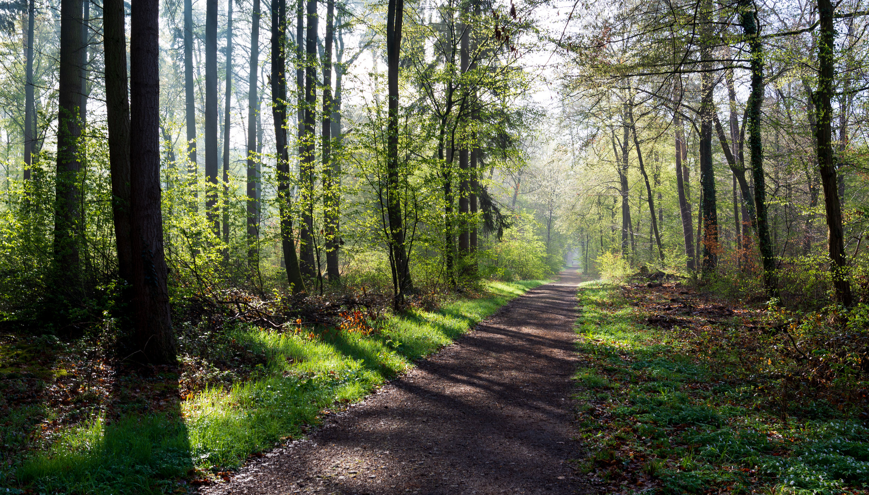

Discussion & Questions
29

Slide 30
Questions? Ideas? Reach out to discuss your projects and needs:
Risa Hiser
Senior Associate
rhiser@quantifiedventures.com
30

Slide 31
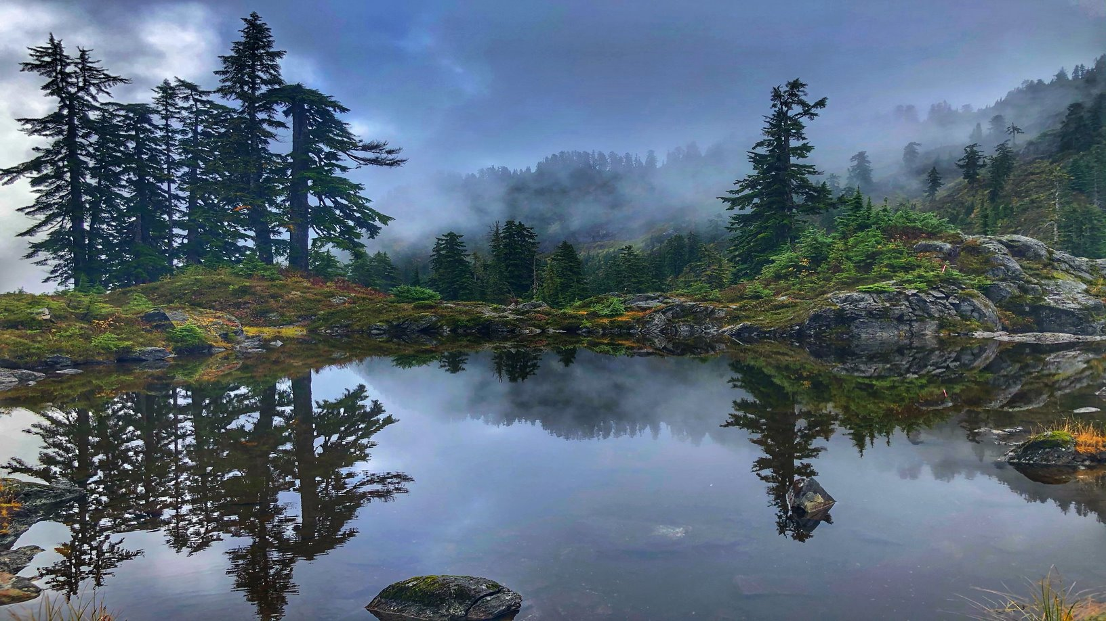
Appendix
1. Environmental Impact Bonds
2. Health: Medical Respite Case Study

Slide 32
Appendix
1. Environmental Impact Bonds
2. Health: Medical Respite Case Study

Slide 33
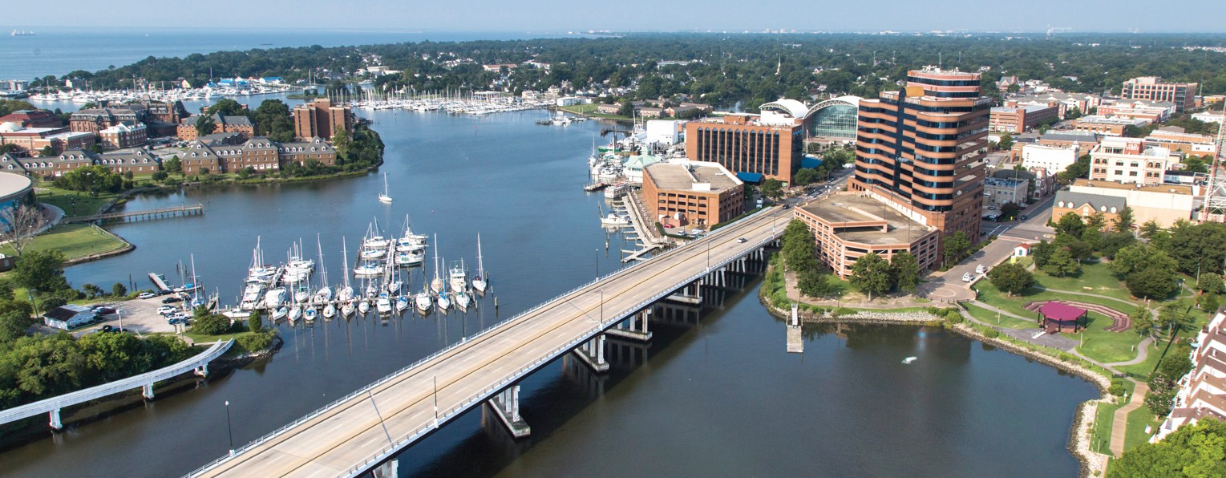
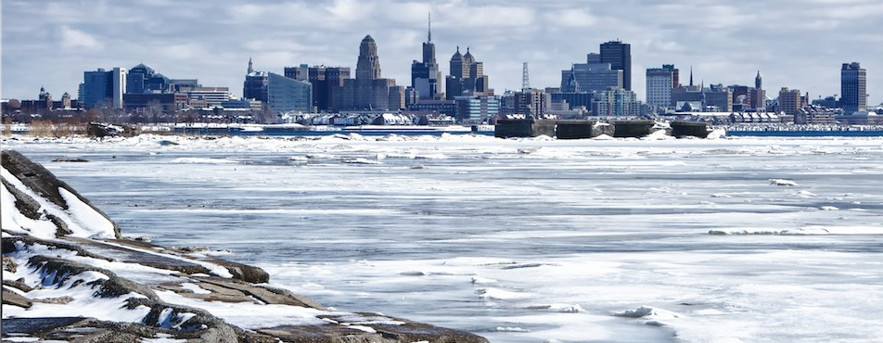
Environmental Impact Bond Structures Are Highly Customizable Based on Local Context, Priorities, and Needs
WASHINGTON, DC
ATLANTA, GA
HAMPTON, VA
BUFFALO, NY
Primary Value Proposition of EIB | What is the cost-effectiveness of green vs. grey infrastructure for CSO reduction? | How can green infrastructure improve local flooding, water quality, and economic conditions? | How can outcomes disclosure and reporting signal climate preparedness to investors? | Can an outcomes-based positive incentive help Buffalo over-achieve on its CSO goals?
Size | $25 million | $14 million | $12 million | $54 million
Term | 30 years (5 year mandatory tender) | 10 years | 20 years | 30 years
Placement | Private | Limited Public | Public | Public
Outcome Metric | Volume capture (flow / runoff) | Volume capture (capacity / storage) | Volume capture (capacity / storage) | Impervious surface area managed
Regulatory Driver? | Yes | No | No | Yes
Outcomes-Based Financing Structure | 3-tiered performance payment structure (Low, Base, High) | 2-tiered performance payment structure (Base, High) | Outcomes evaluation, reporting, and disclosure only | Outcomes-based early call option, coinciding with step-up in coupon rate
33

Slide 34





NSO is launching a best-in-class medical respite program, sitting in the DHHC campus for individuals experiencing homelessness in Detroit.
Program Model
Housing Support
Hospital/ER
Medical Respite
Permanent supportive housing
Temporary housing, other social services
Respite services include:
Clinical care
Case management
Room and board
Peer support
Evidence-based Best Practices
Low-barrier acceptance for program
Wrap- around services on site
Connection to supportive housing
Number of beds in facility | 17
Average length of stay (days) | 30
Capacity/utilization | 80%
Members served (per year) | 165
2
Notes:
Construction funded through DHHC capital campaign, how do we create a financing plan to launch and sustain the medical respite program?

Slide 35



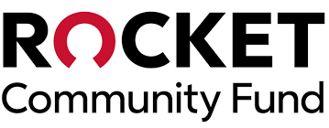


We are leveraging outcomes-based financing to launch and sustain the medical respite program
How it works
1
Philanthropic and impact investors fund the upfront and annual operating costs of the medical respite program.
2
NSO delivers the medical respite program, treating 164 individuals annually. Receives a discounted per diem payment.
1
Fund medical respite program
3
Housing placement and decrease in inpatient and ED costs are measured and repaid by payors when outcomes are achieved.
Philanthropic/ Impact Investment
2
Deliver program for contracted health plan members
4
Impact investors get repaid based on the revenues from value-based contracts.
Payment Type | Rate
Daily Rate | $100 per day
Housing Placement | $4,875 per placement
ED/Admissions Outcomes | Maximum of $1,876 per participant
3
Payor partners pay and debt payments made based on achievement of outcomes
3
Notes:
Notes:

Slide 36

We are closing in on securing $425k to cover initial medical respite operating costs
Capital Need
Proposed Capital Stack
Helps to cover operating costs while starting up
Gives cushion for debt payments in first couple of years
Grant
Grant
$175 k
$150k grant agreement executed in December 2022 with Rocket Community Fund
$25k from CVS Health/Aetna
+
Debt/PRI
Final contracting stages with Kresge Foundation
Annual Rate: 1%
Non-revolving, 24-month credit facility open upon execution of outcomes payor contract
Starting in month 25, $10,000/month payment
Balance due at the end of the term, with option to extend
Non-recourse – positive cash flow from medical respite is the only source of repayment
$250 k
Debt / PRI
5

