Slide 1

Is Your Community Ready for Next?
Cindy Reid - Shelton

Slide 2
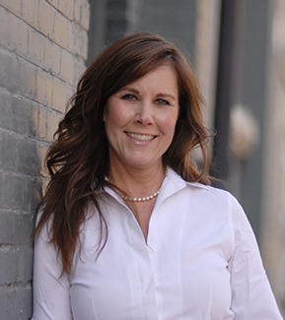
Cindy Reid-Shelton
Partner, Ready for Next Global
CFP, CHFC, CLU, TEP, CEPA, CBA

Slide 3
When Will the Boomers Bail?
Expectations around business exits should be reset
5–10 years
0–5 years
72% of business owners surveyed plan to exit by 2028
47% of owners plan to exit by 2023
More than 10 years or never
Source:
2018 Canadian Federation of Independent Business (CFIB) report, Getting the Transition Right
Notes:
By most accounts, Boomers are increasingly ready to exit their businesses
A 2018 Canadian Federation of Independent Business (CFIB) report, Getting the Transition Right, found that 72% of business owners plan to exit by 2028 with 47% of those owners intending to transition by 2023. It also found that four out of five (81%) cited retirement as their reason for exiting. Extrapolated from the total number of small and medium sized businesses in Canada, roughly 458,000 boomer owners are trying to figure out what to do with their businesses before 2023 and a total of 701,000 are by 2028. The number of businesses owned by baby boomers has a multiplier effect – a baby boomer may own multiple businesses and a business may have multiple baby boomer partners.
Unfortunately, many business owners will end up exiting later than expected because they underestimate the planning that is required for a successful sale.
Over half of business owners have never had their business appraised and nearly half haven’t put a formal exit strategy in place.

Slide 4

Boomer owned businesses drive local economies
40%
At least 40% of a community’s economy
Notes:
Cindy - Pg 3 of CDN white paper
Cities across the country are faced with an unprecedented challenge: navigating through turbulent economic times while facing persistent effects from the COVID-19 crisis. Traditionally, Canadian cities have looked to attract global investment to create the jobs and capital investment necessary to grow their economies. Like many developed countries, Canada has relied heavily on external funding sources for support. Yet, amid the pandemic, many multinational firms are reassessing trade, real estate and general business investments making the need to resuscitate Canadian cities and businesses from within critical.
A recent United Nations Conference on Trade and Development (UNCTAD) report cited that global foreign direct investment (FDI) flows fell 49 percent in the first half of 2020 compared to 2019 due to the economic fallout from COVID-19.
For many Canadian communities, the worst of the FDI fall out is yet to come.
The pandemic has made it even more challenging and important for cities to protect their economic base while providing economic growth opportunities for the people living and working in their communities.
The International Economic Development Council (IEDC) suggests the retention and expansion of businesses generate 80 percent of a community’s economic activity.
By any measure, boomer owned businesses drive local economies, representing at least 40 percent of a city’s economy, if not more.
Some reports suggest these uncertain economic times may impact multiple generations. However, one generation — baby boomers — may offer a solution, a possible silver lining, if they can successfully and smoothly transition ownership of their businesses, ensuring community stability, continued business growth and the protection of long-standing legacies.

Slide 5
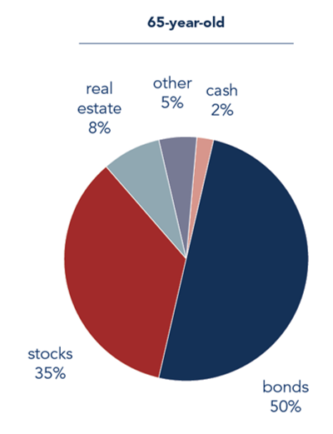
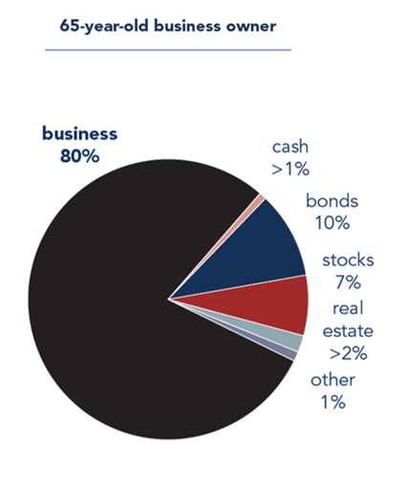
Notes:
Composite showing example of average 65-year-old holdings vs a 65-year-old business owner.

Slide 6
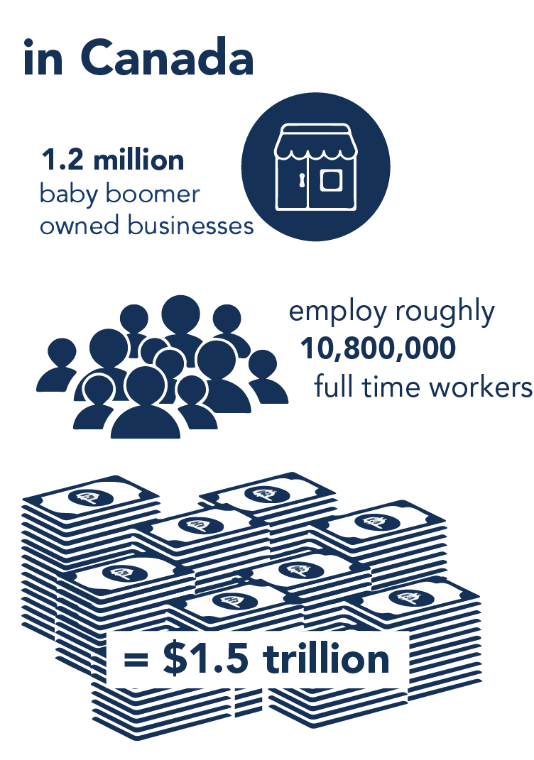
There are approximately 1.2 million baby boomer owned/operated businesses in Canada, employing an estimated 10.8 million full-time workers.
The total enterprise value of these businesses is approximately $1.5 trillion.
Notes:
Cindy
As point of reference, the enterprise value of baby boomer owned businesses is five times greater than the enterprise value of Amazon, Apple and Google combined.

Slide 7
Owners are completely unprepared for transition.
Only 3 out of 10 owners have a transition plan
40% do not have a contingency plan if they die or are permanently disabled
Between 70-80% of private business will fail to transfer
88% of family businesses fail to make it to the third generation
66% of owners are unfamiliar with the complete suite of transition options
78% have no formal transition team
93% do not have a life-after-business plan
Notes:
SPEND LOTS OF TIME

Slide 8

According to StatsCan
2/3
of Canada’s labour force are employed by small businesses
Notes:
Cindy
January 2022
Small- and medium-sized businesses are significant contributors to the Canadian economy. For context, small businesses made up 98.1% of all employer businesses in Canada in 2021.
Small businesses employed 9.7 million individuals in Canada – about two-thirds of the total labour force, in 2020.
By comparison, medium-sized businesses employed 3.2 million individuals (21.2% of the labour force) and large businesses employed 2.3 million individuals (14.8% of the labour force).

Slide 9
Your Community and Business Retention
2 Challenges
2 Solutions

Slide 10
Check-in with your community
Understand your level of risk
Survey owners about transition timelines
Create a specific network and awareness program
Uncover and offer transition pathways
Enhance BRE efforts to include retention through transition
Notes:
Sean

Slide 11
RFN Communities Solutions
Foundations Premium
1000 business owners
Foundations Lite
200 business owners
Business Owner Toolkit
Up to 500 business owners
Unlimited assessments
Unlimited assessments
2-year license
Unlimited assessments
1-year license
1-year license
4 half-day business owner workshops
Compiled owner data
Notes:
Foundation Premium
- $75,000 price tag
- provide compiled data about engagement and results on a quarterly basis
- unlimited assessments
- access to microlearnigs complete with resources and tools to put to immediate use
- 4 half-day in-person workshops for engaged owners – 4 x 50 aka 200 owners
- access to portal for 2 years for ongoing learning
- compiled owner data at end of project with insight from your region, external data and recommendations
Foundations Lite
- 200 business owners
- unlimited assessments
- access to microlearnigs complete with resources and tools to put to immediate use
- access to portal for 1 year for ongoing learning
- provide compiled data about engagement and results at end of year
Business Owner Toolkit
- up to 500 business owners\
- unlimited assessments
- access to portal for 1 year for ongoing learning
- provide compiled data about engagement and results at end of year

Slide 12

Business Owner Toolkit
Help your owners build transferable value and prepare for their eventual transition.
Summary of business data from your community or municipality.
Notes:
More about the Business Owner toolkit
- allows up to 500 business owners access to unlimited assessments – Spotlight, Owner dependence, transition readiness, etc
- access a library of microlearnings to build value and prepare for eventual transition complete with resources and tools to put to immediate use
- self-paced education from a wide variety of professionals on a wide variety of topics to help owners build value in their business and prepare for an eventual exit
- summary of data about businesses who participated from your region

Slide 13
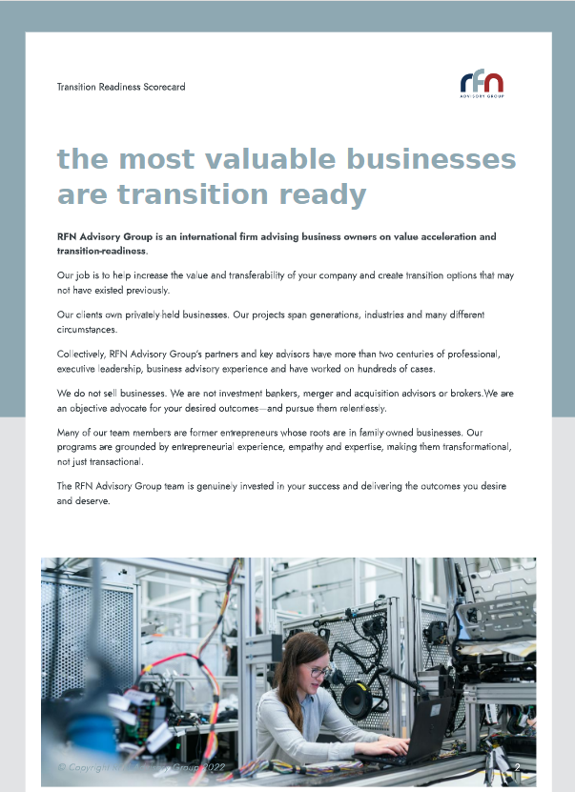
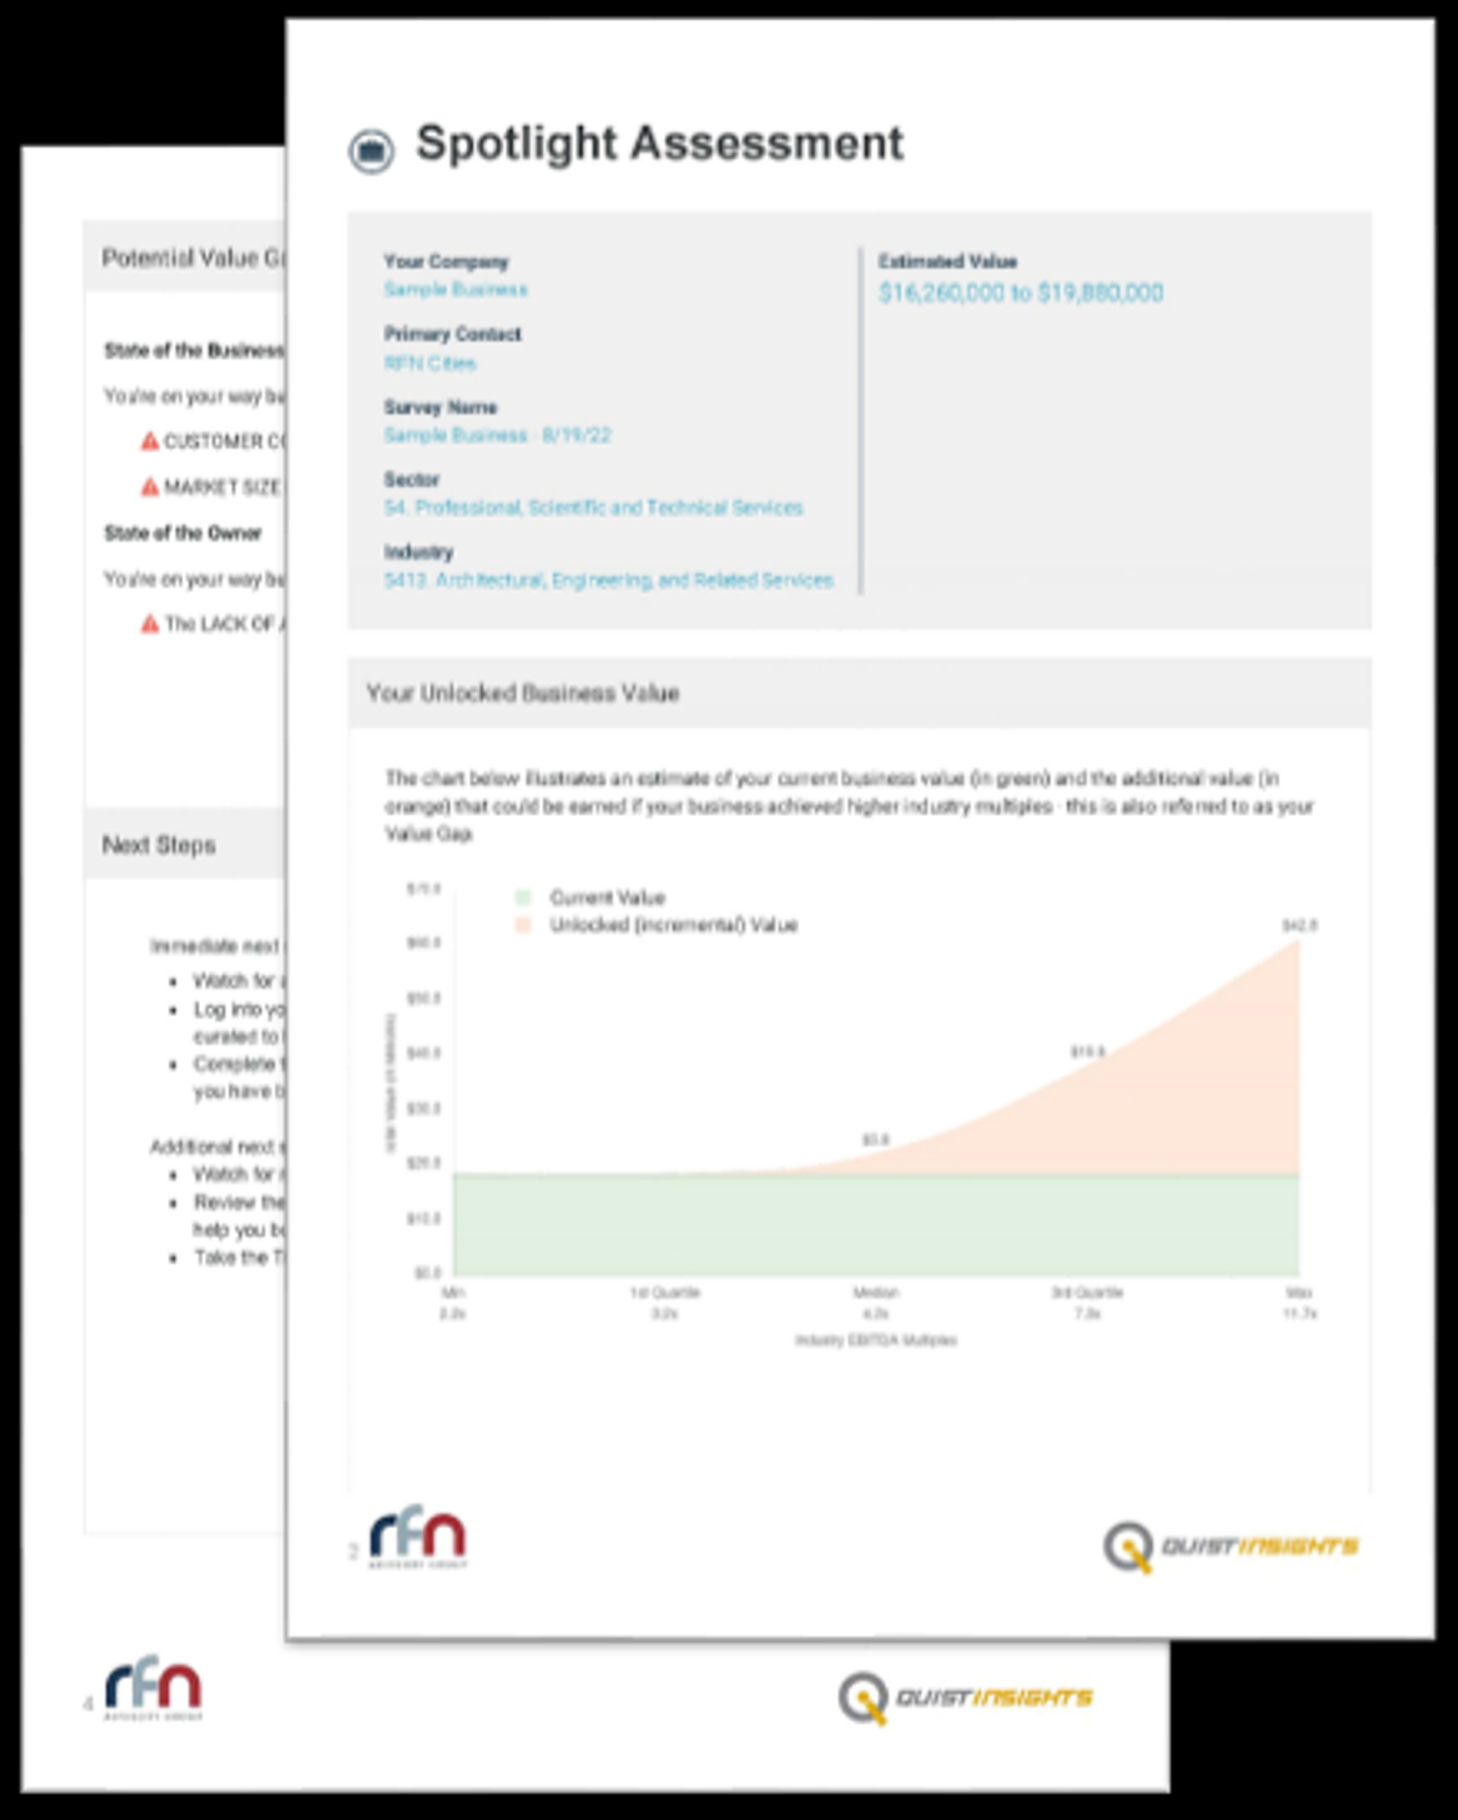
How Owners Benefit
Limited valuation for their business, highlighting value opportunities
Education on topics to support business growth
Tools and resources to implement immediately

Slide 14
Percentage of SK Businesses with Owners Over 65
*
* Estimate based on available data.

Slide 15
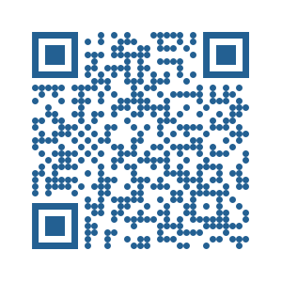

Business Disruption Risk
Rate your community’s business disruption risk with a few different figures.
©2023 RFN Communities LLC. All rights reserved. Not to be used without permission.

Slide 16
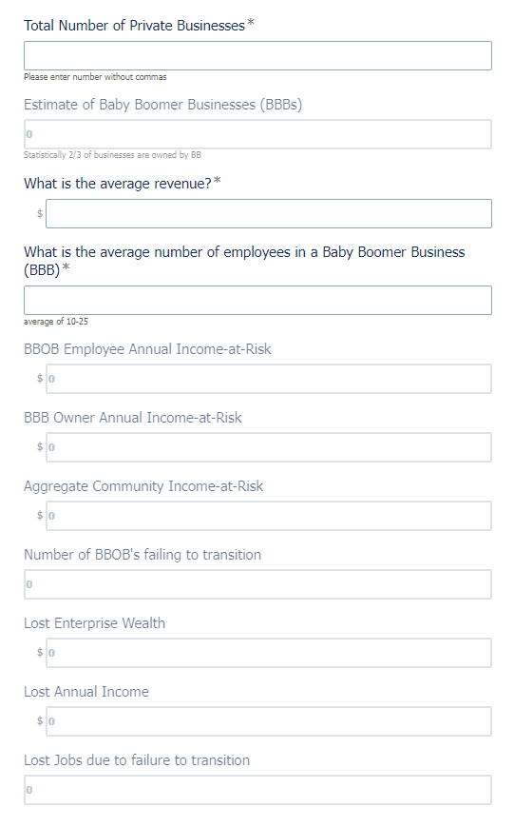

Sample of BDR
Notes:
Enter a handful of numbers
Understand owner and employee income at risk
If a statical number of those businesses fail to transition see lost wealth and income
Jobs on the line

Slide 17

Canadian White Paper
Uncovering the Giant Economic Risk that Could Cost Canadian Cities Trillions.

Slide 18
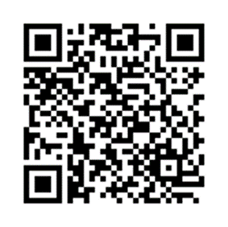

Next Steps
©2023 RFN Communities LLC. All rights reserved. Not to be used without permission.
Notes:
Cindy
QR code = an online appointment contact form
You saw what’s coming in the US – you can jump the queue by engaging us
Optimal number is 10 communities per year in each country

Slide 19
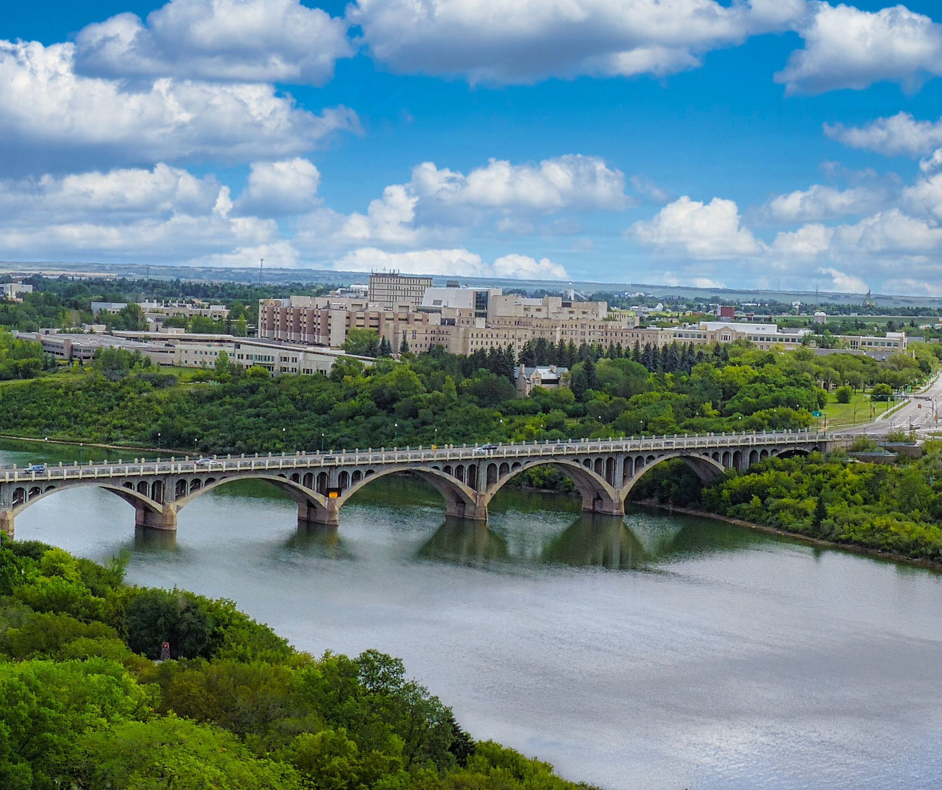

GET IN TOUCH
Send us a message or call to schedule an impact assessment.
Visit ReadyForNextCities.com to take the pledge.
Cities@ReadyForNext.com

