Slide 1


Creating a “Virtual” Settlement Office in Rural and Remote Communities
Lindsay Rubeniuk
Regulated Canadian Immigration Consultant (RCIC)
Economic Developer of Canada (EC Dev.)
Career Professionals of Canada (CPC)

Slide 2

Who is your person or persons?
Who are the people being hired locally from other communities? Provinces? Internationally?
What is their profile makeup?
What are their interests?
What are their languages they speak?
Having a visual of who you are creating the virtual settlement office for will assist you to develop your web-page quicker. As your community grows so will your settlement office information!

Slide 3

Yolanda arrives in your community! Now what??
Where are your resources for Yolanda to access?
How does she know to access them?
How do they find out about childcare?
How do they find about housing?
How do they find about employment for her partner?
How do they find out what schools are available and how to enrol her child?
How does she community activities?
How is the community going to engage this new family?

Slide 4
100th Meridian Immigration & Development
A boutique immigration & community development agency founded right here in the Parkland region of Manitoba;
25 years of experience in community development & several years of practice in immigration;
Created out of a desire to increase the skilled workforce that employers need in our communities, and build community capacity;
Practice Immigration to the Prairie Provinces of Canada.

Slide 5

What is immigration? What is recruitment? What is settlement?
Immigration law is the practice of people moving from one country to another through certain programs that they qualify for. There is temporary and permanent immigration. I need a licence to practice this if working for business or community. The employer themselves can do this if trained/understands process.
Recruitment is the practice of an employer, a recruitment agency or an individual looking for employees oversees. You need a licence to do this or the employer themselves can do this.
Settlement is the practice of working with newcomers and people in Canada who need services such as to improve their language, networking, banking, housing etc. Government organized.

Slide 6
What are Settlement Services?
Settlement services support immigrants and refugees to Canada. They can help settle and adjust to their new life in Canada by offering these services:
look for a job (family members too!)
get a language assessment
register for language classes
find a place to live
sign up your kids for school
learn about community services
Connect with community members

Slide 7
Number of IRCC – Funded Settlement Service Locations
Number of permanent service locations
Alberta: 209
Saskatchewan: 110
Manitoba: 183
Total number of service locations
Alberta: 521
Saskatchewan: 151
Manitoba: 288
Settlement Services landscape in Canada is varied & complex.
Notes:
If I was to ask you, you are willing to miss out on a family coming to your town, because you did not have an office brimming with resources would you say yes? I would venture a guess that you would say “no”.
But trust me I have heard this said by municipal staff and EDOs have said this. Yes it is not fair in practicality not for every office to have this

Slide 8
Various types of services offered for settlement by Canada.
Pre-Arrival Services (discover the services below & prepare to arrive to Canada)
Needs Assessment & Referral Services (NARS)
Resettlement Assistance Program (RAP)
Information & Orientation Services
Employment Related Services
Language Assessments & Training
Health
Housing
Community Connections
Local Immigration Partnerships
Community Partnerships
Anatomy of Settlement Services in Canada is a great resource to understand all the services provided in Canada.
Notes:
If I was to ask you, you are willing to miss out on a family coming to your town, because you did not have an office brimming with resources would you say yes? I would venture a guess that you would say “no”.
But trust me I have heard this said by municipal staff and EDOs have said this. Yes it is not fair in practicality not for every office to have this

Slide 9
Why you need to create your own settlement office or resources even if it is not government funded!
These services are extremely important for the role they play in supporting immigrants.
Vital resource that support immigrant resilience in overcoming hardships and barriers.
Businesses in your community have done a lot to get the foreign worker, having the community supports is essential.

Slide 10
If we do not have a settlement office what information should be the minimum, we provide?

Slide 11
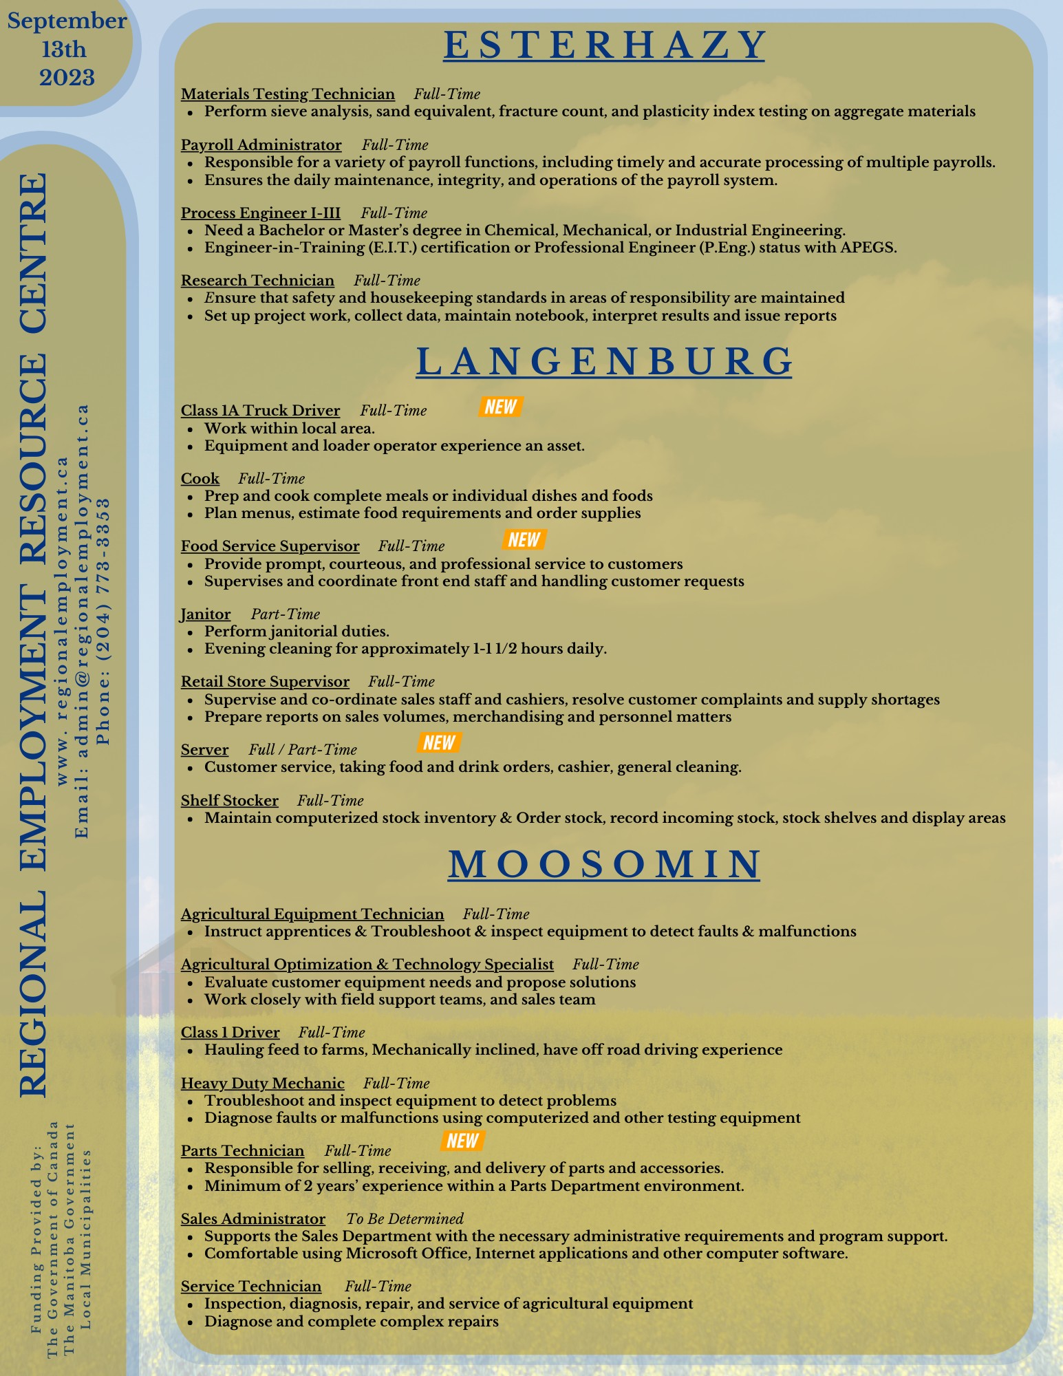
Essential Settlement Services
Employment
How can you attract anyone if you do not have a pulse on the jobs in your community!
It’s essential that when people are looking at immigrating, they are not just “aware” of your community but there is opportunity for employment, and a variety of employment at that.

Slide 12
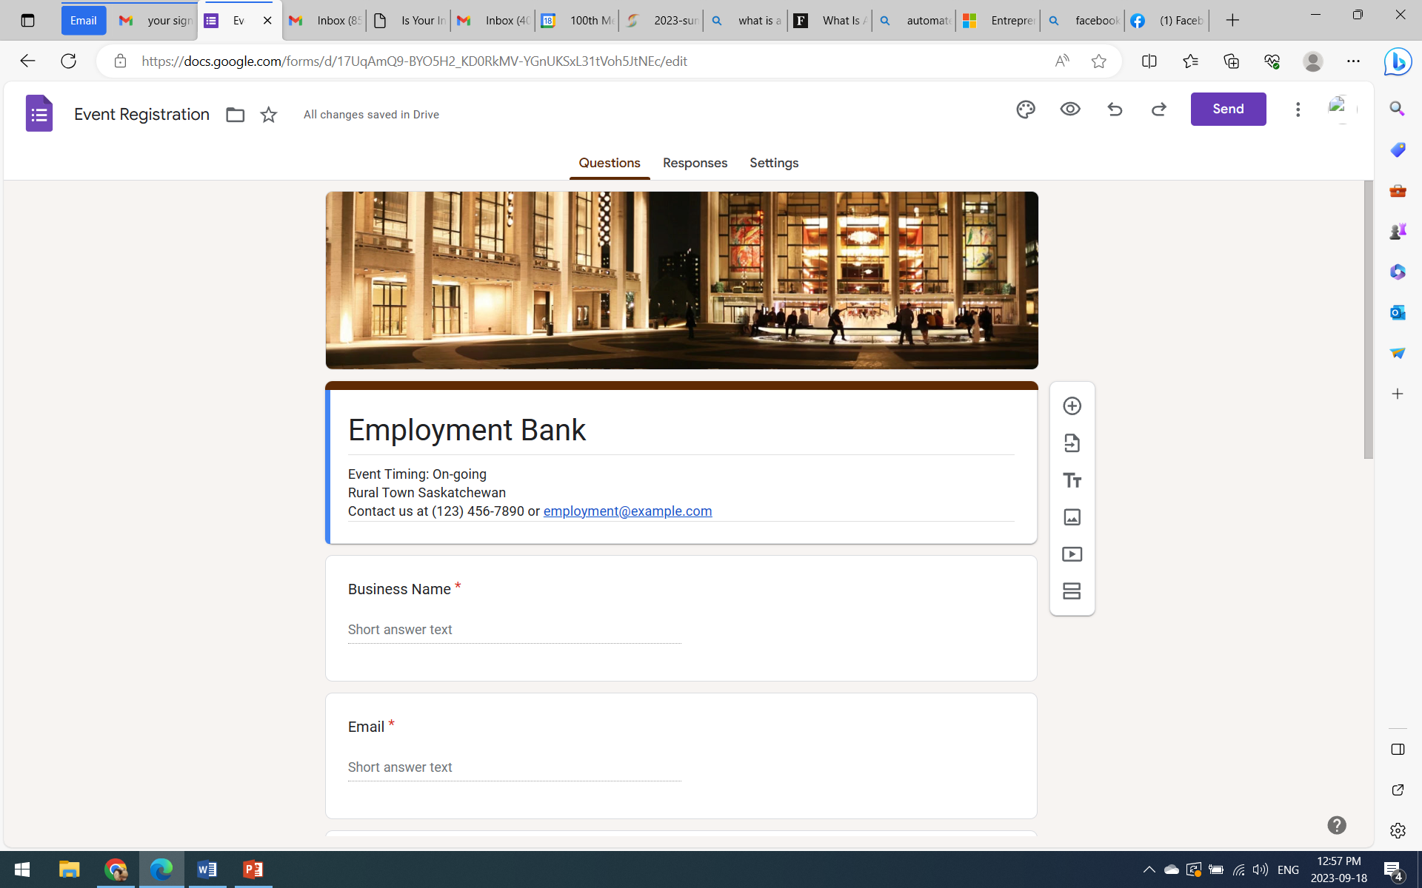
Essential Settlement Services
Employment
Organizing and making the upkeep to your database is essential. If you have something like “Forms” from google.

Slide 13
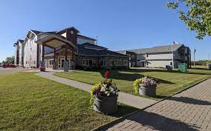
Essential Settlement Services
Housing
Without affordable housing, newcomers will go elsewhere, our labour shortage will continue and will struggle to sustain economic growth.
Connect with your local contractors, developers and building supplies stores to see if a multi-unit can be built.
When you see TFW come in, they will becoming
Jobs & housing…. that is the very minimum….

Slide 14
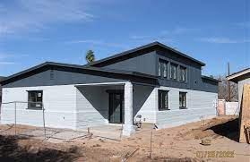
Lemnington, Ontario – 3D Housing
The four-plex, located on the property of the Bridge Youth Resource Centre that will give the organization the ability to provide attainable housing for singles and couples.

Slide 15
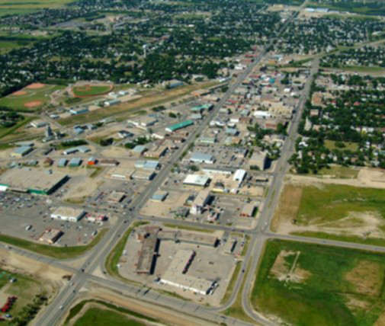
Essential Settlement Services:
Language
It is important to have this service available to assist newcomers in the community.
Yes, the principle applicant arriving through the economic pathway may have passed the CLB requirements but could use improvement.
Dependents may not speak any English at all, and having this resource available could create additional workers in your community.
https://www.noslangues-ourlanguages.gc.ca/en
Have someone volunteer to teach.

Slide 16
Other important information for your community to be able to provide detailed information for:
Child Care
Health Care
Recreation Services
Connectivity (internet/cell)
Transportation
Municipal Services/Community Events
Banks/Accountants
Legal
Realitors
Other essential Information newcomers require the moment they arrive to their community!
Knowledge is power and makes people feel welcome.
Think of it like going to a Air BnB!

Slide 17
Recreation Be sure you put the following information on your website: Description of Sport Video Link Registration Date/Time Contact for more information Equipment that will be needed Costs for Registration & equipment If they are interested in trying community sports, is there a volunteer “Rec Buddy” who is passionate about that sport you can pair them up with?

Slide 18
Federal Government of Canada Work Permit Link Study Permit Visitor Visa Link Passport Links Social Insurance Number Links Provincial Government Health Cards

Slide 19
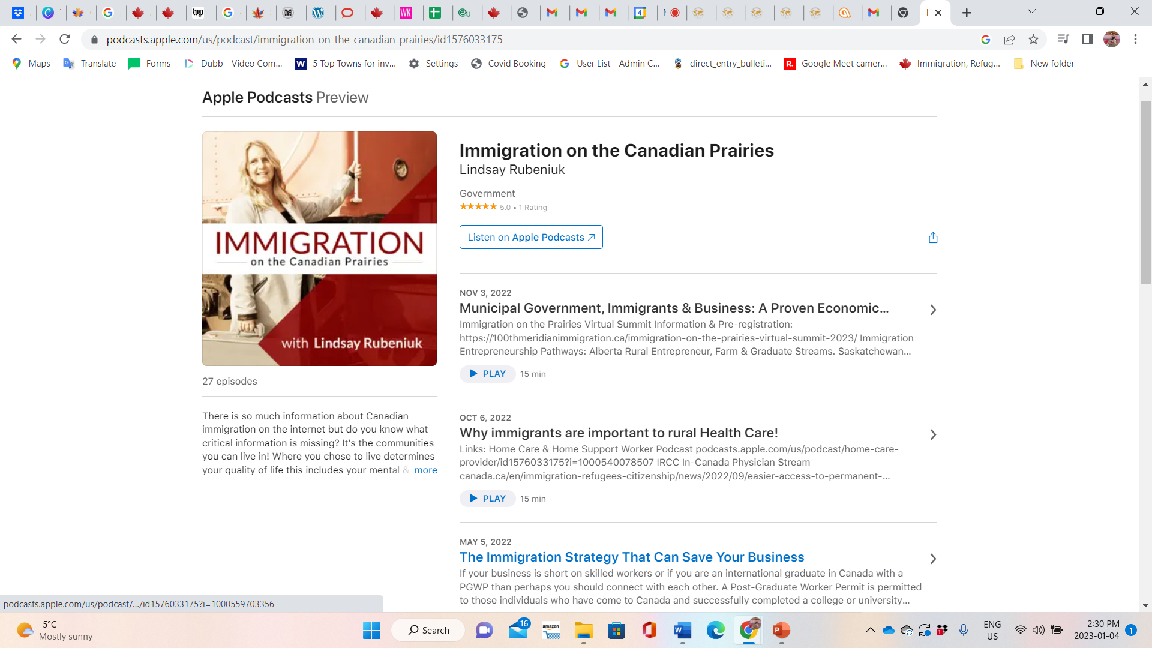

Slide 20
These are the basic, very basic services your community must be offering if you choose to grow your community through immigration.
With or without a government funded office you must find a way to have these services offered.
Why? Because that is just the starting line in the world of immigration attraction & development….
If you do not have this, another community definitely will.

Slide 21
The more you know… Obtain detailed about each service & opportunity in your community! In order to have the best information for your newcomers you must get to know everything about your town and every person who can assist you. This is where asset mapping would be very beneficial!

Slide 22
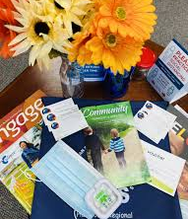
Be retro but always be on-line! Newcomer Welcome Wagon that personally greets new homeowners after relocation, providing them with coupons and advertisements from local businesses. This would include an informational pamphlet that would direct them to use the homepage to access all the information they would need. You could even provide a USB with all the necessary information they need. It would be a great idea for the welcome wagon card to be written in the Newcomer’s language. Employment. Businesses. Connectivity. Childcare. Finance (tax, banking). Housing. Municipal services. Recreation. Health Care.

Slide 23

Chatbots provide an easy and inexpensive way to communicate information. By adding an automated live chat feature to your website that visitors (newcomers) can interact with to get the help they need when they need it. Not only can chatbots help take the strain off customer support (CAO, EDOs), but savvy communities are also using chatbots to expand their enquiry base, and use this process to learn about their community enquiries. This can be used for: 1.0) newcomers looking for a community to move into and; 2.0) newcomers already in your community looking for assistance.
Cost-effectiveness: A chatbot is a one-time investment. Once it has been developed and implemented, you can scale down on hiring people for customer support. Instead, people can be engaged in solving complex problems and creating strategies for community growth
Save time: Chatbots can handle routine repetitive tasks and do them much faster than humans.
Available 24/7: Chatbots can be available to enquiriers 24/7 without much effort. This can, in turn, lead to more satisfied people who wouldn’t hesitate to recommend your community readiness to their network.

Slide 24
Put It Together
Not like you normally would!
Mobile Friendly (first & foremost)
Section Appropriately but as you would a newcomer (Design is key)
Enquiry Form (top, middle, end)
Chatbot
Available in top three language

Slide 25
Share this information! Pick a platform to share this information, my pick is: Webpage with links to you tube channel Ensure to use: Different languages Use professionals, employers and volunteers This should include everything mentioned & more!

Slide 26
Remember, communities and businesses are no different than people… You never get a second chance to make a great first impression! If you treat newcomers well, the news will spread the word, and more people will arrive to see if they can be a fit for your town. If you provide no assistance to new arrivals than expect no assistance from them to stay long-term and promote your town as a good place to live and work.

Slide 27
Homework! What is your community going to do beyond basic settlement? What is your community going to do for potential immigrants to see you are an inclusive community?

Slide 28
100th Meridian services: Virtual Settlement Office creation Immigration community readiness assessments Employer & community immigration pathway training Immigration & Settlement Web-page content creation

Slide 29
Settlement. 100th Meridian Immigration Rural Immigration CED Agency 100meridian.ca Lindsay Rubeniuk Regulated Canadian Immigration Consultant Economic Development of Canada Career Professionals of Canada

