Slide 1
Building a Future
Through Investment
SEDA Collaboration panel
October 11, 2023

Slide 2
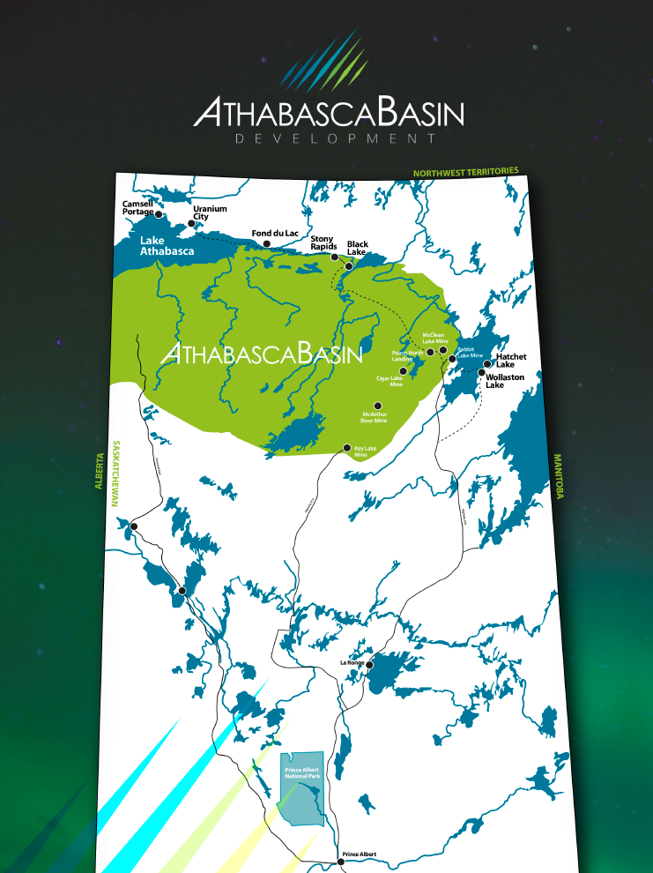
Who we are
Owned by the 7 communities in Northern Saskatchewan’s Athabasca region

Slide 3
The original vision
We heard this from Athabasca leaders and residents when the company was formed:
We want the 7 communities to be unified
We want to build something for future generations
We want to have something when the mining is done
We want employment
We want to participate and maximize on the opportunities

Slide 4
Ownership Structure
Black Lake First Nation
Fond du Lac First Nation
Hatchet Lake First Nation
Northern Hamlet of Stony Rapids
Northern Settlement of Wollaston Lake
Northern Settlement of Camsell Portage
Northern Settlement of Uranium City
Athabasca Basin Development Corporation
Black Lake Ventures LP
Fond du Lac Development LP
Hatchet Lake Development LP
23%
23%
23%
12%
6%
6%
6%
1%
Athabasca Basin Development LP
All Peace Protection 100%
Athabasca Basin Security LP 100%
MTM JV – 29.5% and 35%
Points Athabasca 75%
Great Plains Contracting 17%
Flyer Electric LP 68%
Lonona Contracting 100%
Tru North RV - 50%
Alumarine 100%
Arctic Beverages – 48%
Kleen-All Enterprises 100%
Team Drilling 50%
Synergy 5 Investments 37.5%
Prince Albert Photocopier 100%
Optek Solutions (31.67%)
APIC Insurance 50%
Rise Air – 75%
Points North 48.3%
Long Lake
Insurance – 68.25%
A7 Investments (95%)

Slide 5
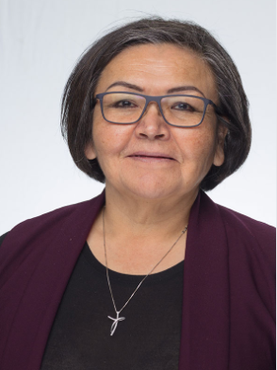
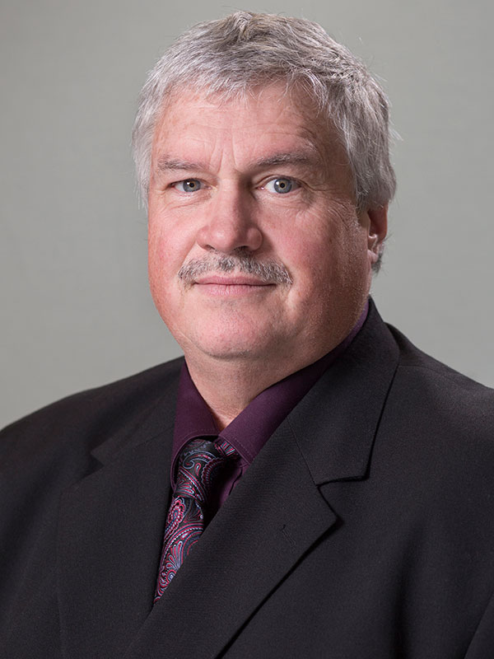
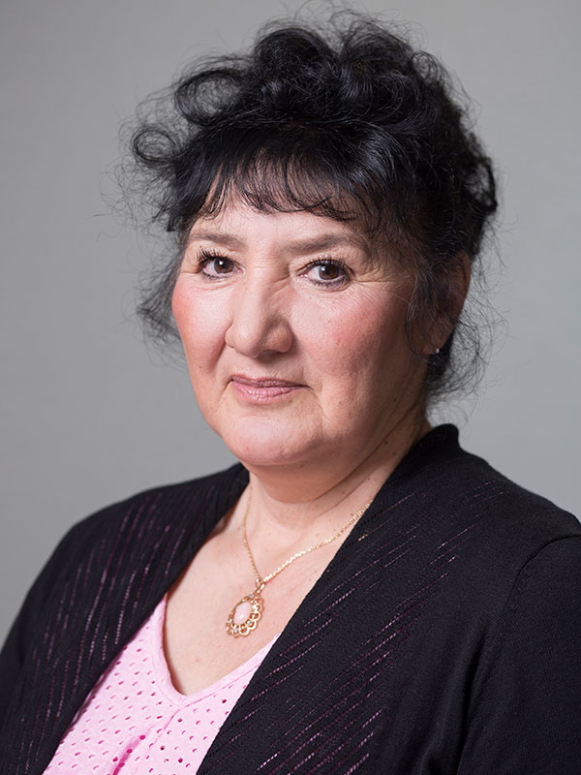
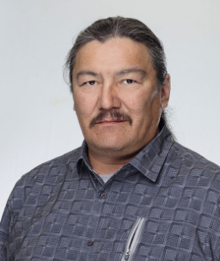
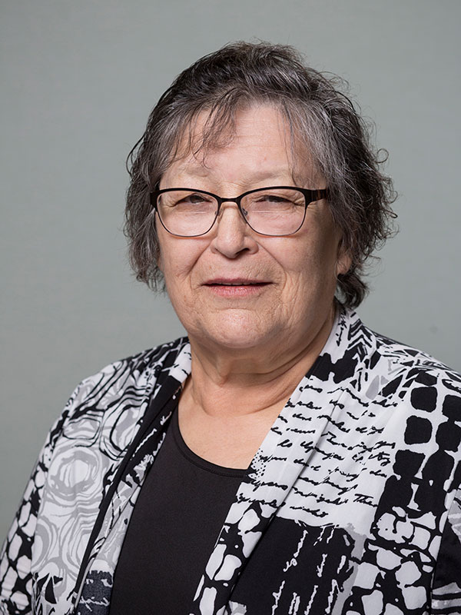
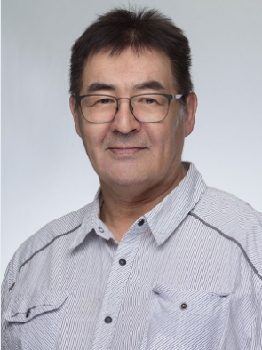
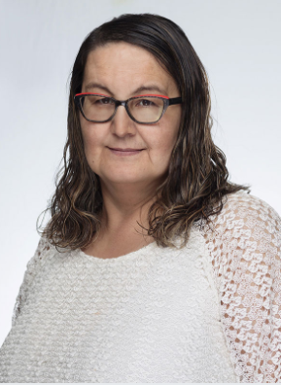
ABD Governance
Governed by a board of directors made up of 100% Athabasca residents
(left to right)
Anne Robillard – Hatchet Lake
Dean Classen – Uranium City
Joyce Powder – Camsell Portage
Kevin Mercredi – Fond du Lac
Terri Daniels – Wollaston Lake
Merv MacDonald – Stony Rapids
Coreen Sayazie – Black Lake

Slide 6
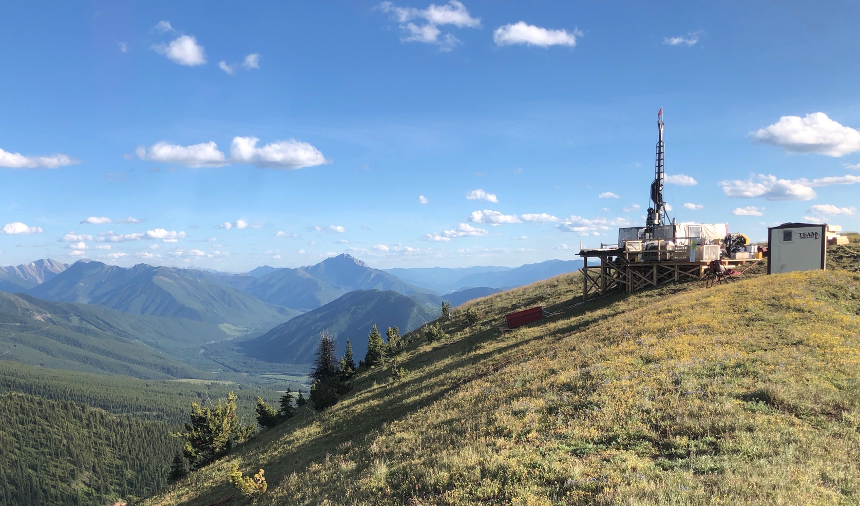

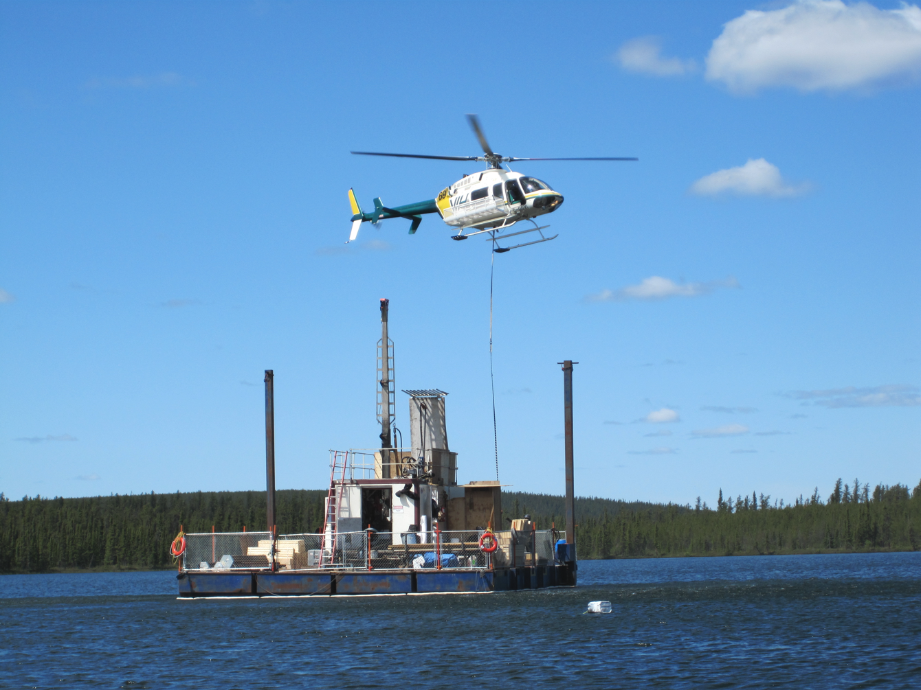
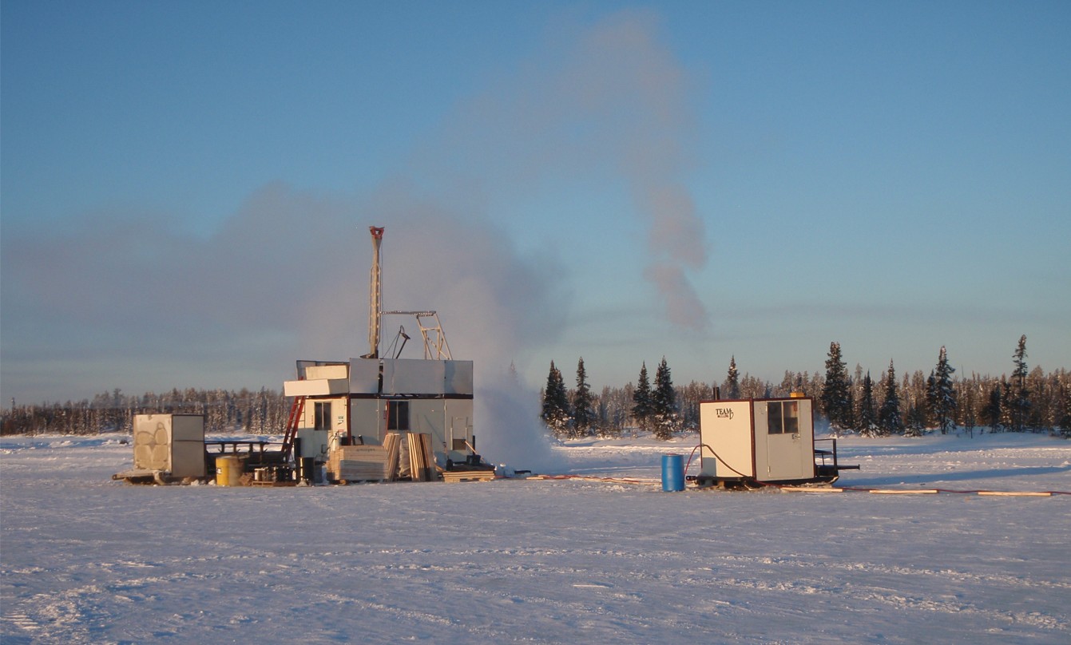
Our Investments

Slide 7
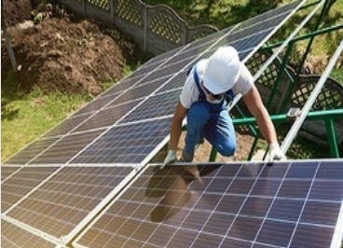

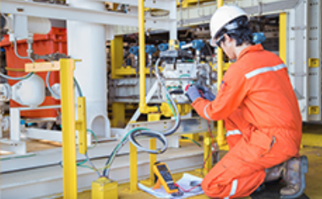
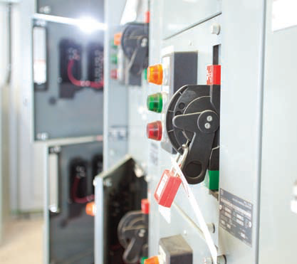
Our Investments

Slide 8
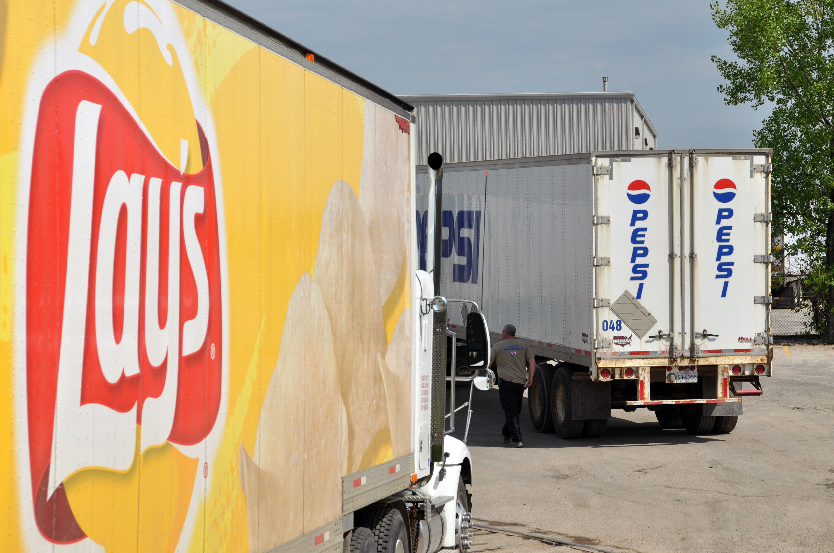
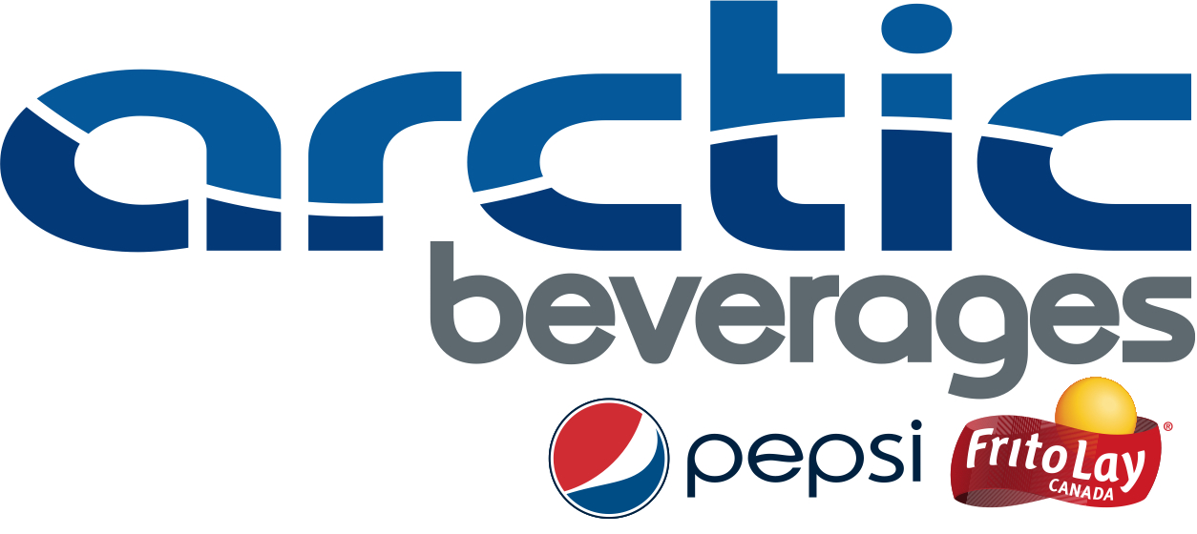
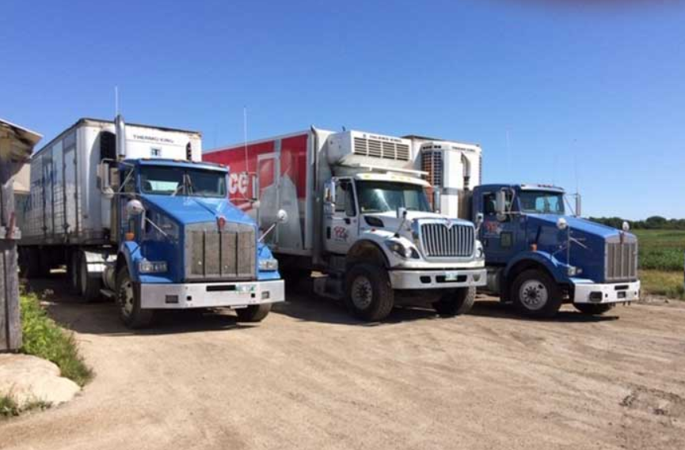
Our Investments

Slide 9
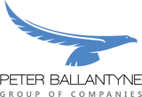




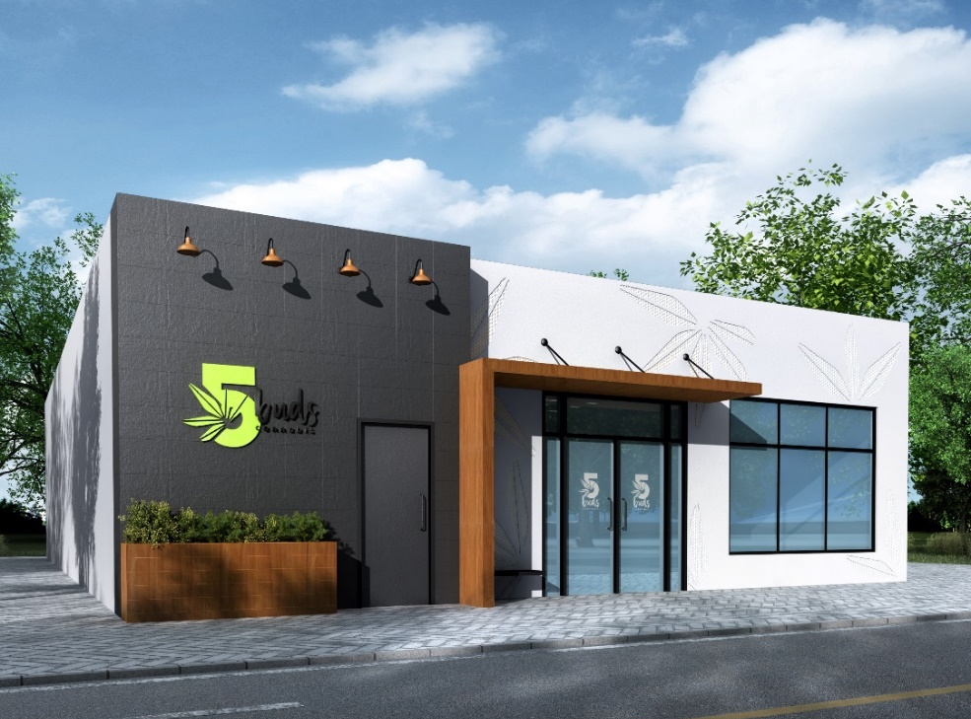

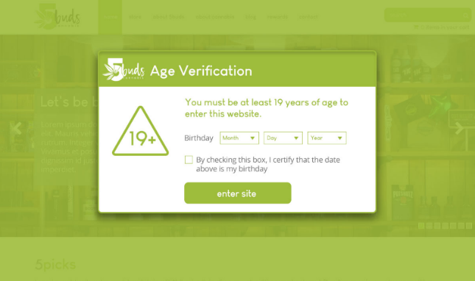
Our Investments

Slide 10
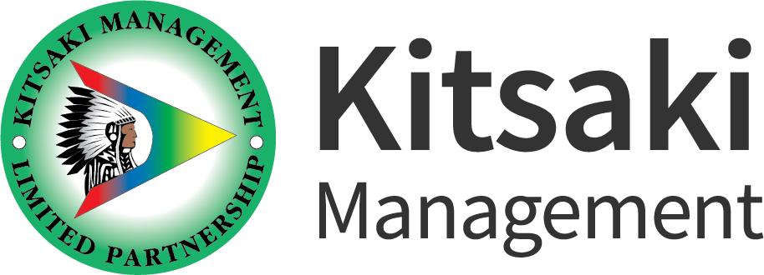
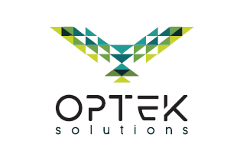
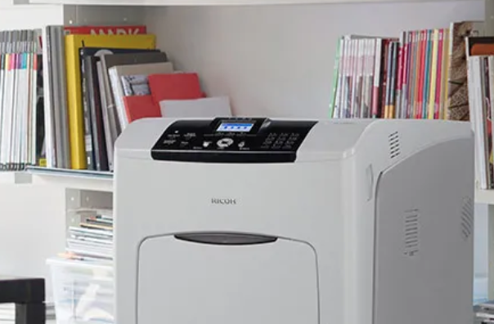

Our Investments

Slide 11
Indigenous Partnerships
ABD and its investments collectively have ownership/partnership with nearly 40 Indigenous communities (directly and indirectly)
  33 in Saskatchewan
  3 in Alberta
  1 in Manitoba
  4 in BC
For example, in Arctic Beverages, there are 17 different communities that have direct or indirect ownership
Notes:
This is who we have partnered with various entities and directly.

Slide 12
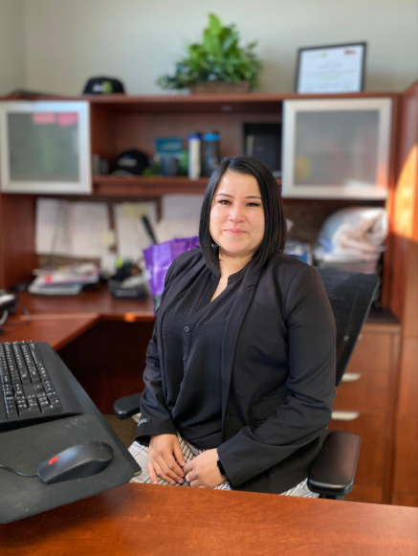
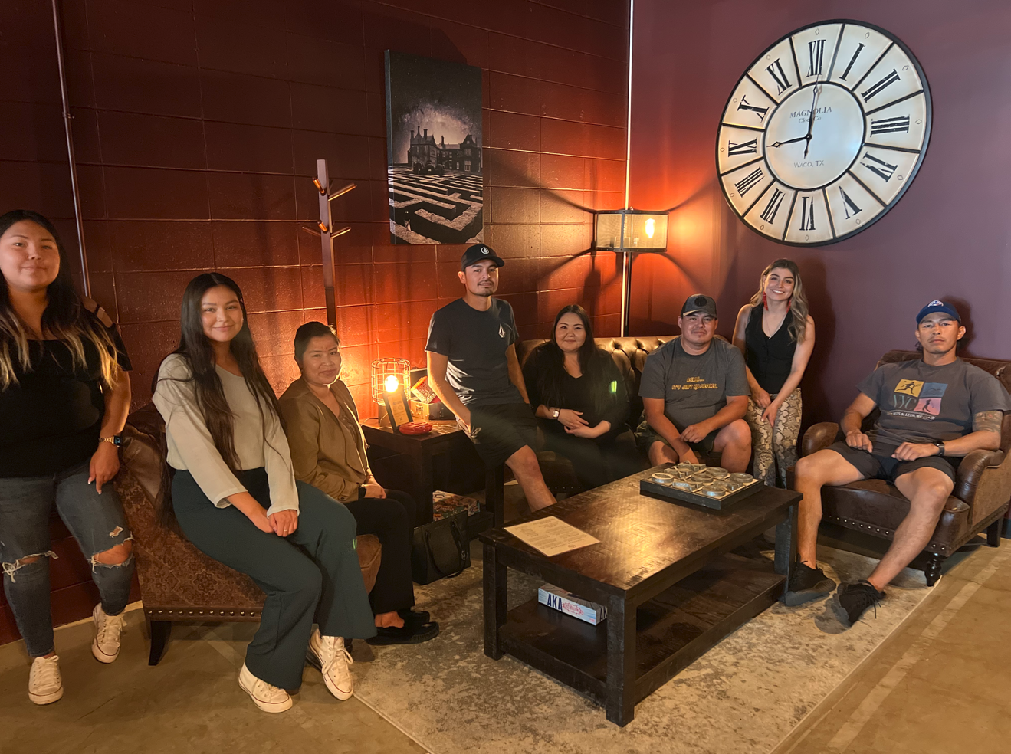
Athabasca Summer Student program
Partnership with PAGC-Dene
Employed 12 students in 2021
Added positions in Athabasca communities this year & event.
18 positions in 2022; 16 in 2023
Position examples:
  Marketing/Communications
  HR/Admin
  Yard
  Warehouse
  IT
  Accounting
  Operations
Notes:
Pictured: Brianda Robillard, Accounting summer student. Now has full time position with Points Athabasca as HR Admin Assistant.

Slide 13
Building a Future Through Investment
In conclusion, ABD and its investments operate at a high level, place a high value on safety and service, have strong management teams and governance, and give back to the communities.
Increasing activity with any of our investments is supporting “Building a Future through Investment.”
This means a resilient company that will be here in 50 years+ and can provide benefits and improve the lives of future generations.

Slide 14
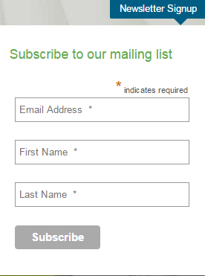


Questions?
Thank you for your time!
www.facebook.com/AthabascaBasin
www.twitter.com/AthabascaBasin

