Slide 1

I acknowledge with respect Treaty 6 Territory and the Homeland of the Métis and express my appreciation for their stewarding of these lands and waters from time immemorial.
The Indigenous Cities Saskatoon artwork, Mary Longman

Slide 2
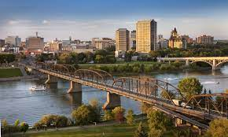



The Challenges and Opportunities of Regional Prosperity Creation
Lisa Helps

Slide 3
What I’d like to share
Why it’s so hard to collaborate
Asset based economic development
Case studies:
SIPP & COAST
A How to Guide

Slide 4

Reframing the conversation: Who doesn’t want prosperity?

Slide 5
Why it’s so hard to collaborate to create regional prosperity:
Mayors/Reeves and Councils and First Nations want control over monies spent on economic development.
Mayors/Reeves and Councils and First Nations need to be able to show results to their constituents or members for the monies they are spending.
Local priorities seem more important than regional priorities.
Fear of loss of control in decision making by working at a regional scale.
Turnover at the municipal level in a four-year election cycle.

Slide 6
Asset based economic development: “The Saskatchewan Dividend”
Lower cost of living
Higher quality of life
Population growth in some rural areas - ”By default or by design?”
Strong resource and export economy
Saskatchewan Economic Development Association
Saskatchewan Indigenous Economic Development Network

Slide 7
How can we leverage the Saskatchewan Dividend?
Harness the power of trading areas by establishing regional prosperity partnerships.
Create governance models that preserve local autonomy and enable regional collaboration.
Diversify Saskatchewan’s export economy through building on regional strengths and upskilling the workforce.
Take a long-term view!

Slide 8
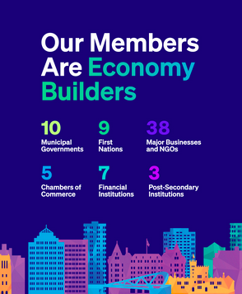
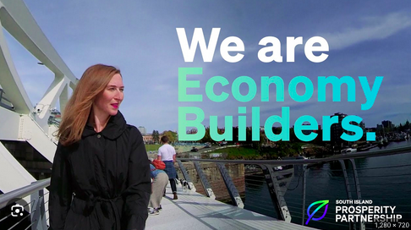
Case Study: South Island Prosperity Partnership

Slide 9
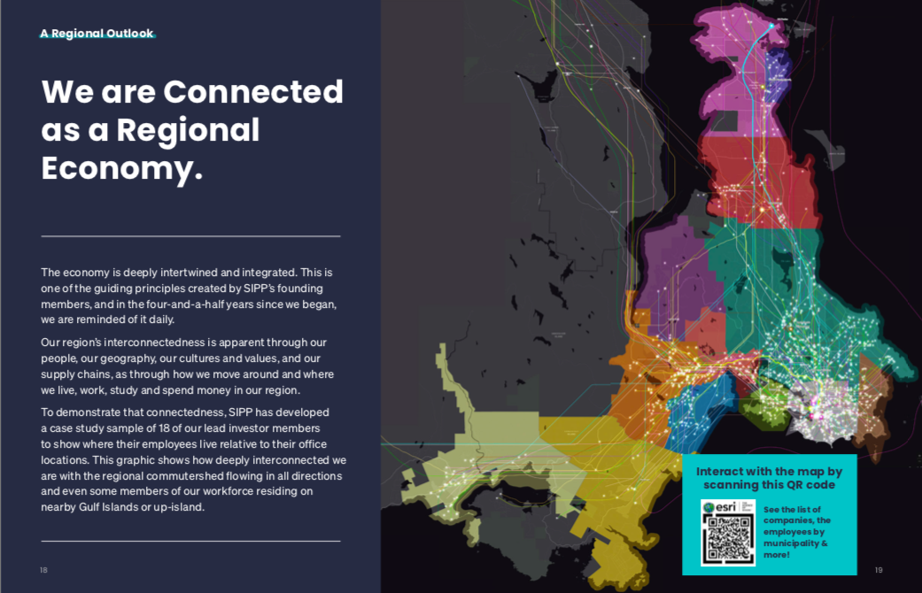

Slide 10
Assumptions aren’t true
ASSUMPTIONS | INJECTIONS
1. The existing Greater Victoria Development Agency and Chambers of Commerce are doing as much as they possibly can to promote Greater Victoria. | 1. Clearly define the role of Chambers of Commerce in the region with regard to economic development and in distinction from the new regional economic development agency / body / organization.
2. A plurality of agencies increases effectiveness and the ability to target specific markets. | 2. Create one agency/body/organization to drive the economic development of the region.
3. Regional planning is best kept separate from regional economic development. | 3. Integrate economic development activities with the Official Community Plans (OCP) of each municipality / build on the goals of each OCP to help drive economic development.
4. Competition among municipalities is the best way to grow the economy of the region. | 4. Develop a plan to co-promote the region to the world.
5. There is a limited pie in the region and each municipality must compete for a piece of that pie. | 5. Develop a plan to grow the pie of the region.
6. Most municipalities are not willing to put money into a regional economic development function. | 6. Develop a funding formula for a regional economic development agency / body / organization that is fair and equitable to all municipalities and that is tied to clear deliverables so each elected mayor and council can point to specific outcomes delivered for dollars invested.

Slide 11

Case Study: Centre for Ocean Applied Sustainable Technology

Slide 12
Questions for discussion:
What are the strengths and opportunities of our ocean and marine sector from a global point of view?

Slide 13
Questions for discussion:
What are the weaknesses and threats of our ocean and marine sector from a global point of view?

Slide 14
Questions for discussion:
What are the benefits and drawbacks of working in earnest to create a global facing, future focused, ocean cluster to strengthen the ocean and marine ecosystem, develop local supply chains and create more high value jobs?

Slide 15
Questions for discussion:
Who from industry, academia and government is willing to form a small, action-oriented steering committee to explore next steps and report back to the larger group within two months?

Slide 16
A “how to” guide:
Centre Indigenous economic development, reconciliation, and the solutions economy
Local leadership is important for regional collaboration
Don’t leave out the difficult people
Governance matters – no politicians, make it inclusive, make it sustainable and able to outlast local government election cycles
ZAPS and MAPS
Create momentum, focus energy, build something that has the positive energy to attract people / organizations to it

Slide 17

One more thing …
Take a long-term view!

Slide 18

Thank you!

