Slide 1
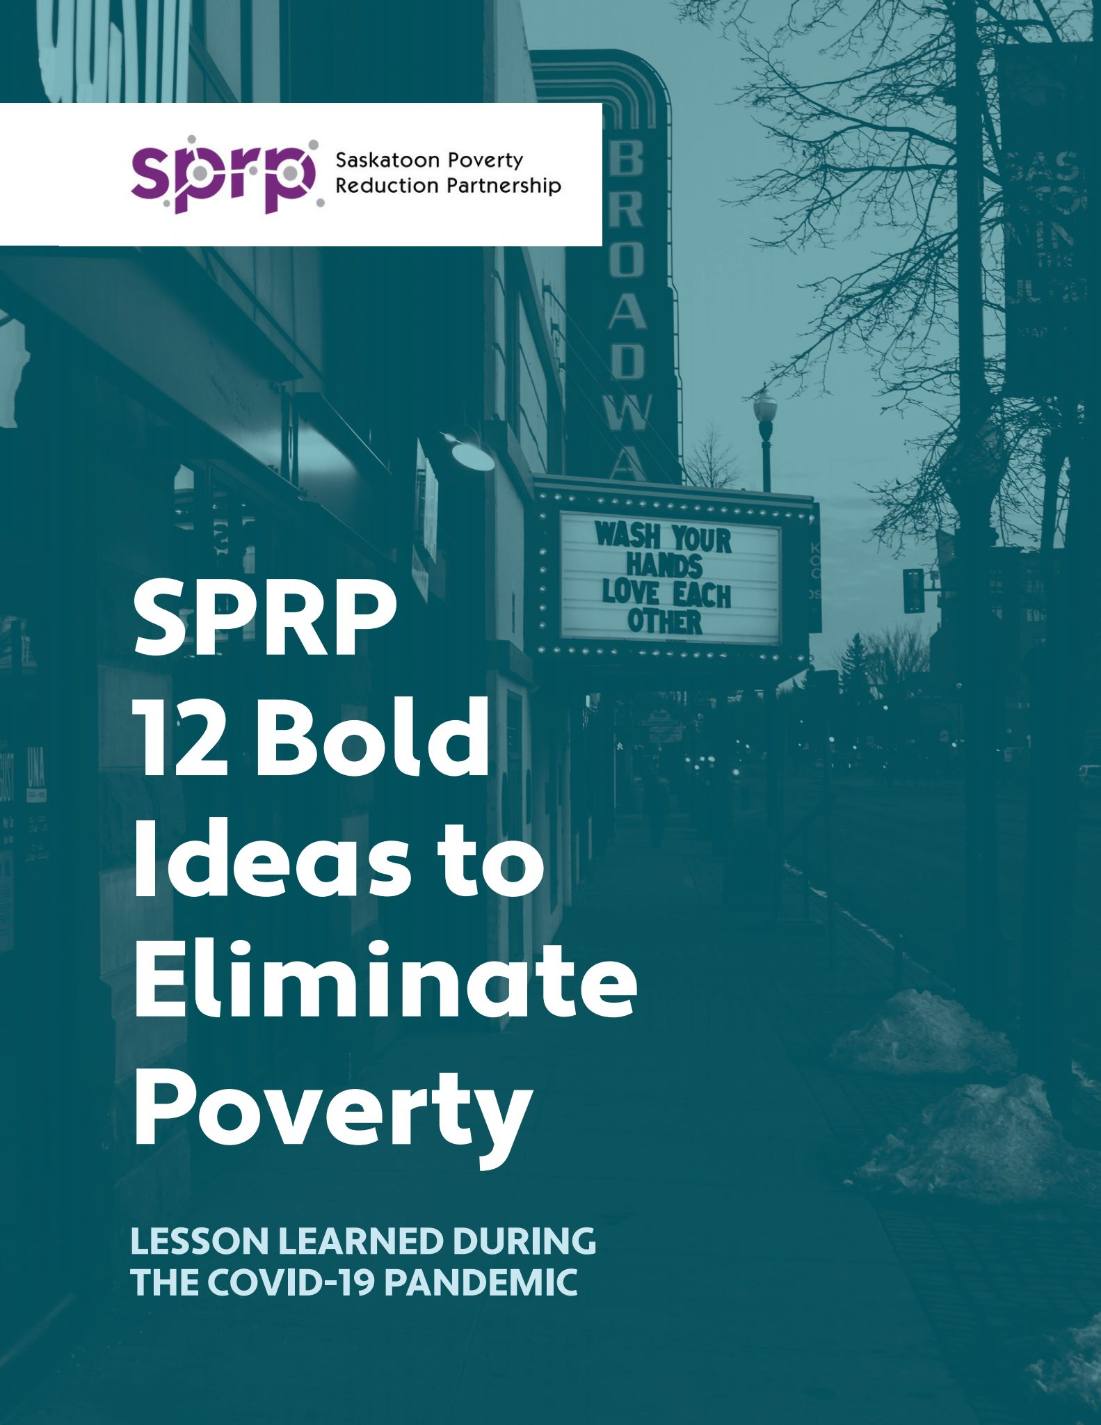
Thursday, October 12, 2023
Collaboration is our superpower.
A closer look at how the SPRP works as a large intersectoral multisectoral collective impact collaborative.
Colleen Christopherson-Cote,
Coordinator, Saskatoon Poverty Reduction Partnership

Slide 2
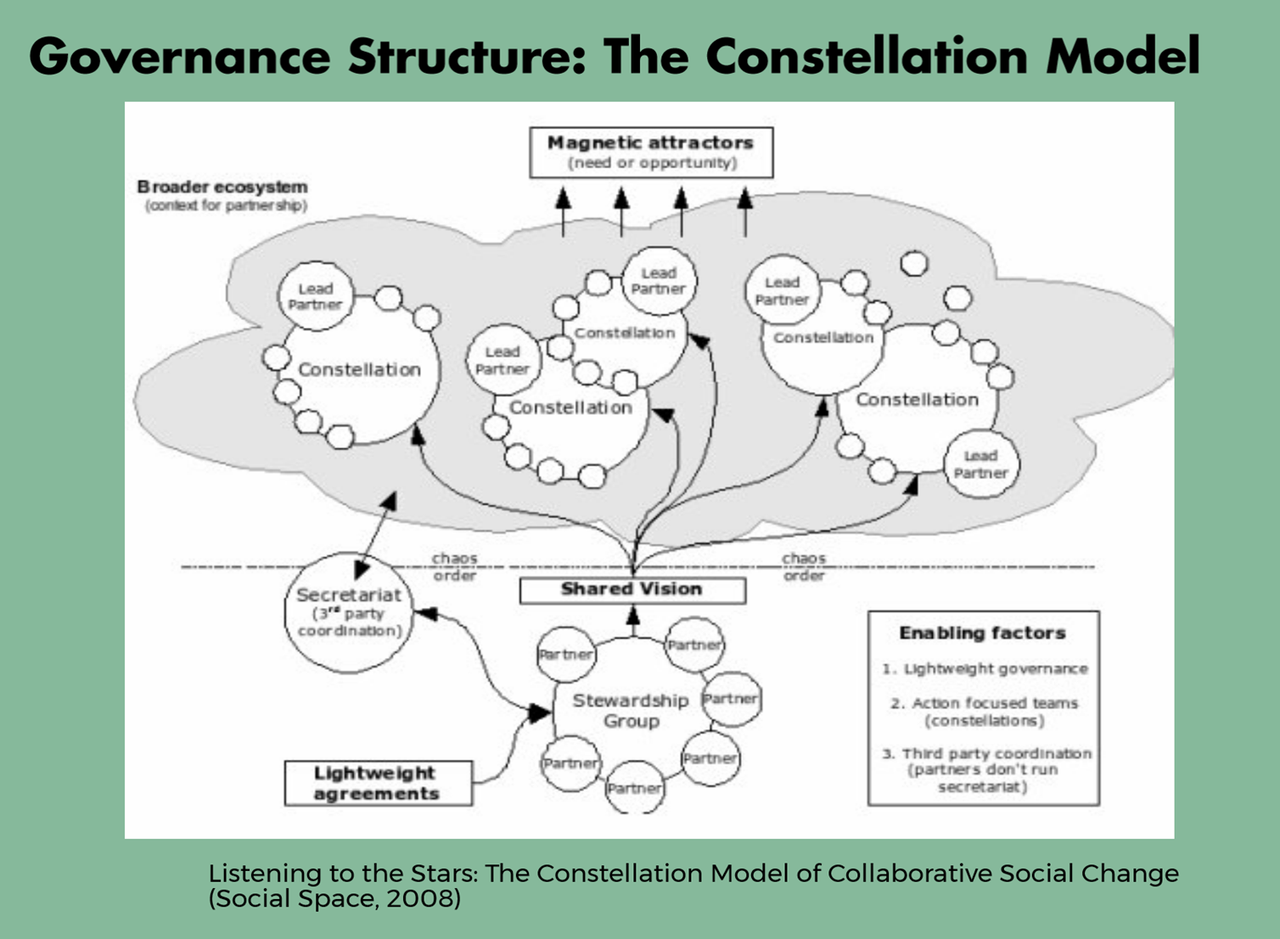

Slide 3
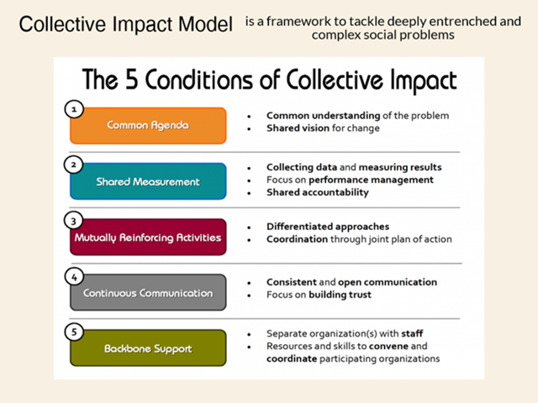

Slide 4
What are the ingredients that make this work?
Relationships move at the Speed of Trust.
Creating Social Change moves at the Speed of Relationships.
Break these rules and the work moves backwards exponentially faster than you can imagine.
Collaboration refers to the engagement of people in order to create relationships conducive for solving complex issues with plausible solutions for which they take responsibility – and catalyze their contributions and assets into collective action.

Slide 5



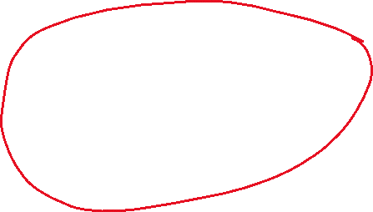

Enter COVID – and a new sense of urgency
What we KNEW was that many of the pressures associated with COVID are exasperated by the pre-COVID conditions for many who are made vulnerable by poverty.
So we asked the 175+ community partners if they wanted us to host a conversation about COVID
AND – they did. But also, they had existing relationships, trusted the convening leadership and saw the common vision.
Safe Community Action Alliance
https://saskatooninteragencyresponse.ca/

Slide 7
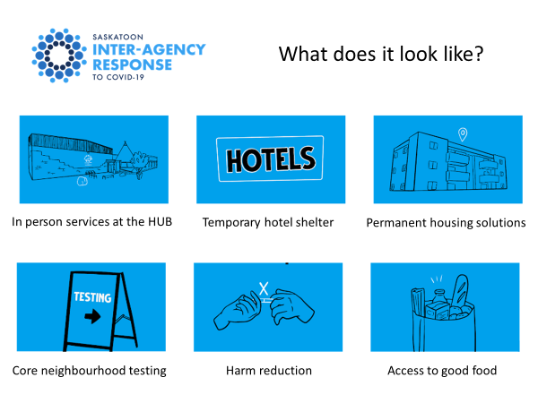
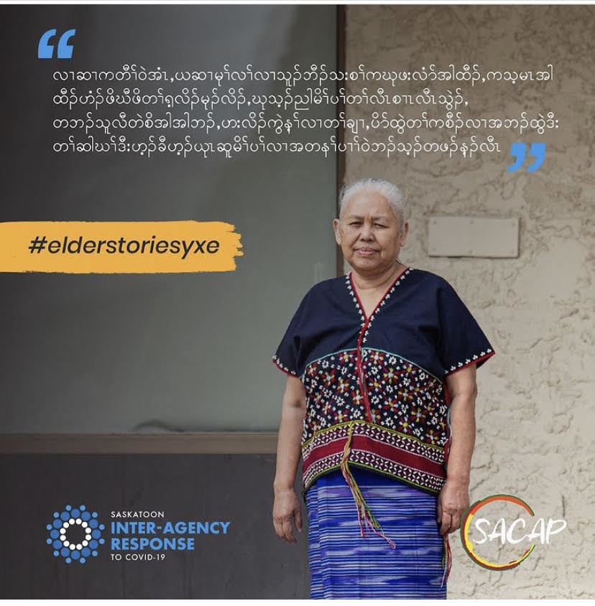
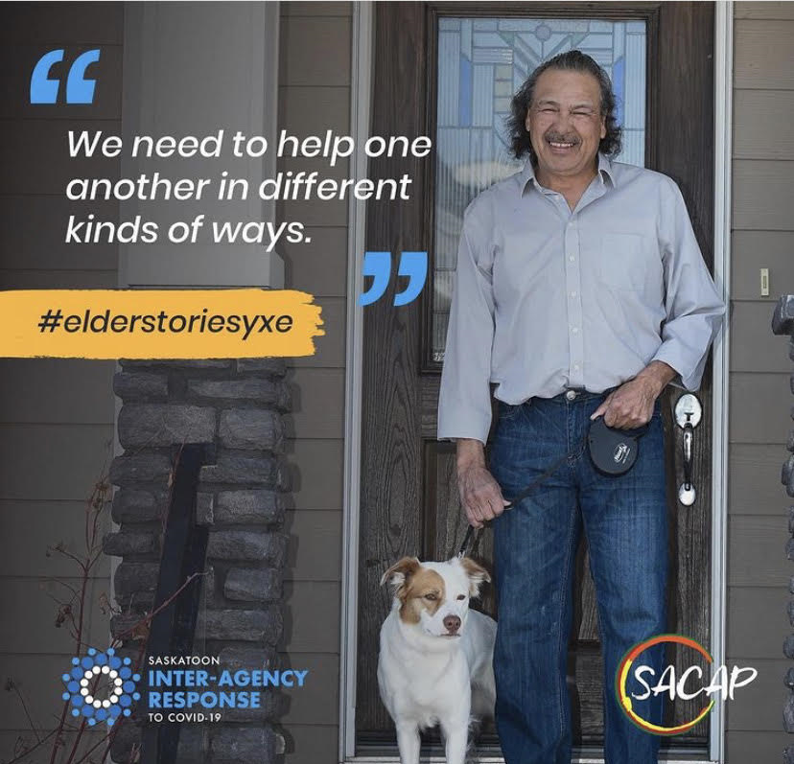
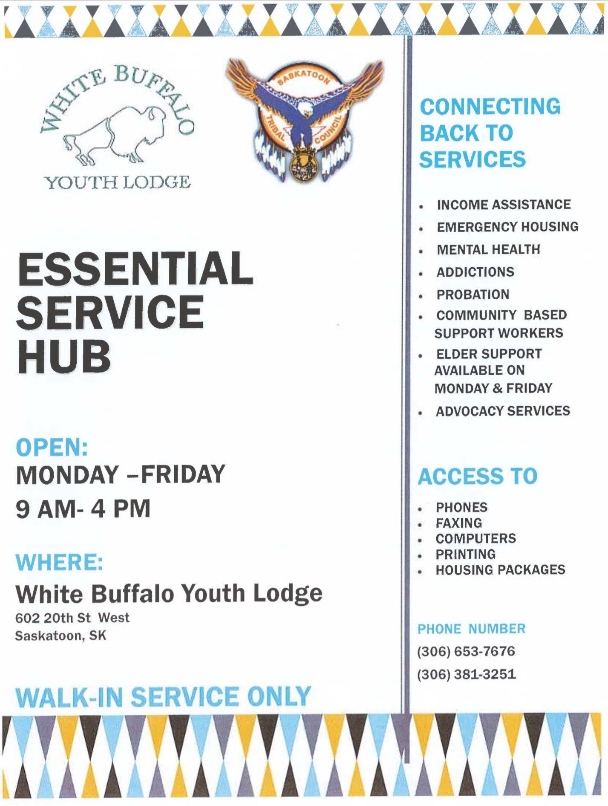
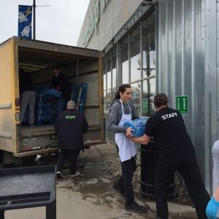
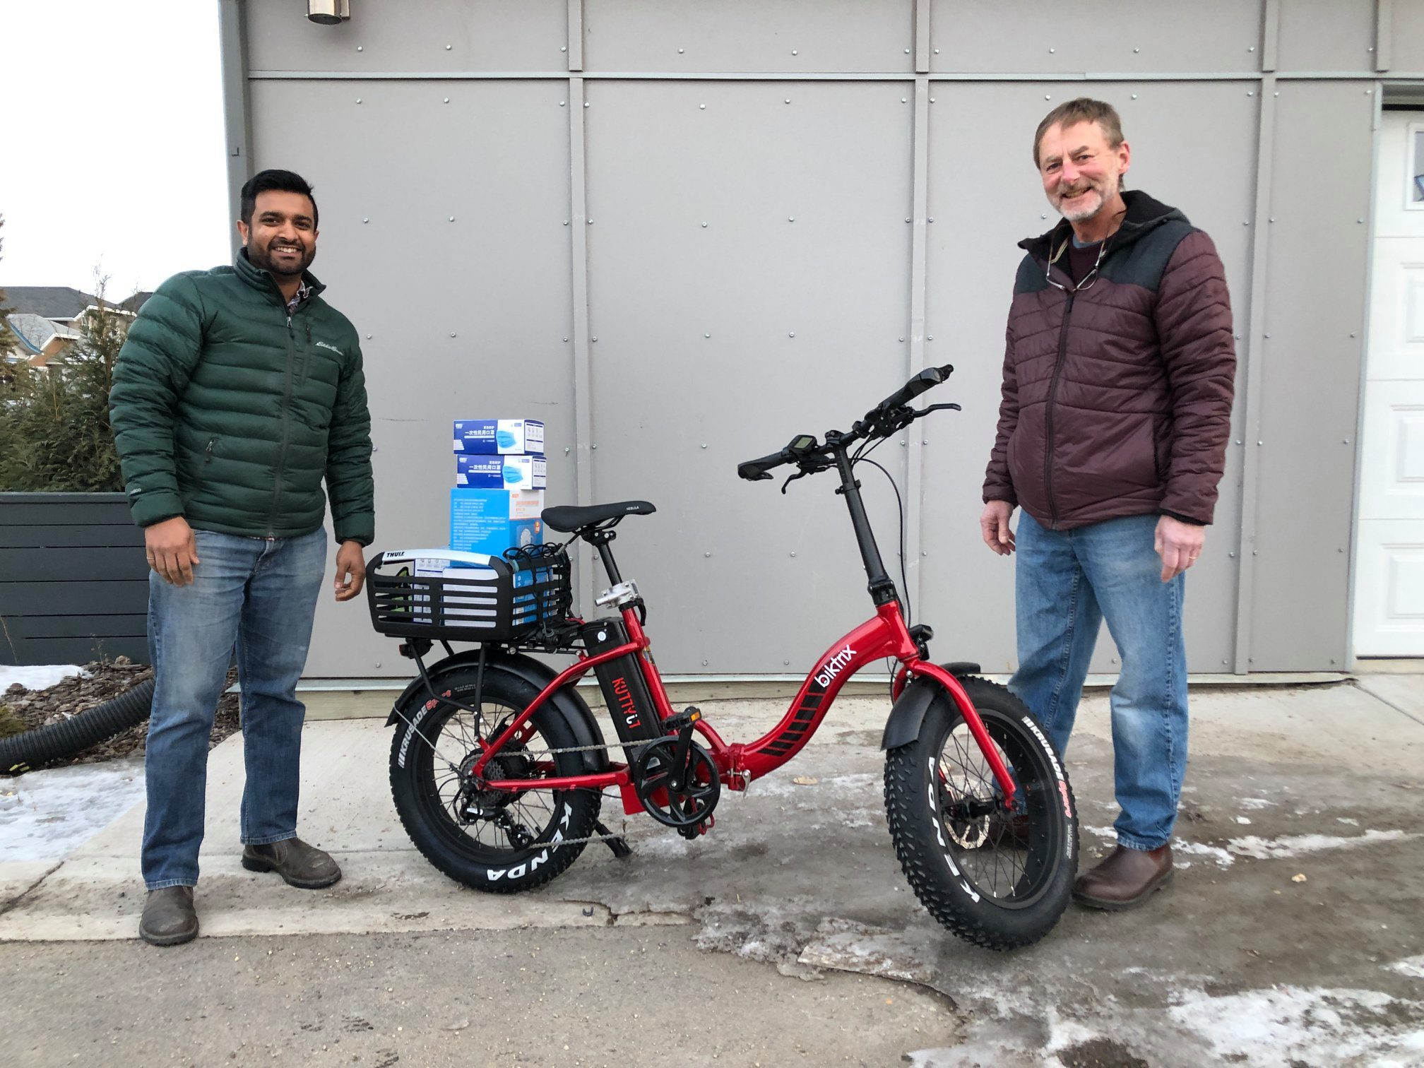
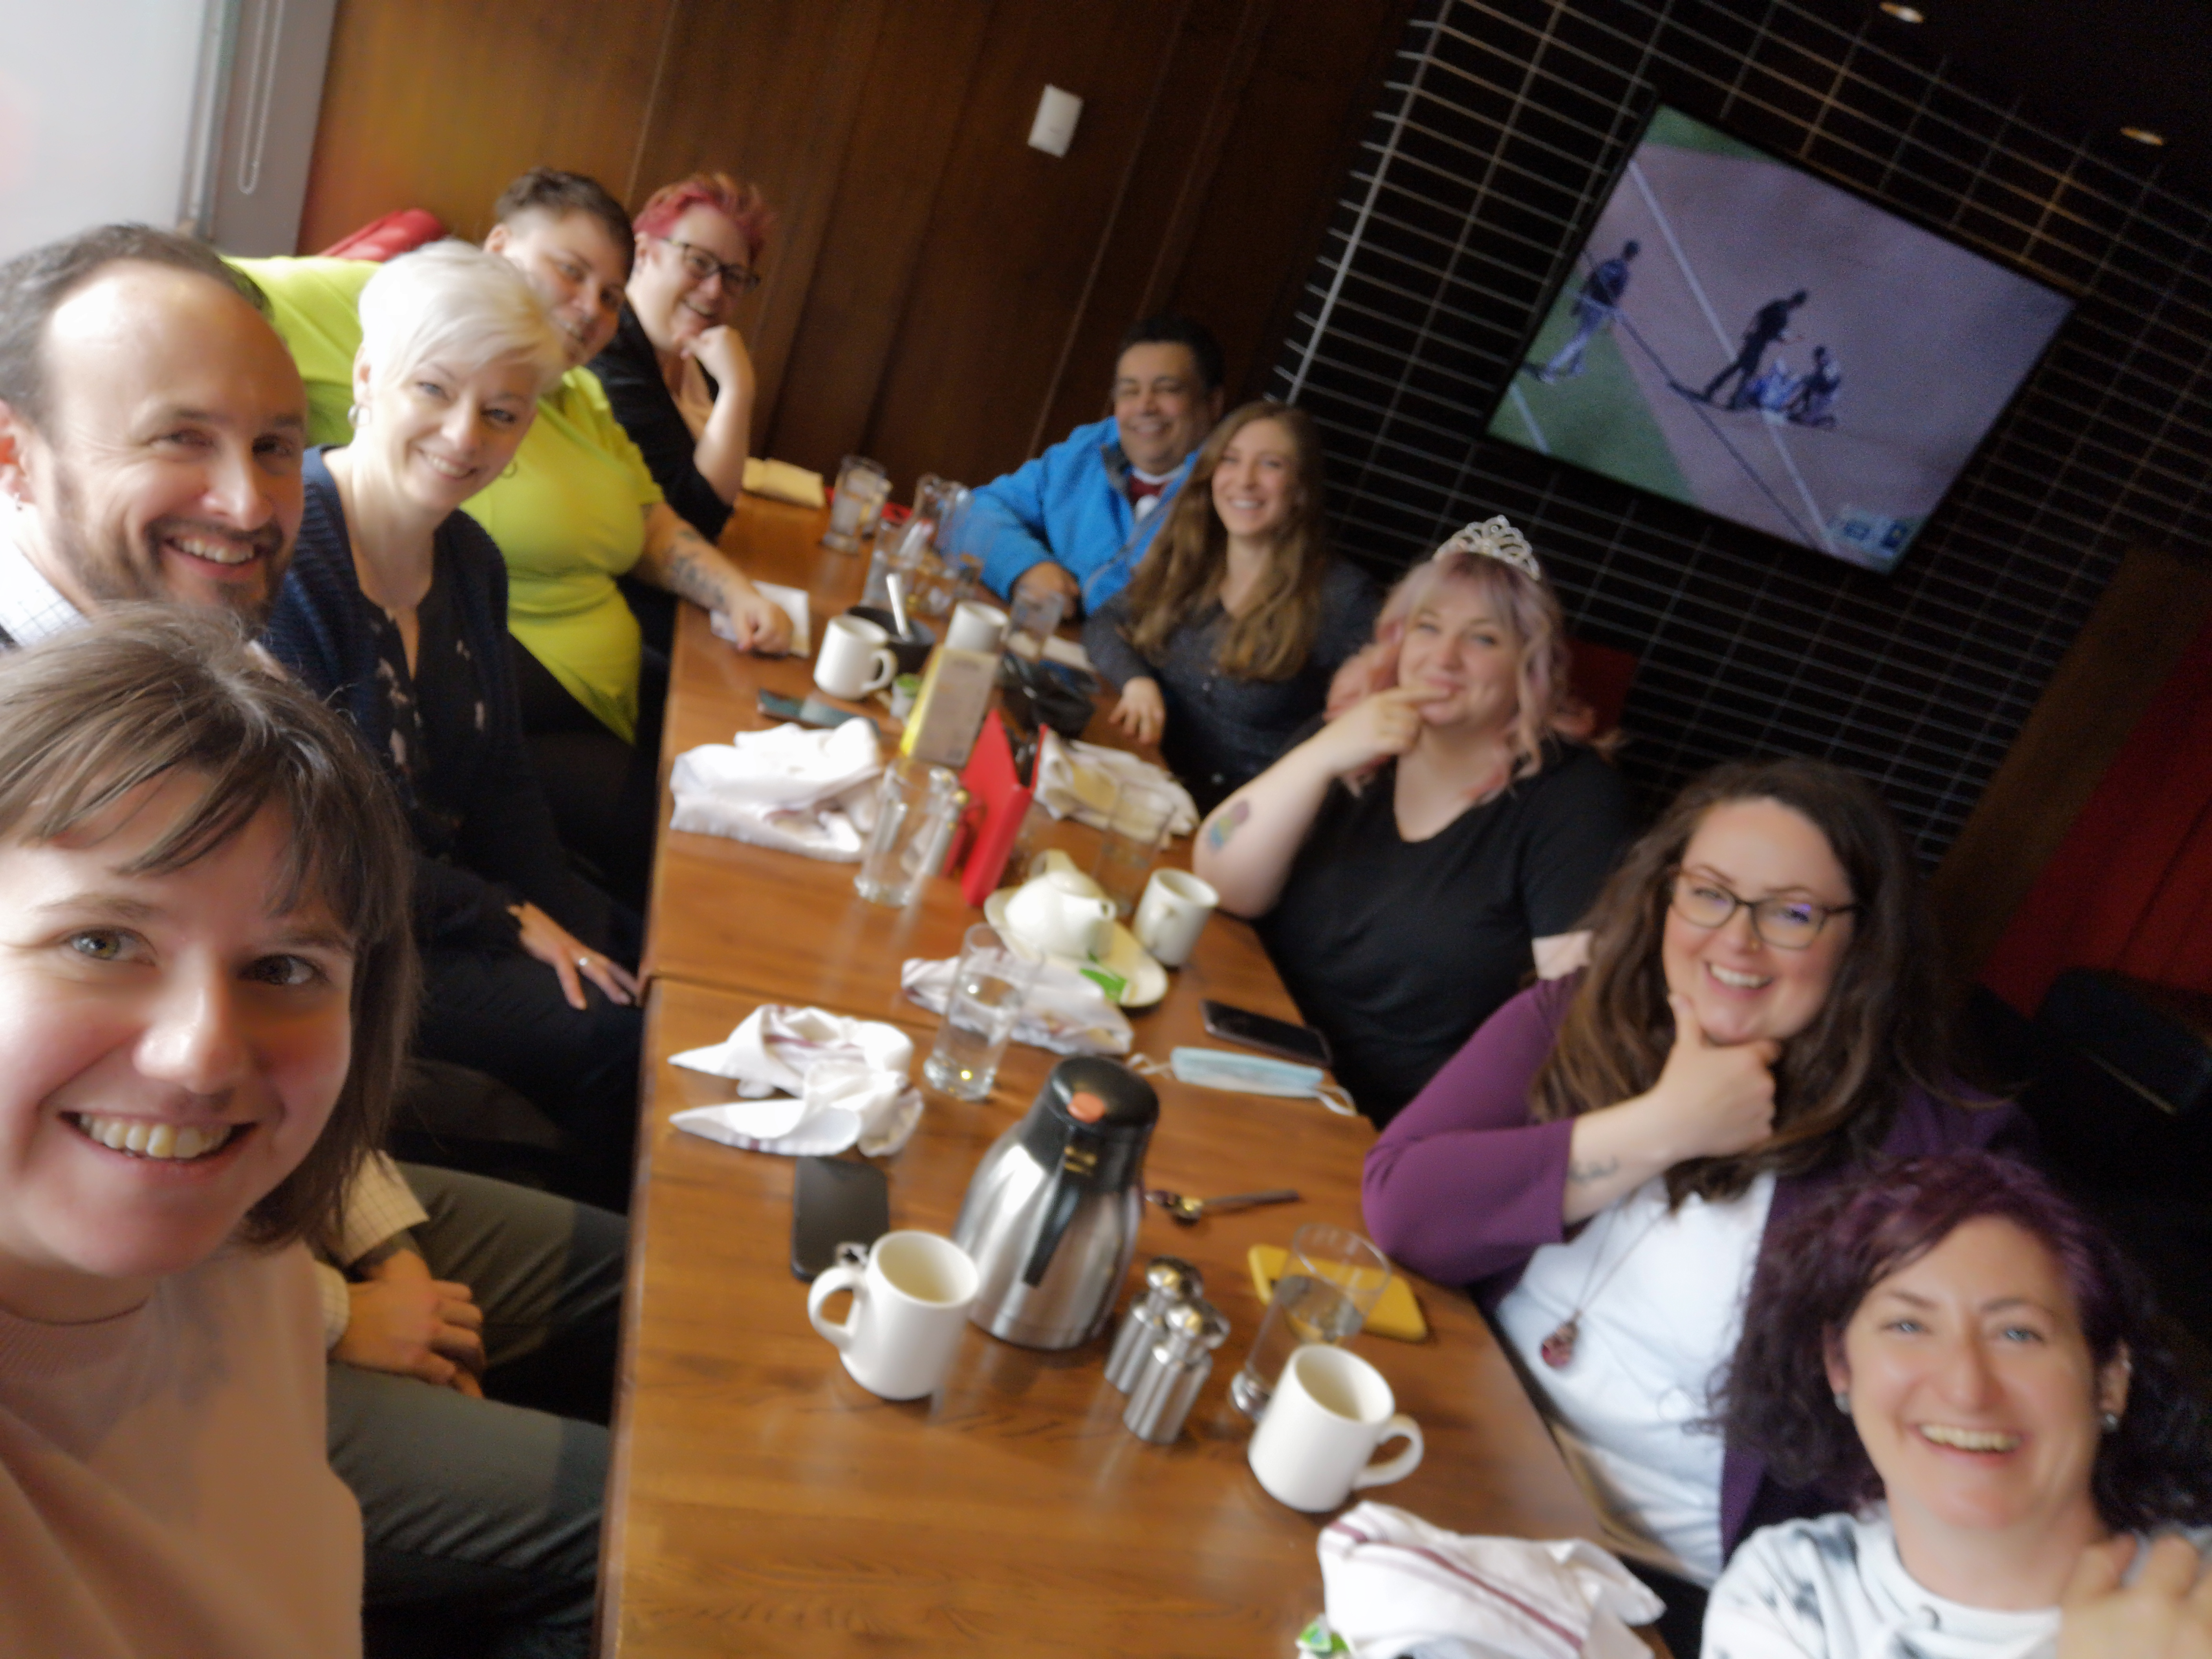

Slide 8
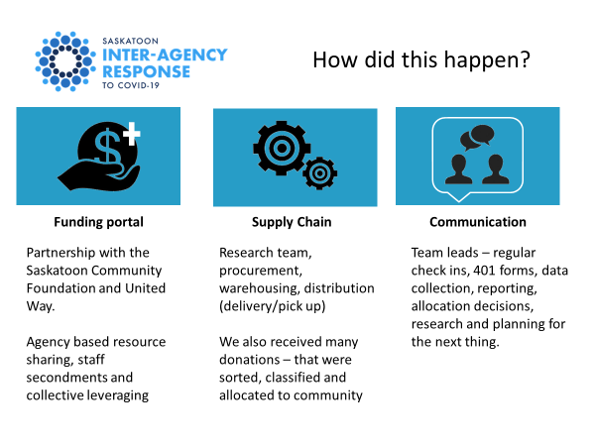
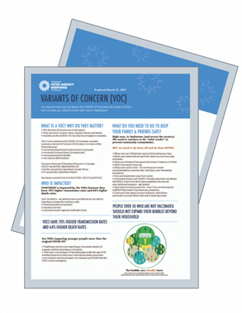
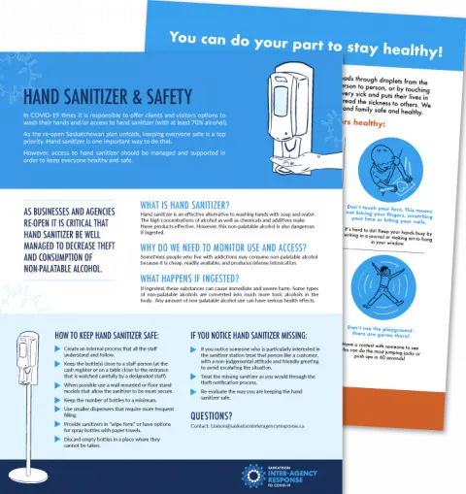
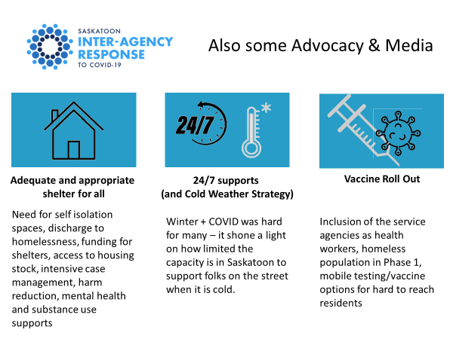
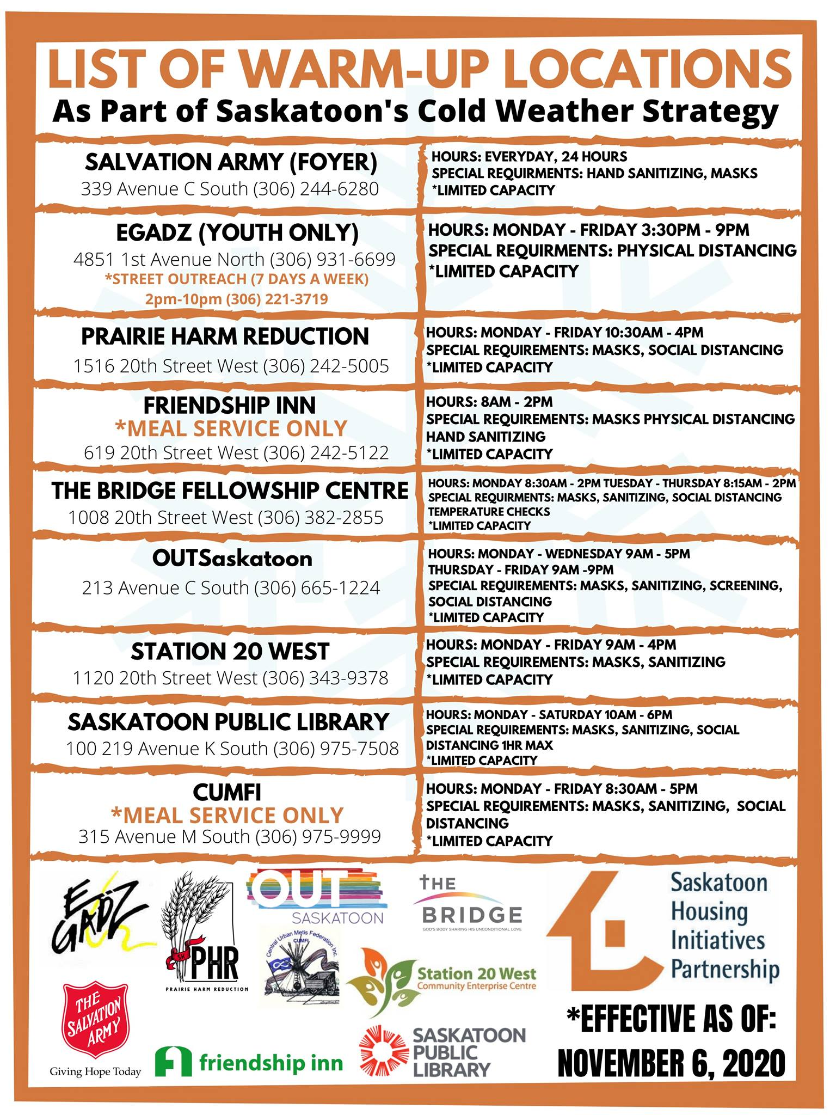

Slide 9
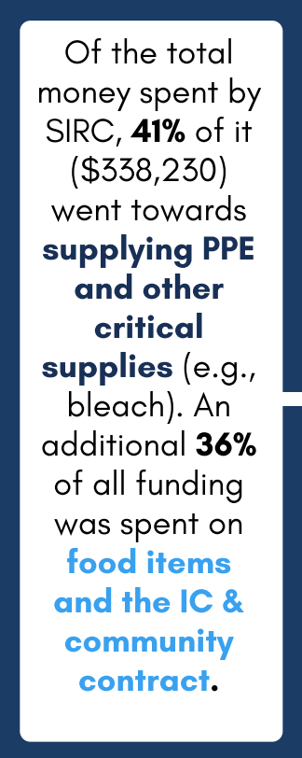
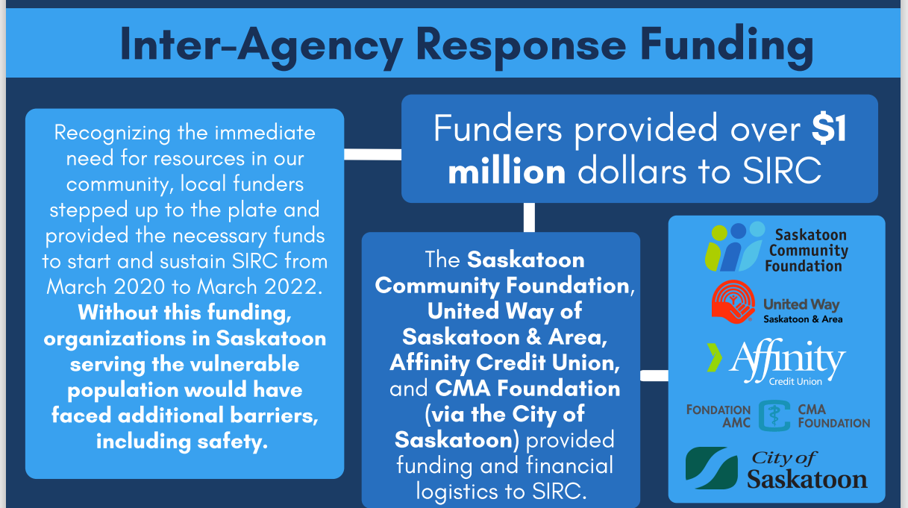
We leveraged our social capital with existing relationships to talk differently about funding models. Community led the priorities, community decisions informed funding models and the funders came through with incredible resources.
We trusted each other and understood the common goal.

Slide 10
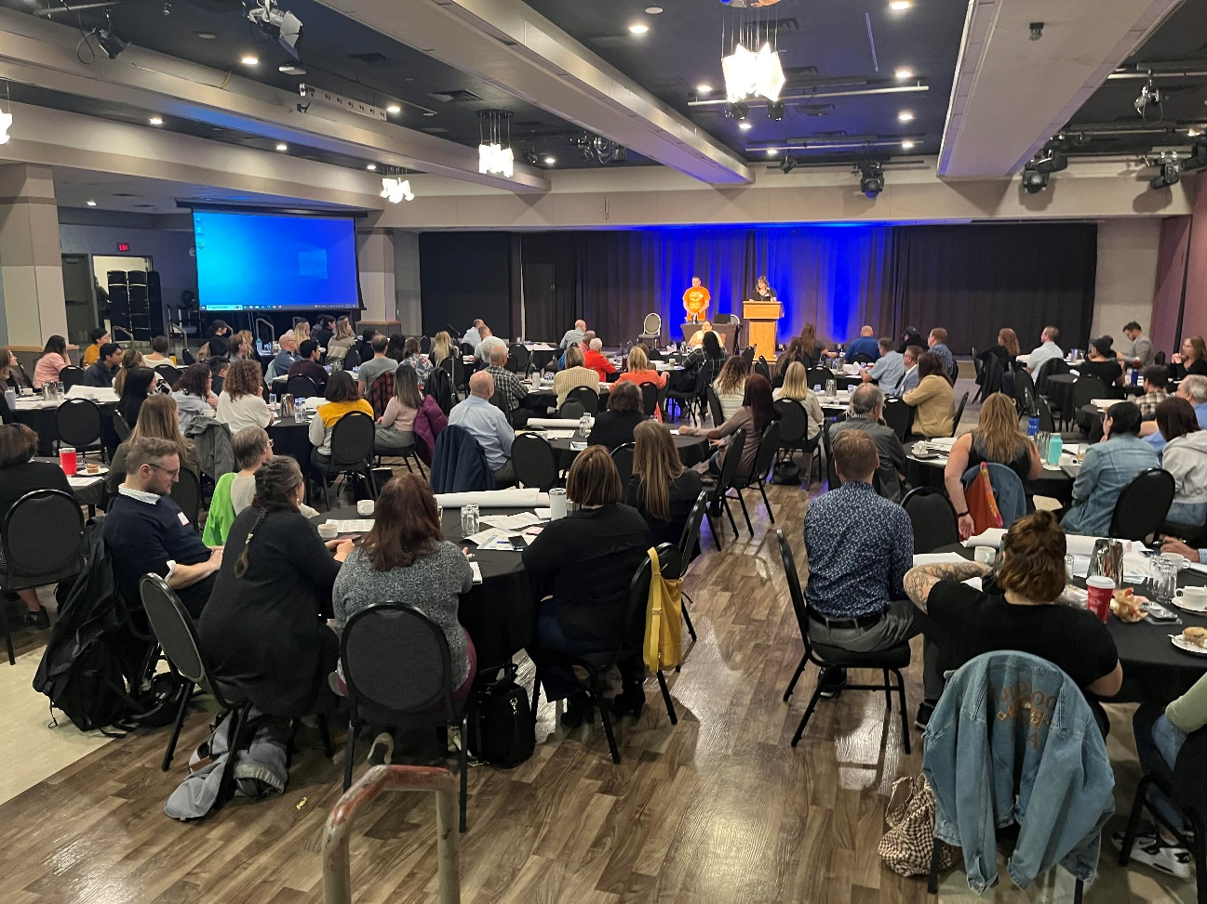
Pivot away from COVID
The SPRP partners gathered to re-energize the work around the 12 Bold Ideas to Eliminate Poverty – 165 registered for a full day meeting.
We trust each other, understand the common goal and see our individual place in the collective action. We are better together.

Slide 11

Connect with Colleen/SPRP
SPRPcoordinator@gmail.com
306.491.8502
FB: @EndPovertyYXE

