Slide 3
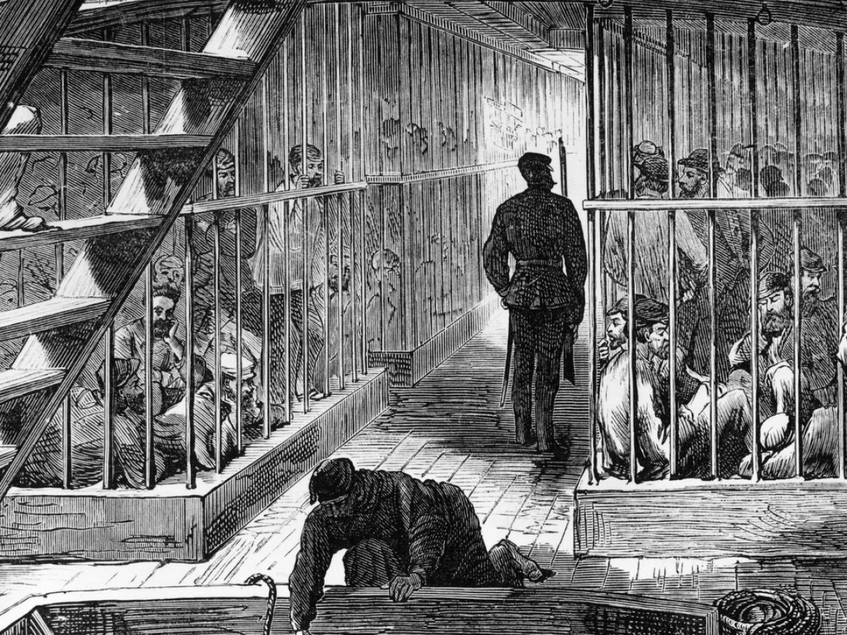
The British Government transported about 76,000 convicts to Tasmania

Slide 5
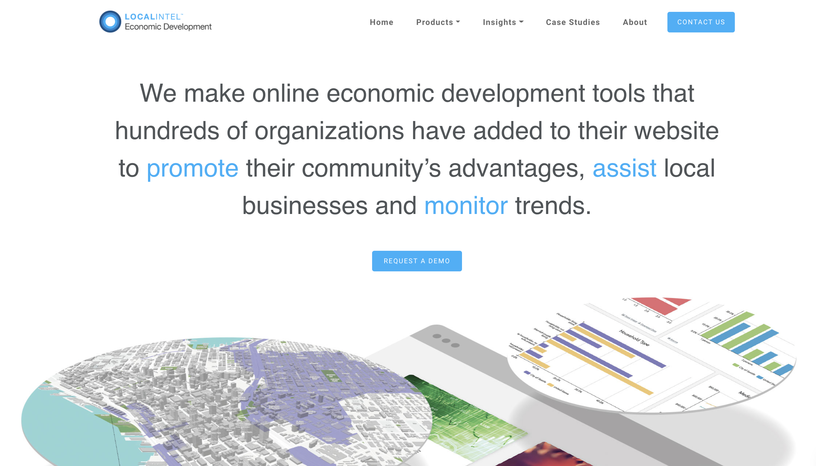
We make online economic development tools that hundreds of organizations have added to their website to promote their community’s location advantages.

Slide 8
“What’s the one thing that communities can do to stand out right now and get attention?”
Notes:
This was the final question asked to a panel of experienced site selectors during a recent webinar hosted by the Site Selectors Guild. This is what they said:

Slide 9
Jeanette Goldsmith, Vice President at Strategic Development Group
“I think it’s a compelling marketing message that really demonstrates what a community’s ‘WHY’ is. It’s got to be distinctive, compelling, and really make me say, that’s kind of interesting, I want to explore that more.”
Jay Garner, President at Garner Economics
“Show something different, show your value proposition, that’s the key.”
Didi Caldwell, President at Global Location Strategies
“Create something memorable and authentic that tells me something compelling about your community.”

Slide 10
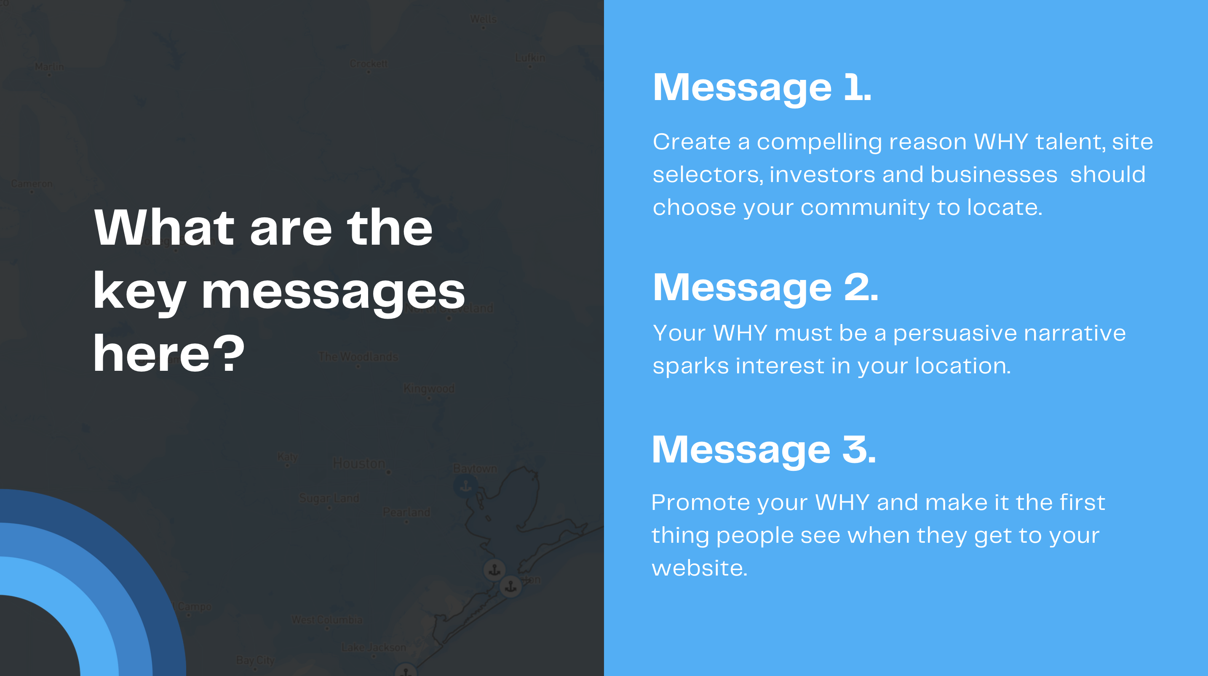

Slide 11
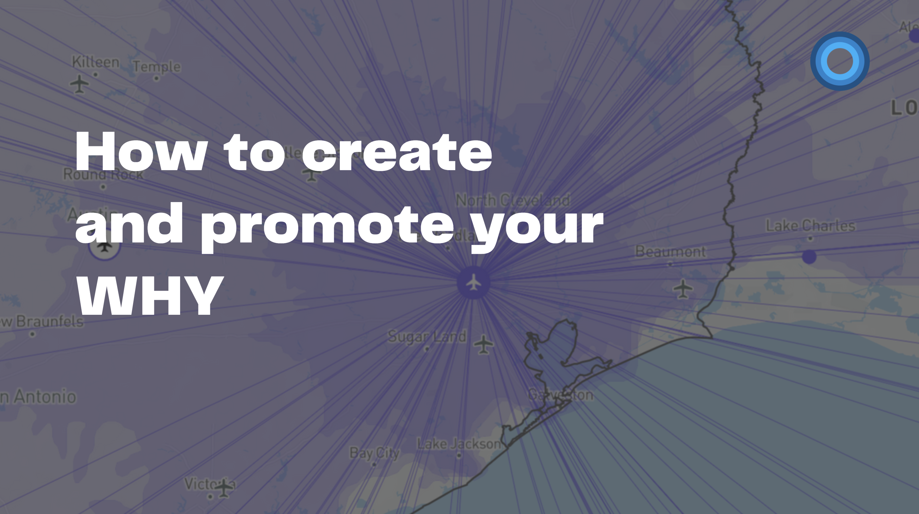

Slide 12
Notes:
Promoting your location’s “WHY” is the most essential element of your website.
But how do you do it?
Where do you start?
What should you include to make it compelling, engaging, and memorable?
Here’s a 4-step process to help you

Slide 13
Step 1.
Understand your target audience
If you really understand your target customer, you can create a compelling marketing narrative that grabs their attention, keeps them engaged and explains WHY your community is the right location for them.
Notes:
Step 1: Understand your target audience
All successful marketing starts with knowing your customers, what gets their attention and what they need to accomplish their goals.
In economic development, your “customers” are the people and businesses you are seeking to engage – site selectors, talent, small businesses, entreps

Slide 14
Who are your target customers?
Talent Attraction
Residents and workers
Business Attraction
Foreign direct investors, location advisors and corporate executives with site selection responsibilities
Business Retention and Expansion
Existing local businesses
Business Formation
entrepreneurs
Notes:
Step 1: Understand your target audience
All successful marketing starts with knowing your customers, what gets their attention and what they need to accomplish their goals.

Slide 15
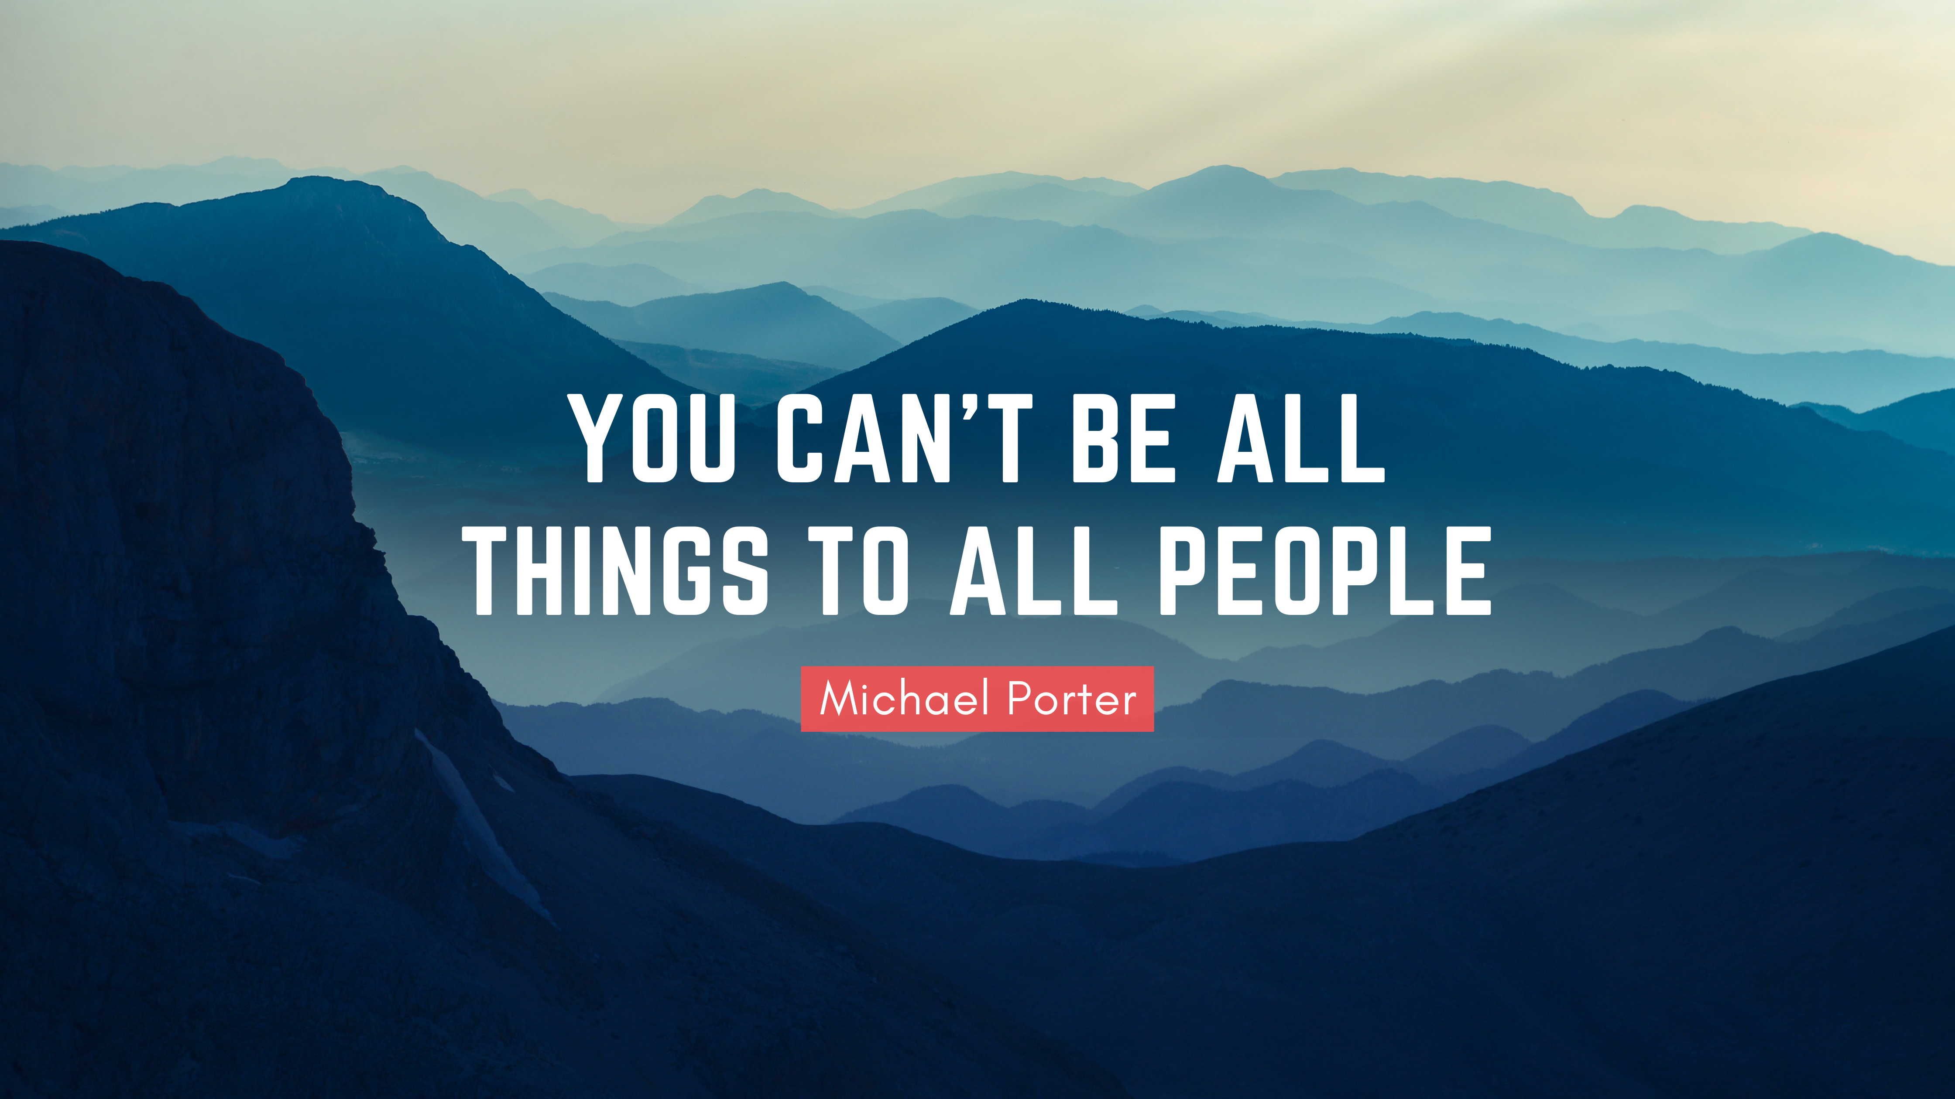
Notes:
Identifying and prioritizing which of these customer types you are targeting is essential as each have different needs and goals.
If you try to be all things to all people, you will end up creating a value proposition that is too broad.
It will be so vague that no one understands what makes your location special and your potential customers will turn to other, more specific options.

Slide 17
Customer needs differ
Site Selectors
Availability of skilled labor
Highway accessibility
Energy availability and costs
Quality of life
Labor costs
Occupancy or construction costs
Corporate tax rate
Tax exemptions
State and local incentives
Inbound/outbound shipping costs
Young Families
A strong network of supportive schools
Affordable housing
Everyday needs are right around the corner
Parks and activities to keep kids busy
Safe community
Health care
Sport and recreation
Proximity to work
Welcoming community
Remote Workers
Good internet access
Access to airports and/or larger cities
Convenience day to day living
Embrace an active lifestyle (indoors and outdoors)
Access to cafes, shopping
Pet friendly communities
Affordable housing
Safe community
Health care
Notes:
Start by thinking about what appeals to your target customer and how that can match up with what your location has to offer.
Put the needs of the customer first and determine the type of information that explains WHY your location can meet those needs.
For site selectors The latest survey of corporate executives by Area Development Magazine found the most important site selection factors are:

Slide 18
Step 2:
Assess your location advantages
Audit your assets, strengths and opportunities.
Match what your location has to offer with what matters most to your target customer/s.
Find a positive message for as many factors as you can.
Don’t be too critical of your location’s short comings compared to others.
Notes:
Step 3 – Prepare your elevator pitch
Document your WHY by creating a succinct elevator pitch.
Emphasize your location advantages that matter most to site selectors and promote them consistently throughout your marketing channels.

Slide 19
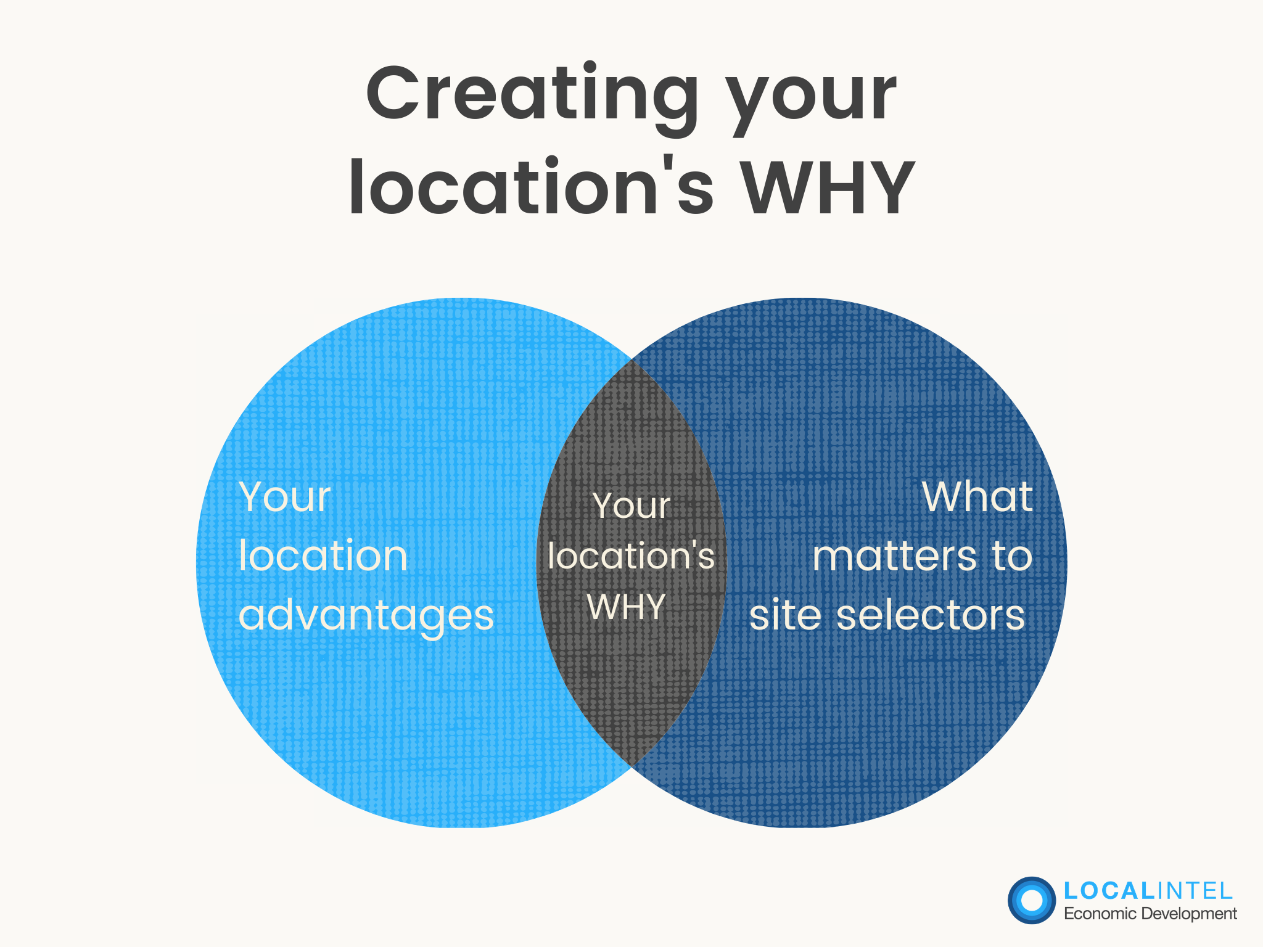
Step 3.
Prepare your elevator pitch
Notes:
Step 3 – Prepare your elevator pitch
Document your WHY by creating a succinct elevator pitch.
Emphasize your location advantages that matter most to site selectors and promote them consistently throughout your marketing channels.

Slide 20
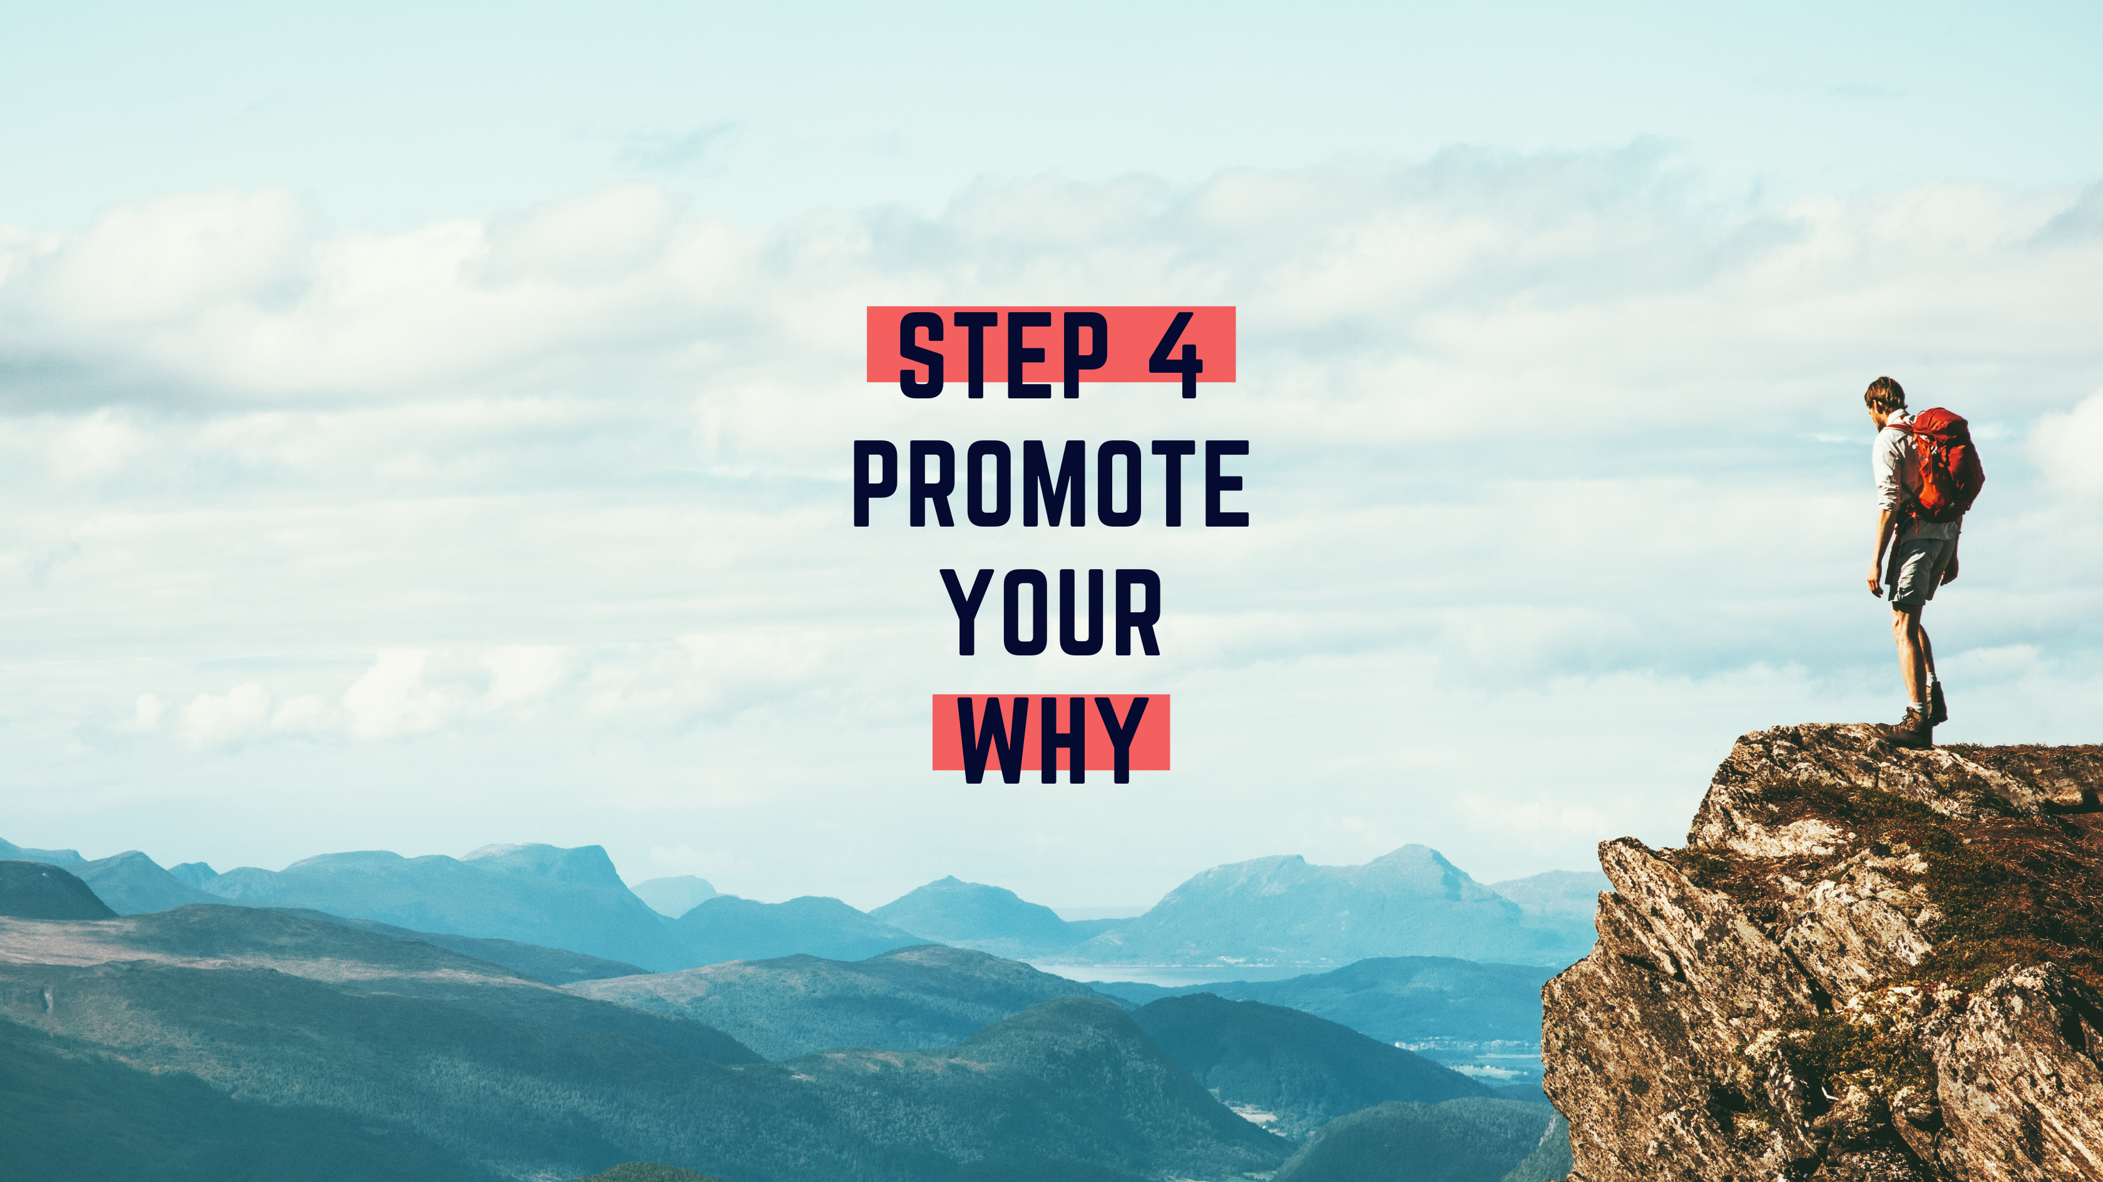

Slide 21
Marketing & Business Development Funnel
for economic developers
attract
A location advisor or corporate executive has started a site selection process. Your goal is to get their attention, spark curiosity and drive them to your website. Your marketing material should communicate your community’s WHY and explain how you are different than competing locations.
Awareness Stage
engage
A site selector lands on your website and is curious to learn more. They are still comparing options, so your immediate priority is to promote your location’s WHY and enhance engagement until they are ready to connect with you in person. Showcase your strengths in the “Why Us” or “Our Advantages” section of your website.
Consideration Stage
Assist
Your location is has been short-listed by a site selector and they are ready to undertake more detailed analysis as part of their due diligence. Your goal is to assist them with the information they need to build certainty, increase trust and feel confident in deciding that your community is the right location for their business.
Due Diligence Stage
Decision
Notes:
Lets start off with an overview of the marketing funnel

Slide 22
Marketing & Business Development Funnel
for economic developers
attract
A location advisor or corporate executive has started a site selection process. Your goal is to get their attention, spark curiosity and drive them to your website. Your marketing material should communicate your community’s WHY and explain how you are different than competing locations.
Awareness Stage
engage
A site selector lands on your website and is curious to learn more. They are still comparing options, so your immediate priority is to promote your location’s WHY and enhance engagement until they are ready to connect with you in person. Showcase your strengths in the “Why Us” or “Our Advantages” section of your website.
Consideration Stage
Assist
Your location is has been short-listed by a site selector and they are ready to undertake more detailed analysis as part of their due diligence. Your goal is to assist them with the information they need to build certainty, increase trust and feel confident in deciding that your community is the right location for their business.
Due Diligence Stage
Decision
Notes:
The awareness and consideration stages is where you want to be promoting your WHY

Slide 23
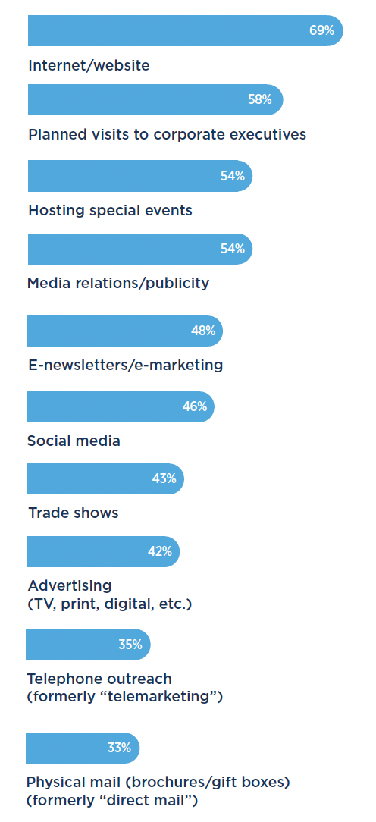
Most-Effective Marketing Techniques
(DCI 2020)
Notes:
The 2020 edition of Development Counsellors International’s Winning Strategies in Economic Development Marketing identified the most effective ways to market to location advisors and corporate executives

Slide 26
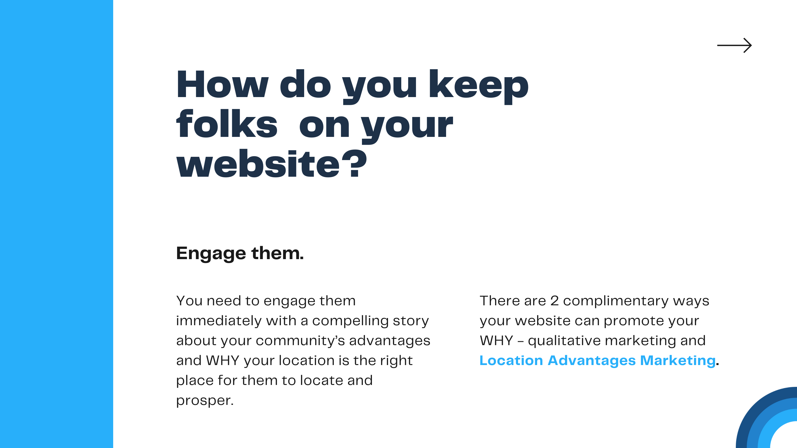

Slide 29
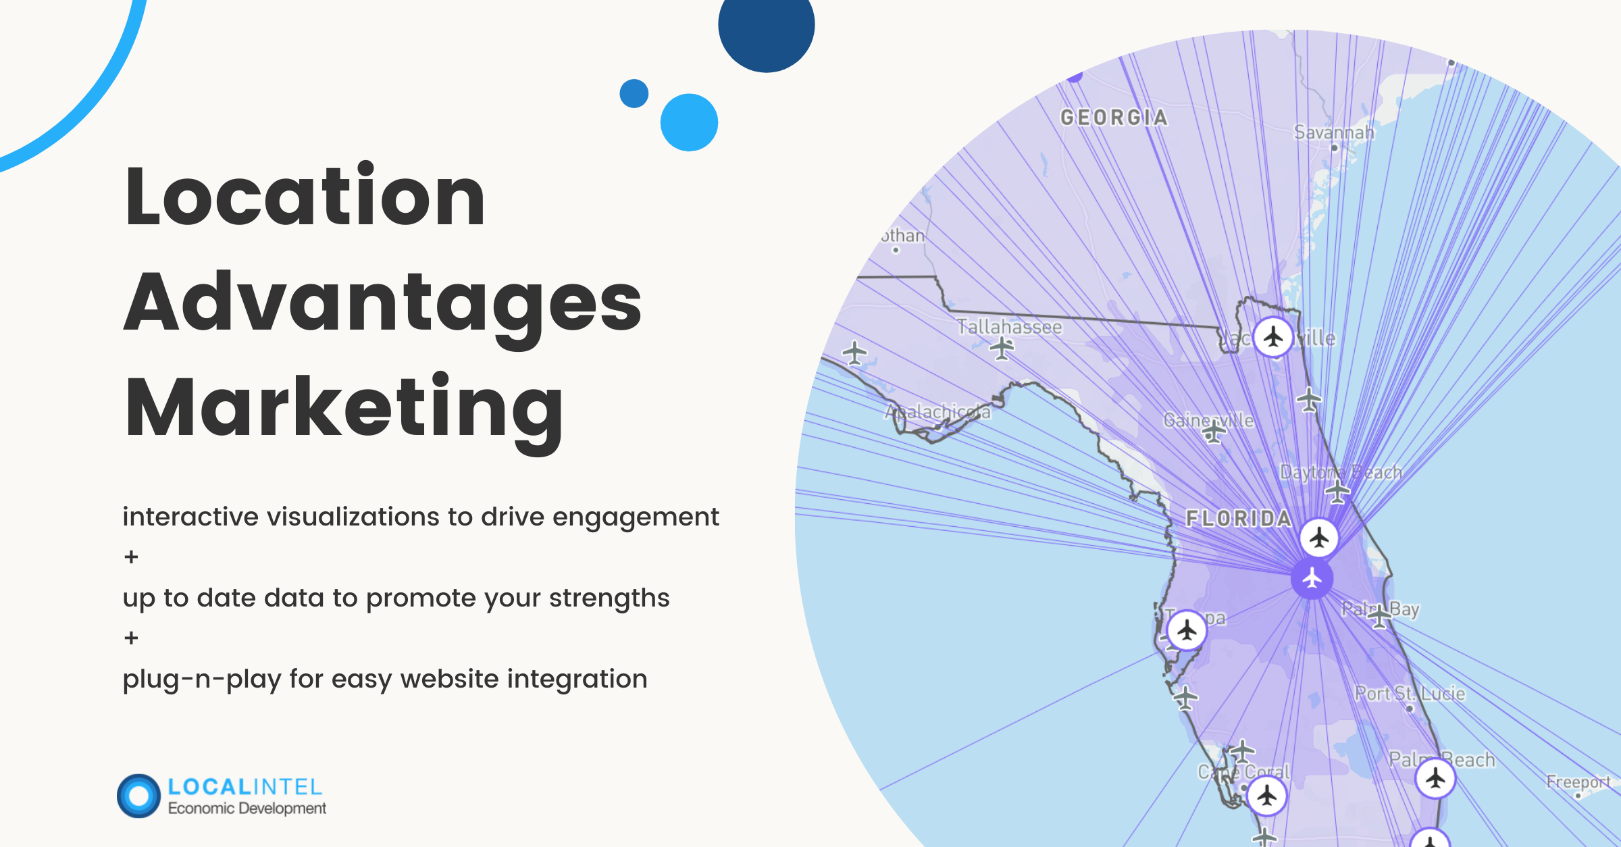

Slide 30
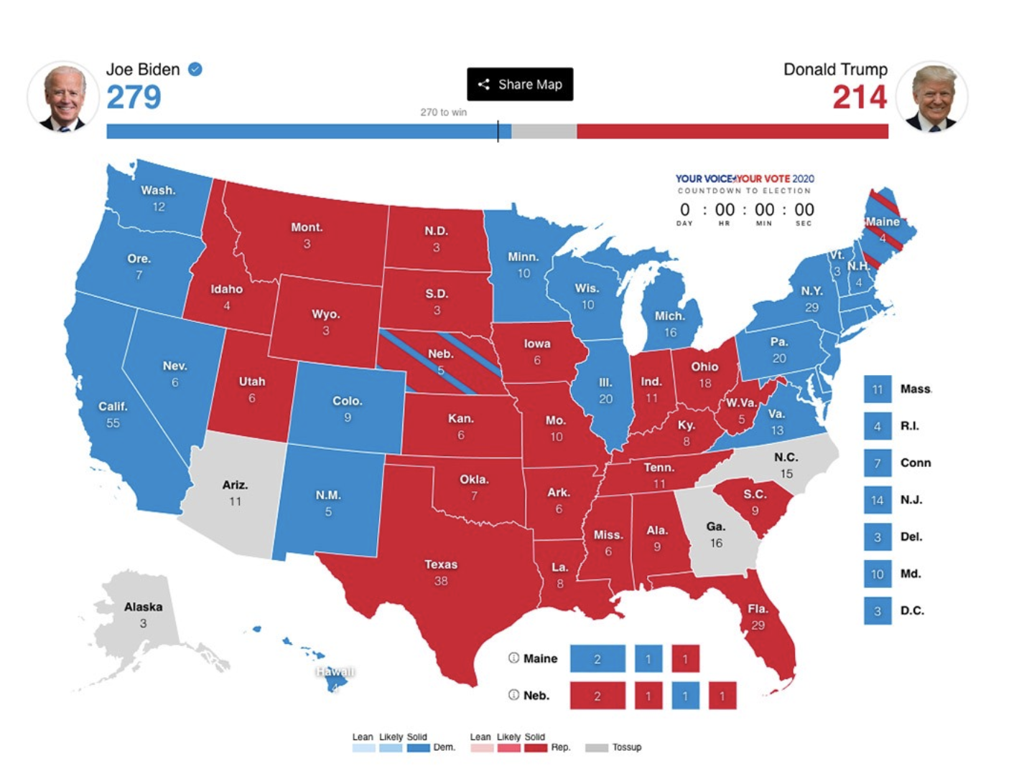
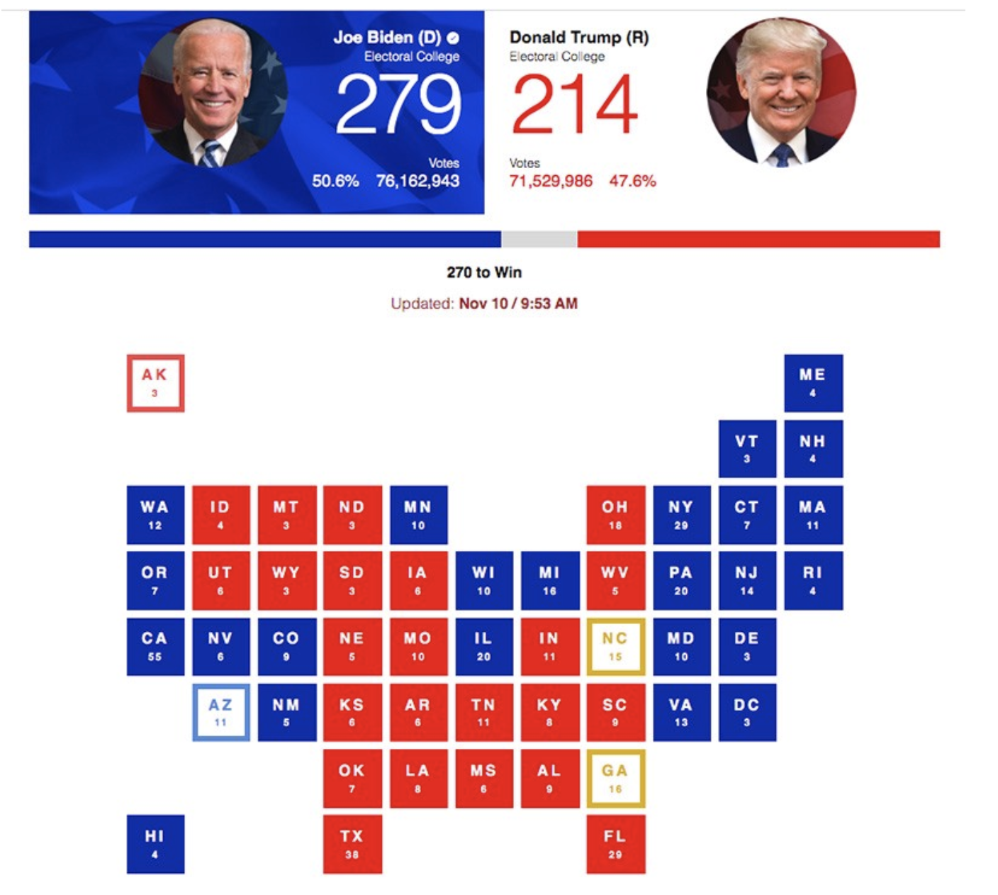
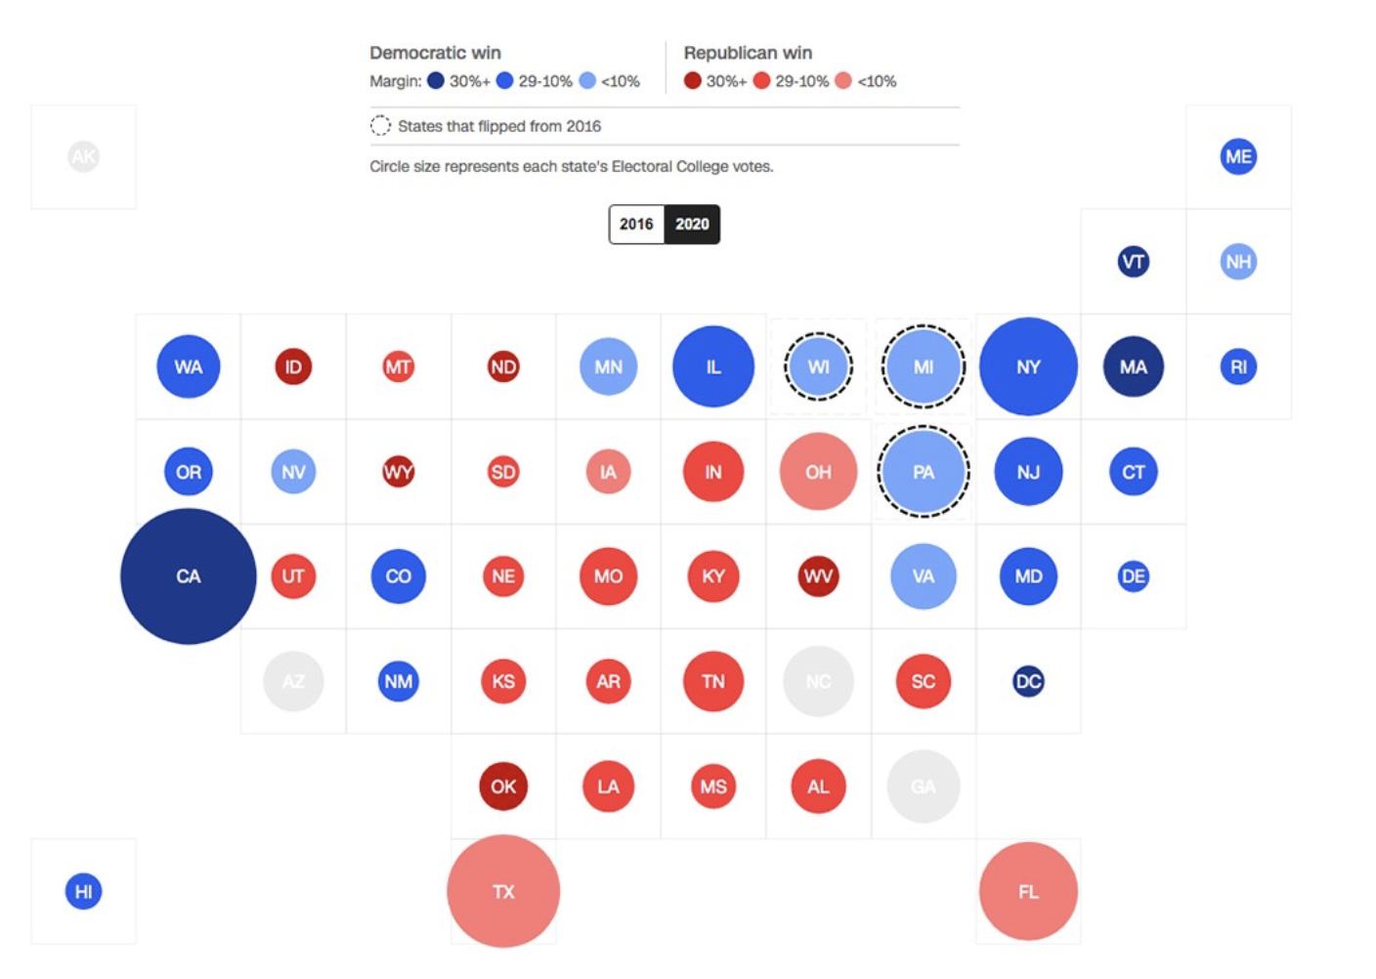
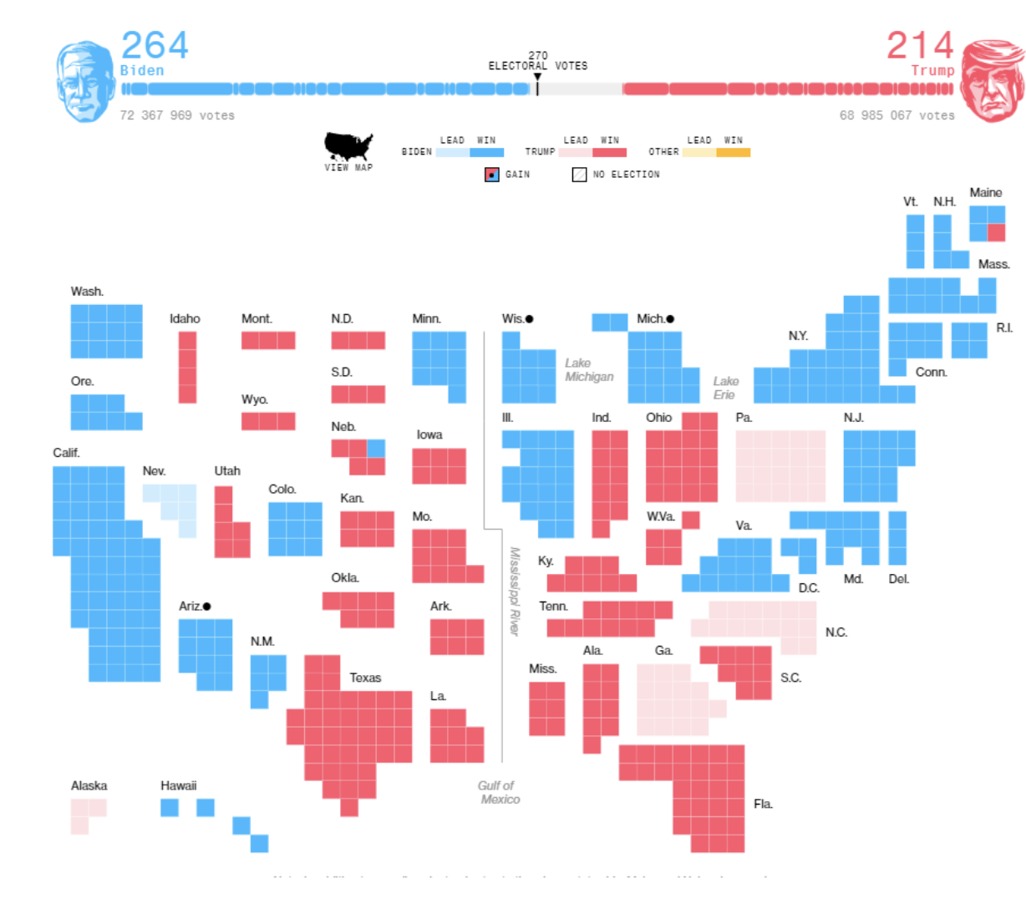
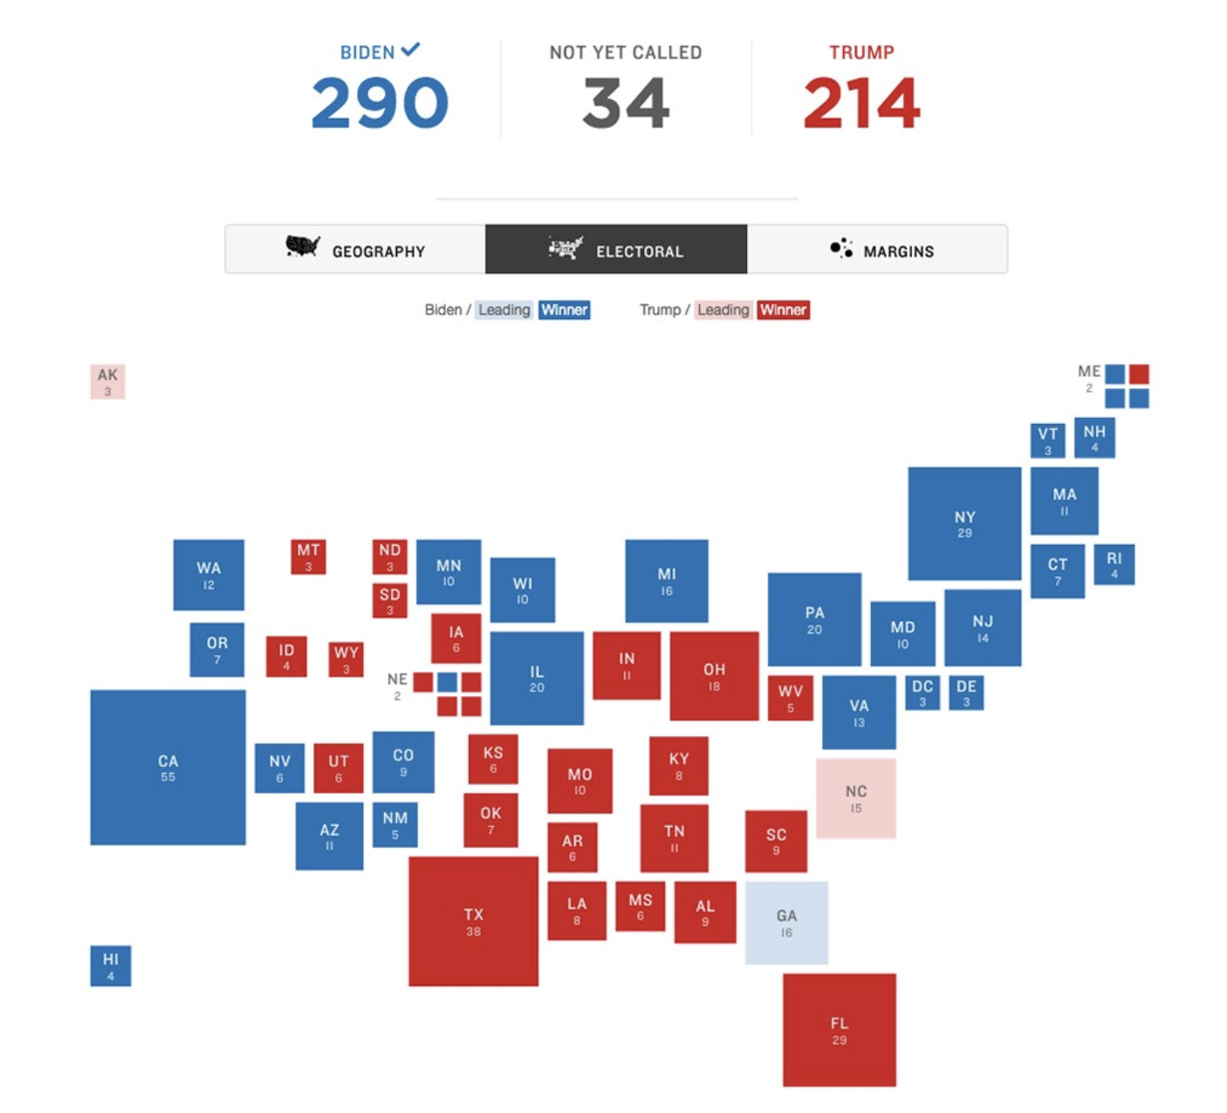
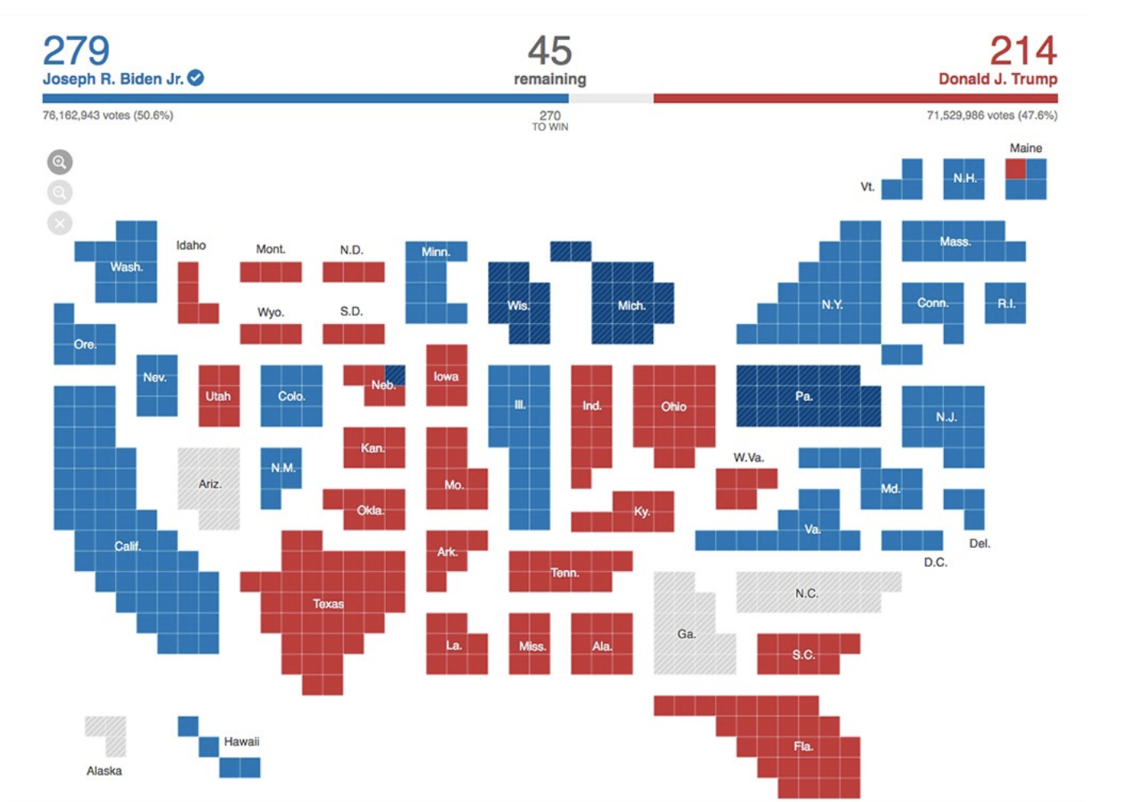
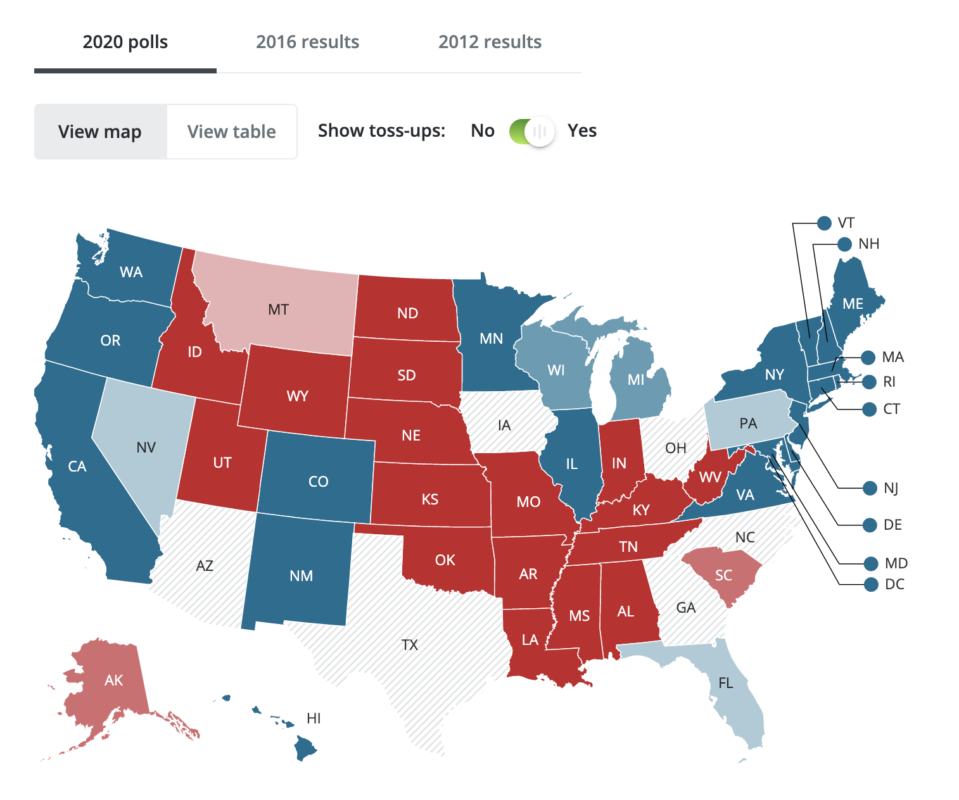
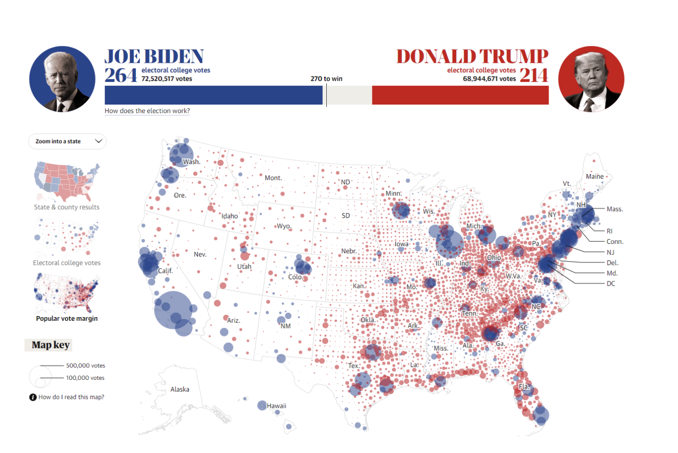
Who else is using visualizations to increase engagement on their website?
Notes:
The second way is LAM, which takes a leaf out of the book of modern day media sites.

Slide 32
Live examples

