Slide 1
THE MINDSHIFT
Rethinking our approach to economic recovery.
With Nail The Numbers Pro, Taunya Woods Richardson, CMC
©2022 Nail The Numbers, Incorporated

Slide 2
‘SMALL’ BUSINESSES IN SASK, 2020
146,016

Slide 3
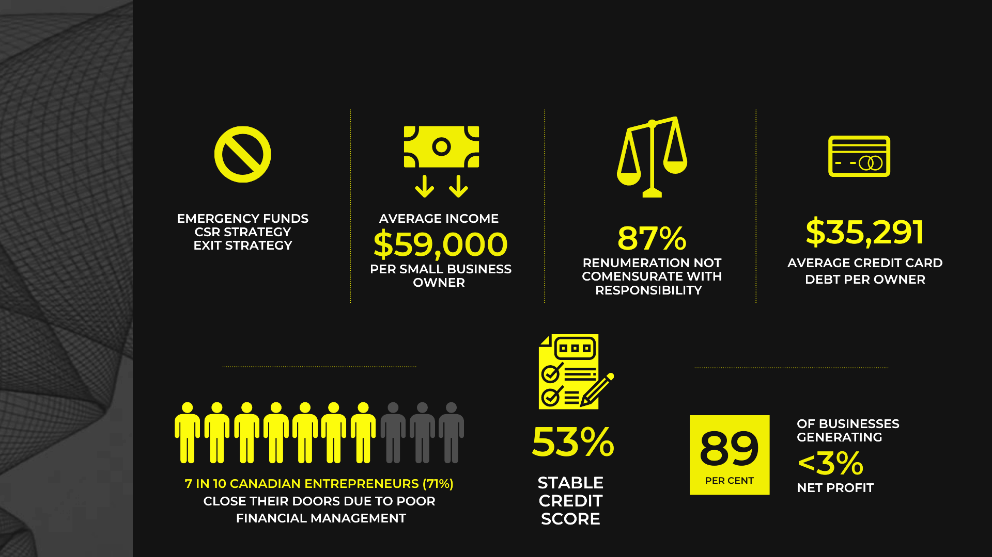
BY THE NUMBERS: BUSINESS
PRE COVID

Slide 4
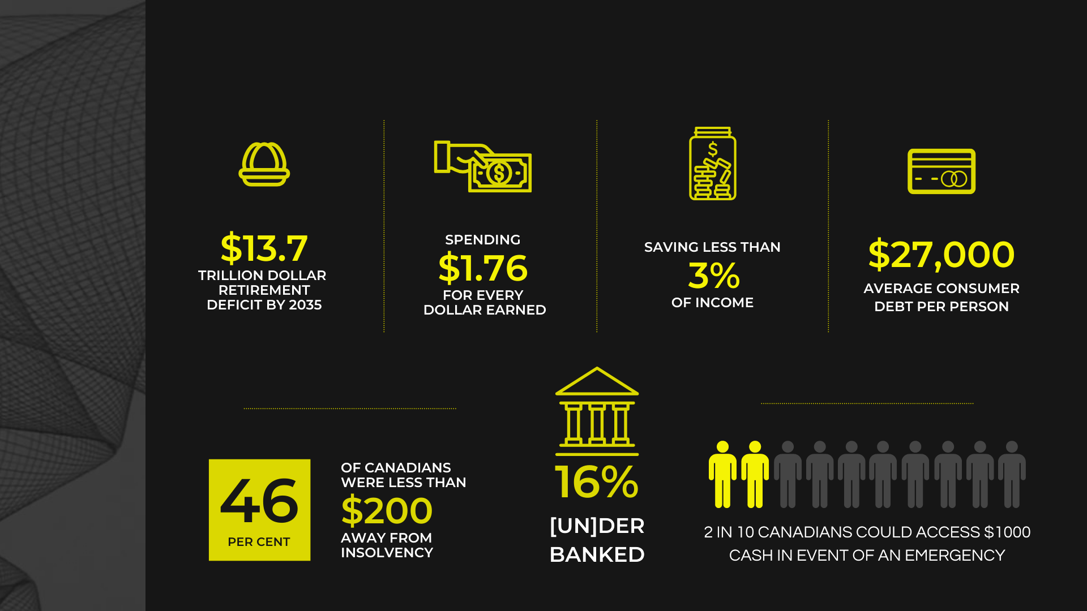
BY THE NUMBERS: PERSONAL
PRE COVID

Slide 5
FIRST PRINCIPLES APPROACH
GAP

Slide 6
WAKE UP CALL #1
ROI

Slide 7
WAKE UP CALL #2
COMP

Slide 8
CLARITY = CONFIDENCE
SPENDING
Needs / Wants / Splurge / Debt
Retirement Needs
+ SHARING
Giving / Donations / Taxes
= EARNING
Monthly Compensation Required
+ INVESTING
+ SAVING
Emergency Funds

Slide 9
WAKE UP CALL #3
RETIREMENT
SHORTFALL

Slide 10
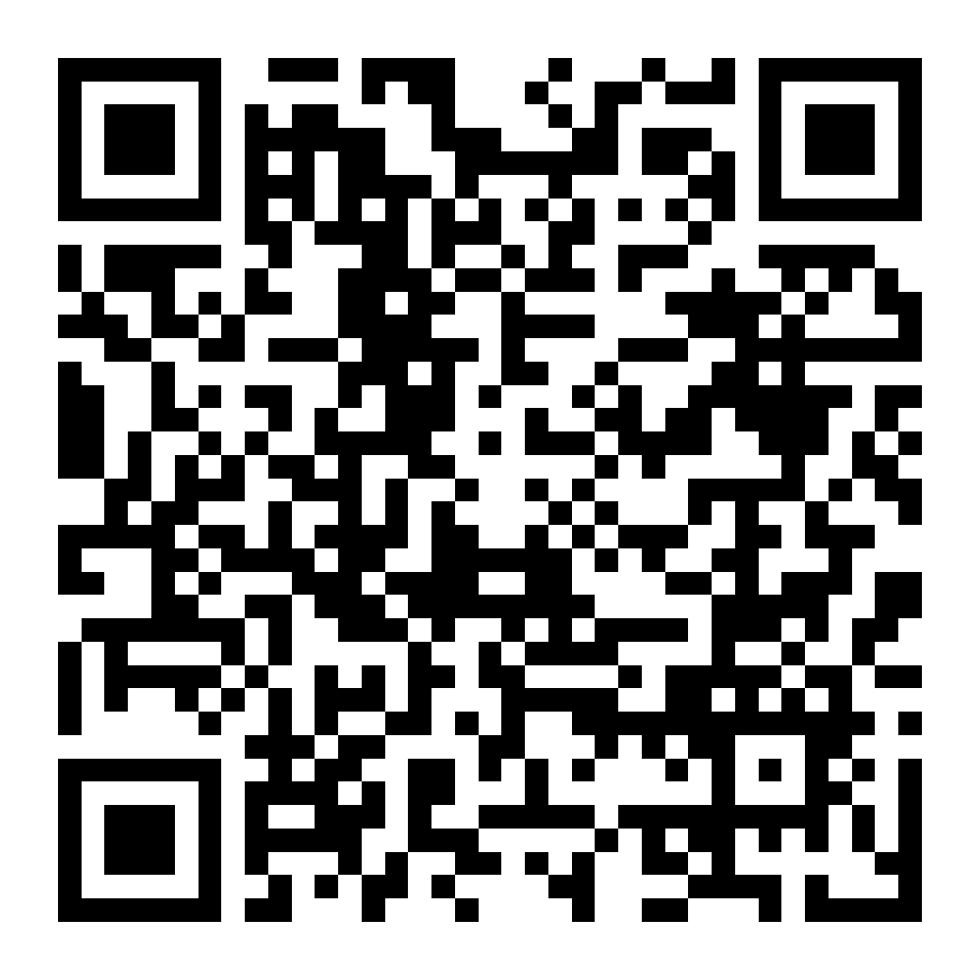
THE WAKE UP CALL CHALLENGE
CODE: wakeup22

Slide 11
GOAL ALIGNMENT

Slide 12
THE PLAN
Start with the end in mind.

Slide 13
FROM SMALL TO STEWARDS OF PROFIT
Small Biz Owner
Entrepreneur
Investor
Philanthropist

Slide 14
THE FINANCIALLY FIERCE FORMULA
Indirect Costs
Revenue Streams
Direct Costs
Planned Profit 11.5%
Profitable Price
Sales Strategy

Slide 15
THE FINANCIALLY FIERCE OUTPUTS
3 Year Cashflow
Quarterly Action Plan
Monthly Measurement

Slide 16
TEXT ‘YES’ + YOUR NAME
306.713.8321

Slide 17
TAUNYA WOODS RICHARDSON
TAUNYA@NAILTHENUMBERS.COM
1.844.844.3660

Slide 18
LET’S
GAP
FIX
THE
AND STRENGTHEN OUR ECONOMY

