Slide 1
BEAVER RIVER BROADBAND
The Local solution
the ‘last mile’ internet service Provider
Enhancing the Sasktel Network

Slide 2
MLTC Nations

Slide 3
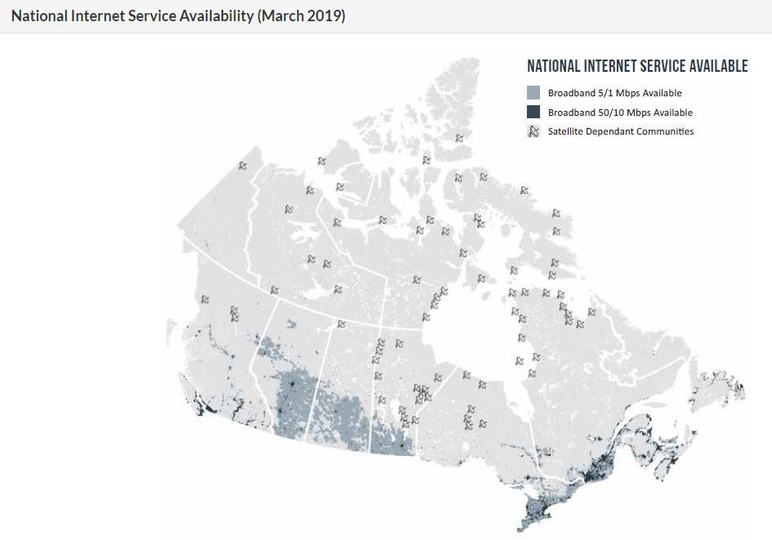

Slide 4
CURRENT CONDITION
MLTC Communities vary in quality and availability of broadband dependant on the community. Most have minimal service (5 Mbps) under the current SaskTel offerings
None of the MLTC nations meet the federal standard of quality 50 megabits per second download and 10 Mbps upload
2 of the communities have no cellular phone access and are still serviced by only copper lines making cellular internet access non existent
CRTC declares broadband internet access a basic service and the Government of Canada accepts this position but solutions the communities must address on their own
Ineffective service was highlighted during Covid when students were sent home from school, patients were unable to access distance healthcare options and people had difficulty accessing online platforms to work from home – internet access was highlighted as serious issue in our communities that needed to be addressed ASAP

Slide 5
OVERVIEW
MLTC was looking for Internet service to the 9 Nations
MLTC has requested SaskTel to provide service solution options
SaskTel came with a cost for pure fiber install to every household and brought Wood River Controls to price a Wi-Fi based solution that runs off the fiber that stops at the base of every MLTC community
The cost of fiber to every home runs in the $46 million range
It was determined that the wireless connection would build a good service that was upgradable and could be maintained effectively as well as offering a good customer service support system
This capital price tag in either scenario will be borne by the 9 communities
MLTC has applied to the Universal Broadband Fund for financial support for installation. Status of application continues to be unknown at this time.

Slide 6
THE BUSINESS OPPORTUNITY
MLTC service area was large enough to provide a cost effective service including good customer care not afforded by single communities trying to find a solution
MLTC intends to build companies to provide services to our own nations and to supply good quality service to any other nation or community who wishes to engage
Formation of a new Internet Service Provider
Partner WoodRiver Controls supplies service to over 1500 clients in southern SK so knowledgeable and quality service provider
Majority Indigenous owned
Maintaining our revenue in our communities – keeping that loonie circulating
Clear understanding of rural and remote needs and able to provide unique solution for each location
Master Service Agreement with SaskTel to make use of fibre backhaul ensuring availability of solid scalable service
Built for First Nations but access available for any municipal communities with same technology

Slide 7
RESULTS
Building the last mile of Internet service to every home in 9 First Nations
Cowessess First Nation accepted our services on reserve
Bringing internet to 2500 homes with one project
Use of fibre brought to the edge of the community by SaskTel but not disseminated into the community due to cost for capital install to each home and lack of financial ability for individual homeowners or communities to complete the last mile of installation to the home.
This created solution would open access for neighboring municipalities to obtain the same service off the new installed broadband towers
Potentially as many as 12,000 people in the North West impacted with new access for both First Nations and neighboring municipalities
Agreement exists with Sasktel to use their backhaul from cell tours to piggy back the broadband from newly built towers in each First Nation (less expense using existing infrastructure)
Completing all 9 projects together allows for economy of scale and ability to negotiate a better deal with Sasktel for access to fiber optic cable.

Slide 8
john.degraauw@woodrivercontrols.com
1- 639-931-7800
tina.rasmussen@mltcii.com
1-306-832-2104

