Slide 1
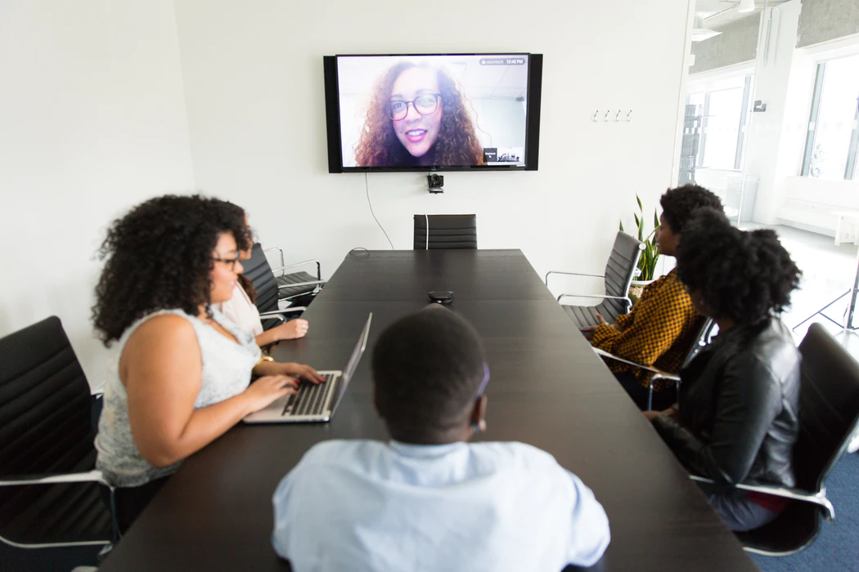
Workforce Strategies for the Future
of Work in a Post-COVID World
September 2022
Notes:
Stephen Harrington, study the future of work.
Get a bias on the table right away. Everything has changed, we’re at an inflection point. The hardest thing to do is find the time to think about how fundamental the change could be.
Next normal example. Starting with “where”? Predict those models won’t last. Those that anchor in strategy will. In other words, the Future of Work as a topic isn’t about HR issues. It’s about how we build capability and capacity to execute our strategies in the future, and how there are a whole new set of options available – a whole new war for talent.
Going to cover:
What have we learned this far into the pandemic?
What’s emerging next that we need to think about?
And what we can do, starting now to get ready

Slide 2
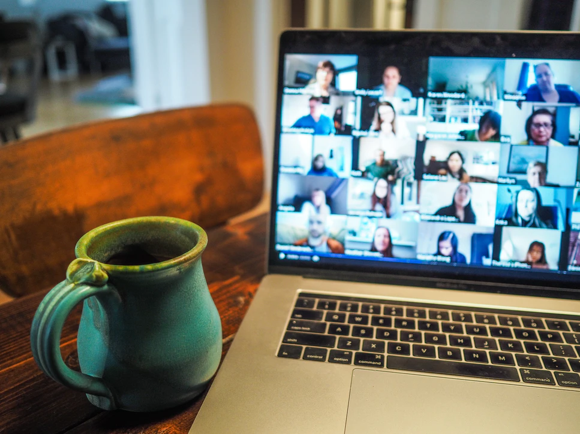
What have we learned?
Notes:
Our new POV for 2022 finally has some data to try to explain what’s happened through the pandemic

Slide 3
We proved remote can work…
Across the globe, organizations were faced with the challenge of adapting quickly to remote and hybrid work
BY THE END OF 2021…
Remote workers will represent 32% of all employees worldwide, compared to 17% of employees in 2019^{1.}
Canada is no exception with 32% of employees working remotely, compared to 4% in 2016^{2.}
51% of all knowledge workers worldwide are expected to be working remotely, up from 27% of knowledge workers in 2019¹.
AND
IN 2022…
37%
28%
52%
30%
53%
33%
32%
In the world:
The US will lead in terms of remote workers with 53% of their workforce¹. UK, Germany, and France will have 52%, 37% and 33% of their workforce working remotely
India and China will produce some of the largest numbers of remote workers, but with relatively low penetration rates with 30% of workers in India and 28% of workers in China being remote¹
In Canada:
Heading into 2022, 39% of workers prefer to work most or all of their hours remotely, while 41% prefer working half of their hours remotely. Only 20% prefer mostly working in person.
The vast majority (90%) of new teleworkers report being at least as productive at home as they were at their workplace
Notes:
First of all, the horse has left the barn on hybrid work. You can see it by the numbers here. Incredible how consistent the trend is across major economies. Recently saw another stat that said 80% of Canadians that worked from home during the pandemic, would like to continue to work from home the majority of the time post-pandemic.
Organizations see the tension coming. On the one hand they feel they need to compete in a talent market that will be offering more flexibility, on the other they don’t like the risks to culture and all the other benefits a physical workplace brings (e.g. innovation). No wonder Hybrid is the most popular ‘best of both worlds’ response at this stage.
SOURCES:
“Gartner Forecasts 51% of Global Knowledge Workers will be remote by End of 2021,” Gartner. June 22, 2021.
https://www150.statcan.gc.ca/n1/pub/71-607-x/71-607-x2020009-eng.htm
https://www.ipsos.com/en-ca/news-polls/only-half-of-Canadians-say-they-expect-to-return-to-office?__cf_chl_managed_tk__=qK6NTbluZu894qcyTtVneTg52Y60HYF5VYZuijoBAX4-1641423262-0-gaNycGzNCOU
ADDITIONAL STATS:
5% of Europeans regularly worked from home before COVID-19, now 12.3% of Europeans regularly work from home. (“COVID-19: How many remote workers are there in different parts of Europe?” World Economic Forum. May 21, 2021.)
62% of workers with a Bachelor’s degree or more education say their work can be done from home BUT only of those without a four-year college degree say they can (Kim Parker, et al, “How the Coronavirus Outbreak Has – and Hasn’t – Changed the way Americans Work,” Pew Research Center. December 9, 2020.)
61% of millennials and 58% of Gen Z would prefer to use video conferences instead of traveling for work (Deloitte Millennial Survey, 2020)
80m Americans will be working remotely in 2021 and 36M will be working remotely in 2025, an 85% increase from pre-pandemic levels (Upwork, December 2020)
11,718% increase in Medicare beneficiaries using telehealth - from 11,000 members for the week ending March 7 2020 to 1.3 million members for the week ending April 18 2020.
85% of CEOs agreed COVID significantly accelerated their digital transformation
U.S. employers added 50,000 new enterprise-technology workers in March 2021, marking the fourth month of consecutive gains in the field, (source)

Slide 4
…but certain populations were left behind
The pandemic has had disproportionate effects on certain segments
in senior positions (SVP or C-Suite) are thinking of leaving their jobs, compared to 1 in 6 men in such roles, and 1 in 4 women at the beginning of the pandemic¹
In March 2020, employment losses for women accounted for 62.5% of overall employment losses in Canada³
1 in 3 women
…AND…
56% of working moms describe themselves as “surviving” or “struggling”
…while 44% describe themselves as “thriving”²
The unemployment rates for young (under 24) and experienced (above 55) Canadian workers are higher than the overall rate⁴
2/3 of the world’s school-aged children – 1.3 billion children ages 3-17 – do not have internet connection in their homes…
1.3B
…this prevents them from learning vital skills needed to compete in the modern economy⁵
Notes:
But before we get too excited about a coast-to-coast-to-coast labour market that shakes off geographic constraints and improves labour market attachment for all… let’s remember as it stand today who benefits.
For those that are enjoying the benefits of working from home there is a wellness challenge that must be addressed – privilege needs to be addressed. And for those that can’t work from home… could we imagine a future with ‘something for everyone?’
Tell the site inspector story… where, to when, to how
SOURCES:
“The state of women in corporate America,” McKinsey/Lean In. September 2021.
“The Next Great Disruption Is Hybrid Work – Are We Ready?” Microsoft, March 22 2021
https://www150.statcan.gc.ca/n1/en/pub/36-28-0001/2021005/article/00005-eng.pdf?st=E51FcqN1
https://www150.statcan.gc.ca/t1/tbl1/en/cv.action?pid=1410028702
“How many children and young people have internet access at home?” UNICEF. December 1, 2020.
ADDITIONAL STATS:
The financial services sector recovered 94% of its pre-pandemic employment (Business Insider) BUT In New York, as of December 31st 2020, the number of small businesses open decreased by 27.1% compared to January 2020 (Opportunity Insights Economic Tracker)
Jobs With Biggest Recoveries or Losses Since Pandemic Start” Business Insider, September 2020
“Percent Change in Numbers of Small Businesses Open” Opportunity Insights Economic Tracker, February 1, 2021
Dan Burns, “U.S. Black-white unemployment rate gap widens again in July,” Reuters, August 7, 2020.
Approximately 65% of workers with a bachelor’s degree or higher teleworked during COVID-19
22% of workers with a high school diploma or less teleworked
“How might internet connectivity affect health care access?” Kaiser Family Foundation. December 14, 2020.
With vaccine-appointments being primarily reserved online, the digital divide in the United States has become a matter of physical health and safety:
32 million American adults don't have sufficient knowledge to navigate a computer.
25 million people in the U.S. did not have internet access at home in 2019.⁴

Slide 5
2020 and 2021 ushered in the “Great Exhaustion”…
48%
of Canadians new to remote work report accomplishing more work per hour¹
35%
note that their hours have increased since the onset of COVID-19¹
AND
Globally, Gen Z workers are the least satisfied generation at work, with only 56% satisfied with work-life balance and 59% satisfied with their job overall²
Business leaders are faring better than employees, with 61% thriving³
GLOBAL WORKFORCE SENTIMENT³
54%
of respondents feel overworked
AND
39%
of respondents feel exhausted
Notes:
Diving deeper, we’re tired. You’re tired right? I’m tired, no sense pretending. This has been hard. We’re all feeling the lose of freedom, and that exhaustion is impacting our workforce.
And our leaders! Not enough conversation about how that group is struggling, and needs support.
Sources
https://www150.statcan.gc.ca/n1/daily-quotidien/210401/dq210401b-eng.htm
Rachel King, “What’s fueling ‘The Great Resignation’ among younger generations?” Fortune, Aug 26, 2021
Based on a survey of 3,400 enterprise workers in the United States, the United Kingdom, Germany, Australia, New Zealand, and Japan
3. “The Next Great Disruption Is Hybrid Work—Are We Ready? – Microsoft Work Index,” Microsoft, March 22, 2021
Additional Stats
The numbers are discouraging, for both men and women: 42% of women and 35% of men in Corporate America have felt burned out in the last few months (up from 32% and 28% respectively last year) (Source)
Women seem to be more likely to experience burnout, with 80% of women reporting burnout vs. 72% of male workers (Source)
Gen Z (57%) and millennials (54%) feel most pressured to be available at all times and are most likely to describe their job as repetitive (65% and 58%, respectively) and tiring (65% for both). (Source)
Of those with a burned-out manager, 73 percent said "many" of their team members also seem burned out. Of those without a burned-out manager, only 22 percent said the same. (Source)

Slide 6
…and led economists to coin the term the “Great Resignation”
According to OECD, about 20M fewer people are working than before COVID-19 struck…
A Microsoft study of more than 30,000 global workers found that 41% of workers were considering quitting or changing professions this year¹
…of these, 14M have exited the labor market¹
30.3%
The number of Canadians who left their jobs because of “dissatisfaction” has nearly tripled since June 2020
Canadian businesses reporting labour shortages, especially in accommodation and food services, transportation and recreation and tourism²
Notes:
Big debate in Canada about whether the great resignation is happening in Canada. Certainly US turnover numbers are higher… but leave intention and dissatisfaction is increasing in Canada.
My opinion
It would be plain hubris to assume we’re going to be immune to these turnover challenges
Even if Canada can maintain an unhappy workforce that for some reason refuses to actually quit, is that better?
Sources
Ishaan Tharoor, “The ‘Great Resignation’ goes global” Washington Post, Oct 18 2021
Note: those that have exited the labor market are classified as “not working” and “not looking for work”
https://www.ctvnews.ca/canada/these-canadian-industries-are-currently-facing-the-biggest-labour-shortages-1.5612004
Additional Stats
In both June and July, the rate of voluntary quits was 2.7% of the U.S. workforce. In August, the turnover rate was 2.9%. Those numbers mark unprecedented churn: the 4.3 million people who quit in August 2021 was roughly 20% higher than the number of resignations in August 2019, and more than 40% higher than the number who quit in August 2020. (Source: Time)
Other sources
Kate Morgan, “The Great Resignation: How employers drove workers to quit” BBC, July 1 2021
Ian Cook, “Who is Driving the Great Resignation?” HBR Sep 15 2021
Alyssa Fowers, Rachel Siegel, Andrew Van Dam, “The permanently temporary 2021 economy, in charts” Washington Post Oct 16 2021

Slide 7
New worker preferences are here to stay
The pandemic was a catalyst for remote work, with many now realizing the benefits of flexible working models
9 out of 10 of Canadian workers want flexibility in where and
when they work
The dread and anxiety of the past year are giving way to a new kind of professional fearlessness…
54% of Canadian employees are willing to quit their job if not offered the flexibility they want²
…a daredevil spirit seems to be infecting even the kinds of risk-averse overachievers who typically cling to the career ladder⁴
Notes:
SOURCES:
Libby Cherry, “The Hybrid Work Revolution Is Already Transforming Economies” Bloomberg, August 26 2021
Work Reimagined Employee Survey 2021, EY
What we learned about ourselves in lockdown,” Axios/Harris Poll. March 15, 2021.
The Worker-Employer Relationship, 2021 Deloitte HC Trends Special Report
NYTs, https://www.nytimes.com/2021/04/21/technology/welcome-to-the-yolo-economy.html, April 22 2021
Additional Stat:
68% of employees would consider quitting their current job and working with an organization with a stronger viewpoint on the social issues that matter most to them. (Gartner)
“Individual YOLO decisions can be chalked up to many factors: cabin fever, low interest rates, the emergence of new get-rich-quick schemes like NFTs and meme stocks. But many seem related to a deeper, generational disillusionment, and a feeling that the economy is changing in ways that reward the crazy and punish the cautious.” - NYT
ADDITIONAL STATS:
¾ of employees expect their employer to take a stance on current societal or cultural issues, even if those issues have nothing to do with their employer (Gartner)
One in four London and New York respondents were thinking of leaving their global cities. Of the people who said they wanted to move, many felt that the pandemic influenced their desire to move — as much as 71% in New York City. (Gensler)
According to a LinkedIn study, Austin, Phoenix, and Nashville gained the most new workers and New York, San Francisco, and Hartford, CT lost the most between April and October of 2020 (LinkedIn)

Slide 8
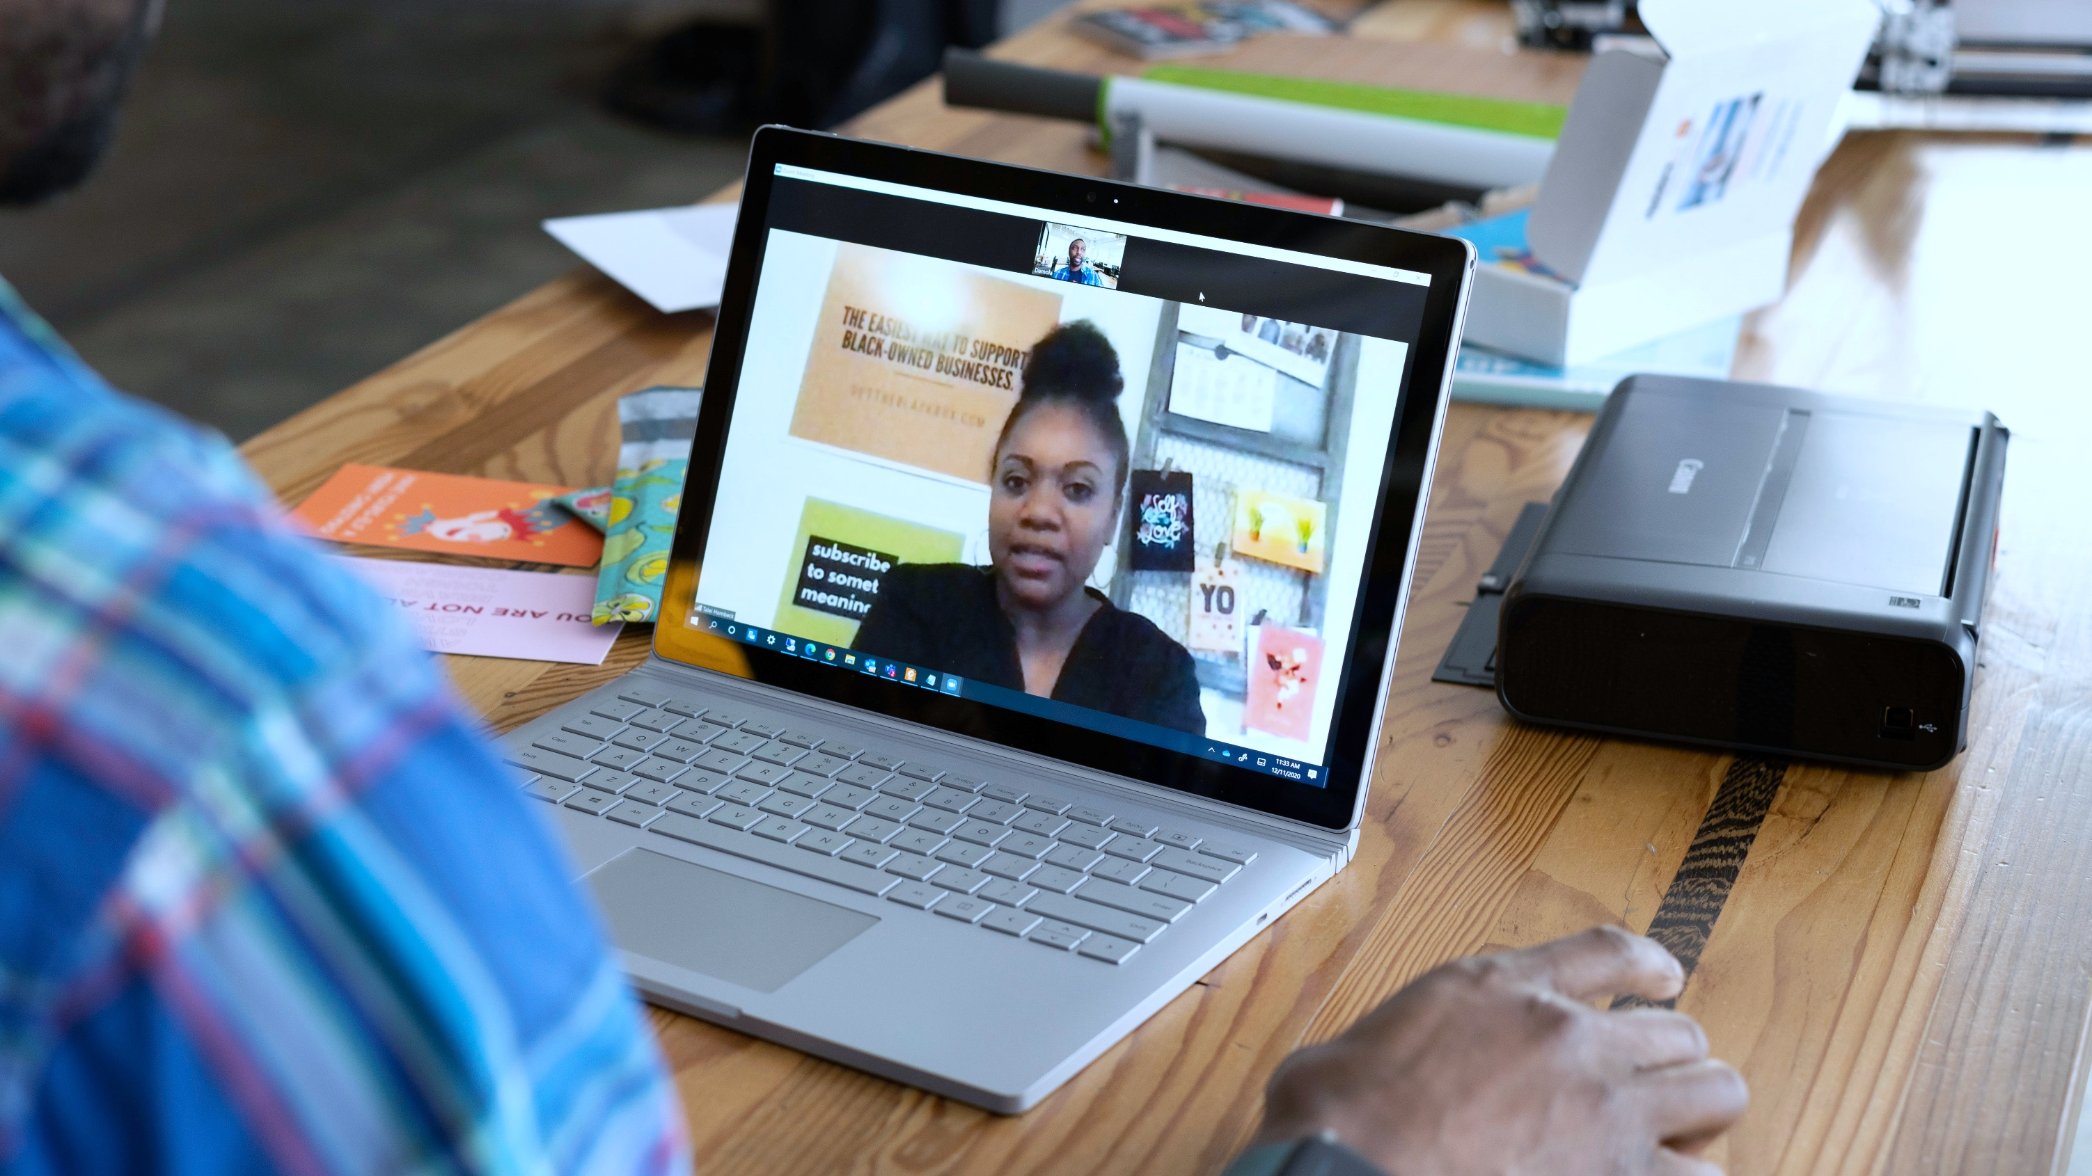
WTF
What’s the Future?

Slide 9

Human potential is becoming our greatest untapped asset
Unleash human potential with tools, technology and processes that empower people to break through hierarchy and bureaucracy
Internal talent marketplaces allow companies to retain existing talent^{1,2}
Gallup found that millennials rank the opportunity to learn and grow in a job above all other considerations, and 69% of non-millennials say it is important to them³
At Unilever, within 60 days there were 700+ posted business critical projects and 26,000 unlocked hours
YET
As of the end of 2020, over 500,000 hours had been unlocked from the talent marketplace
72% of executives identified “the ability of their people to adapt, reskill, and assume new roles” as the first and second most important factors in disrupting work
Only 4 in 10 employees
BUT
strongly agree they have opportunities at work to learn and grow³
only 17% say their workers are very ready for this
Notes:
Talk about internal talent marketplaces. Admit this is a large organization concept, but if you think about how you could access workers in an ecosystem its something small and medium sized employers can think about as well.
Talent wants to move, experience different problems and learn new skills
We can leverage that fungibility to get things done
The concept of the ‘full time job’ is holding back our thinking here. I’ve long believed a future workforce model includes your tight core of talent… the capabilities that differentiate you, that give you advantage – and that core is surrounded by flexibly models: internal talent markerplaces, contractors, consultants, gig workers… specialized talent you can access just-in-time
SOURCES:
Unilever
July 2021 Deloitte Human Capital Trends Report
“Workplace Learning and Development Programs.” May 2021. Gallup

Slide 10
Productivity is taking on new meaning
Organizations have leveraged new ways of working to boost productivity, but the increase has not been uniform
WORK EFFECTIVENESS
WORK
EFFICIENCY
WORKFORCE EMPOWERMENT
3.1%
annualized growth in output
per hour since the crisis began, compared with 1.4% in the previous business cycle, per Goldman Sachs economists¹
According to an experiment conducted by Microsoft Japan, a move to a four-day work week resulted in a 40% increase in productivity²
Nearly 4 in 5 professionals said they make use of windowed work—the ability to break their day into chunks of professional and personal time. Of them 73% said the arrangement helps them be more productive³
Notes:
Presenteism hang-over
Is the 4day work week the future? A tech determinist would say yes, and hurry up about it
« Windowed work »
SOURCES:
Enda Curran, “Goldman Says Pandemic Is Shaping a More Productive U.S. Economy,” Bloomberg. July 13, 2021
Lisa Eadicicco, “Microsoft experimented with a 4-day workweek, and productivity jumped 40%,” Business Insider. November 4, 2019.
Robert Half, “Survey: A Window Into Windowed Work,” Cision PR News Wire. June 30, 2020.
SPEAKER NOTES:
Work Effectiveness: Give your team clarity, capacity, and commitment to its outcomes to work EFFECTIVELY
Work Efficiency: Do away with legacy organizational, function, and team practices that do not help achieve desired outcomes so your team can work EFFICIENTLY
Workforce Empowerment: Prioritize wellbeing and engagement and establish wellness norms that can help drive sustainable productivity over time so your team can feel EMPOWERED

Slide 11
The history of work
POST-INDUSTRIAL REVOLUTION
2020s
WORK
RE-ARCHITECTED
  COST
  VALUE
  MEANING
INDUSTRIAL REVOLUTION
2000s
LEAN SIX SIGMA
Focus on Outcomes
1950s
WHITE COLLAR TAYLORISM: KAIZEN
Process optimization
1913
ASSEMBLY LINE
Identify and
eliminate waste
1820s
TAYLORISM
Produce more in
less time
Scientific management
Focus on Output
Notes:
Work in the centre.
Early stages were about speeding up tasks. Organizing tasks in an assembly line. Shifting through things like Kaizen and Lean Six Sigma to a focus on processes.
Now is the time to take tasks and processes out of the centre of our focus. And instead start with Humans in consideration of costs (stop doing low value tasks, and focusing humans on higher order work) value (using the higher value work to connect meaningfully with employees) and ultimately meaning… better jobs, better outcomes.
Customer service job. 30% of the time was transaction processing. Light automation toolset to remove. Data analytics toolset to improve customer insights. New skills for employees to utilize data for decision making, and to share insights with customers. 15% of save time driving insights, 15% more time with customers.
“The world is experiencing a third great Promethean moment, after the Printing Press and the Industrial Revolution.” - Thomas Friedman
The Industrial Revolution has focused on optimization and efficiency, moving from Taylorism to Assembly Line, to White Collar Taylorism, and Lean Six Sigma
First in how humans work – the steps they take – and, then the automation of what human do
The focus then turned to taking out waste, and process optimization
The focus still on the process.
To capitalize on the moment we face now, we need to think about our call to action—about what is next
This is our Promethean moment (as Tom Friedman says) – our chance to operate in a radically different world and reimagine the future of work

Slide 12
Where we are now
We have been adding technology to the workplace, but we have not stopped to look at the work, workforce or workplace
A recent Goldman Sachs study estimates …
Over ~1 trillion hours lost on inefficient tasks from the disconnected workplace, totaling ~800 hours of wasteful work per year per employee¹
Communication Platforms
Teams
Paper Documents
270 hours in unnecessary meetings
209 hours in duplicative work
320 hours on context switching¹
Teams
Email
Institutional Knowledge
New Technology Solutions
AND
A recent Microsoft study showed that weekly meeting time has increased 148% and the number of emails delivered in February 2021 increased by 40.6B when compared to
February 2020²
Teams
Teams
Legacy
Systems
Notes:
It’s time we think from the work out, because the way we’ve been building our tools isn’t working.
SOURCES:
Goldman Sachs, The Future of Work, July 2020
“The Next Great Disruption Is Hybrid Work – Are We Ready?” Microsoft, March 22 2021

Slide 13

What do we do?

Slide 14
We must look at work, workforce, and workplace through an enhanced lens
Rearchitect the Work
WORK
The activities performed and technology applied to produce work outcomes and create value
Value of Work
Outcomes of Work
Tasks/Process
Technology
Unleash the Workforce
Adapt the Workplace
WORKFORCE
WORKPLACE
The combination of skills, talent options (such as FTEs, contractors, gig workers, crowd sourcing), jobs and teams to perform the work
The context and environment in which work is done including physical design and technologies, collaboration, culture, and workforce preferences
Skills
Human Capabilities
Talent Options
Jobs
Geographic Location
Physical Design
Culture
Collaboration

Slide 15
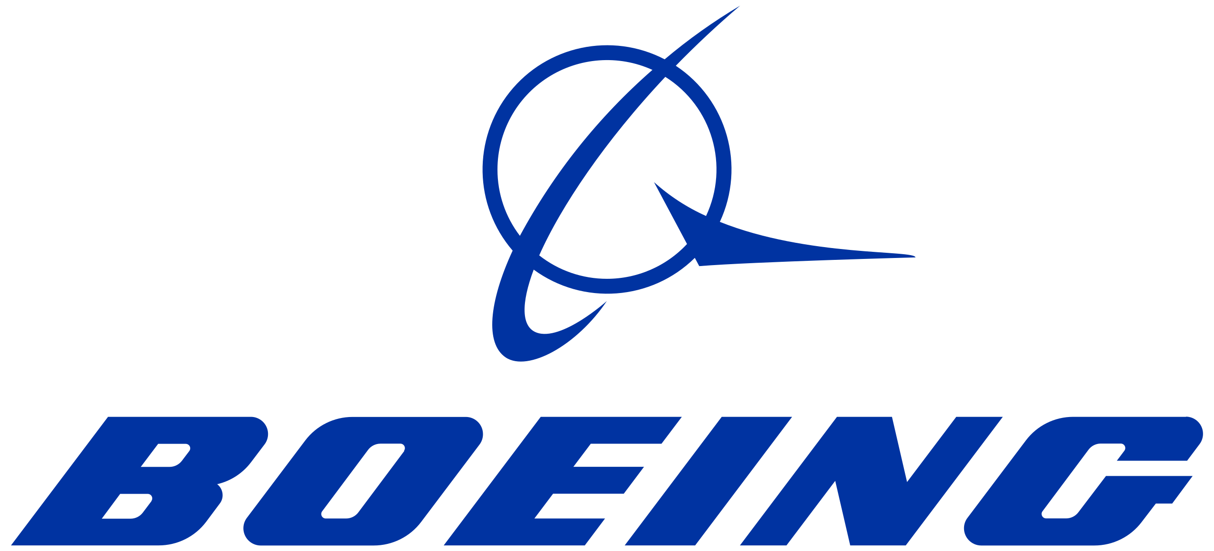

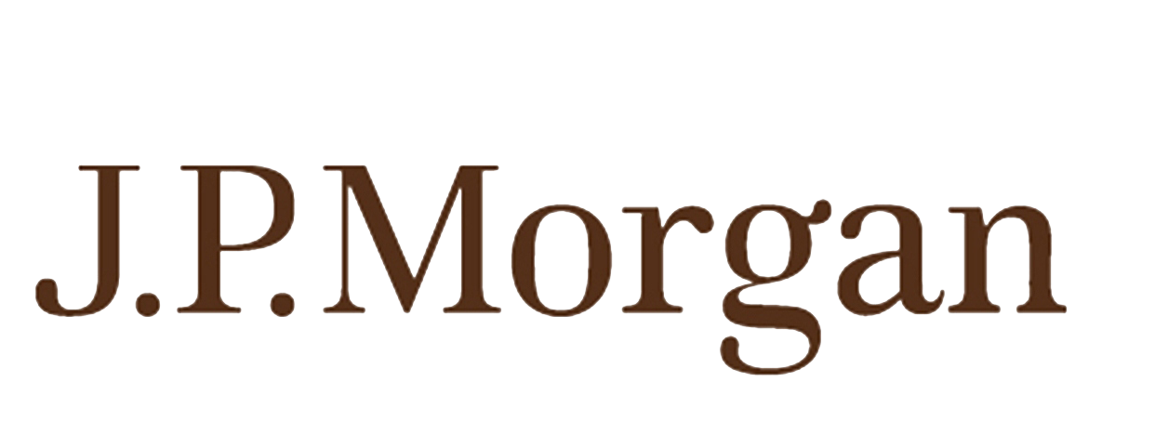
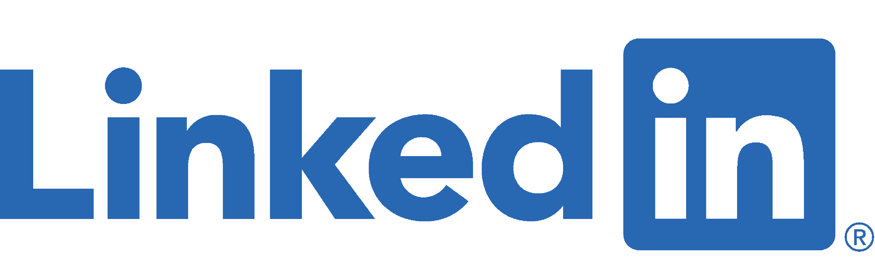
Talent management is shifting to directing a workforce ecosystem of machines and people
ACCESS
CURATE
ENGAGE
Create talent markets and mobility practices to source the best people, capabilities, and skills
Deliver consumer-grade development experiences and services to optimize the way people grow their career, mentor, and learn
Integrate, redesign, and create workforce platforms and policies that maximize performance and engagement for a diverse workforce
87% of respondents define their workforce in broader terms than just
full- and part-time employees
partnered with Mesa Community College to teach students how to assemble and test equipment that create the “central nervous system” of Boeing’s airplanes
built an agency-wide internal
talent marketplace creating a
transparent and accessible way for internal talent to seek opportunities¹
It is estimated that 1-in-6 people have some sort of neuro-minority status, yet unemployment rates for neuro-minority people are far higher than for others - up to 80%
Employees in JP Morgan’s
‘Autism at Work’ program,
achieve, on average, 48% to 140% more work than their typical colleagues, depending on the roles
is piloting Skills Path, a new method for skills-based hiring with commitments from BlackRock, Gap Inc., TaskRabbit, and more
Notes:
“Talent management,” is based on a linear employee lifecycle of Attract Develop Retain. In an unleashed workforce the key is directing or governing a workforce ecosystem of machines and people. How do you tether an unleashed workforce to your organization and the objectives and mission within
It’s about Accessing the capabilities and deploying them when and where you need them, Curating experiences that develop them unleashing their potential and growing the collective intelligence of your organization and Engaging them – enrolling them in their purpose and motivating them via the impact they are having
Much of this is leadership, but much of it too is powered by technologies that enable internal opportunity marketplaces and direct learning to the flow of work. These become part of the future workplace and how it operates.
SOURCES:
1. Quinten Dol, “22 Companies Spearheading Digital Innovation In Their Industries In 2021,” Built In, January 5, 2021.

Slide 16
Challenging orthodoxies will be crucial for success
There are many traditionally-held ideas about working remotely and its shortcomings that must be challenged to move into the future of work.
An ideal customer experience
Productivity
“How do I know they are productive if I can’t see them in the cubicles in front of me?”
Culture and Relationship Building
“You can’t build relationships….our culture will erode”
Onboarding
“You can’t onboard new joiners”
Innovation
“We won’t be able to innovate if we can’t have serendipitous interactions at the coffee bar”
Upskilling
“People don’t want to learn new skills”

Slide 17








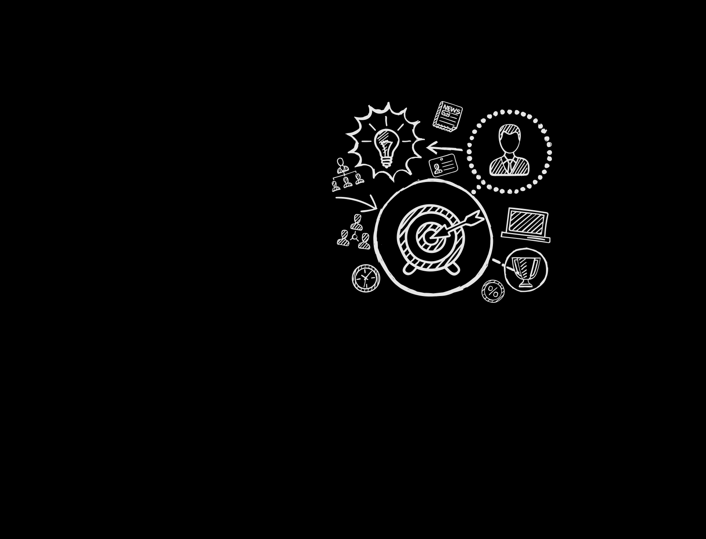
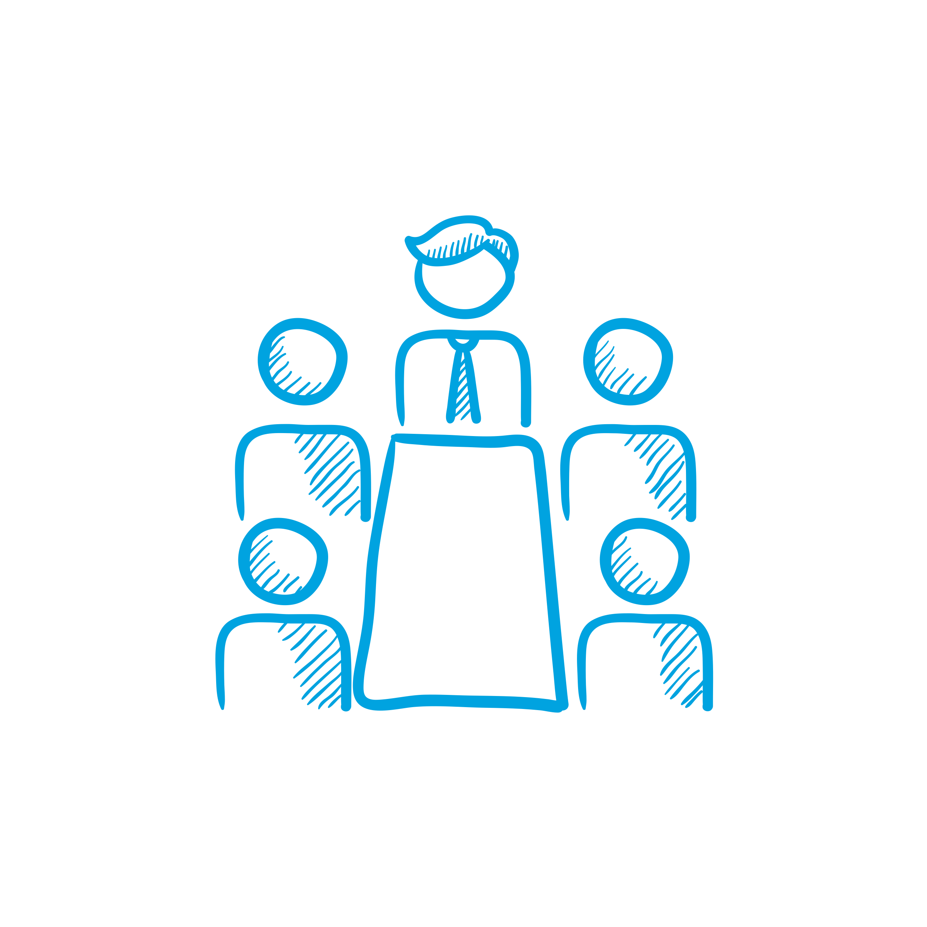


Parting thought – Where do we start?
Get more disciplined about identifying and building Future Skills
Bring data to the redesign work at scale
Establish a strategy for new ways of working and execute it

Slide 18
Let’s get to Work.
Notes:
.

Slide 19
Thank you!
About Deloitte
Deloitte refers to one or more of Deloitte Touche Tohmatsu Limited, a UK private company limited by guarantee (“DTTL”), its network of member firms, and their related entities. DTTL and each of its member firms are legally separate and independent entities. DTTL (also referred to as “Deloitte Global”) does not provide services to clients. In the United States, Deloitte refers to one or more of the US member firms of DTTL, their related entities that operate using the “Deloitte” name in the United States and their respective affiliates. Certain services may not be available to attest clients under the rules and regulations of public accounting. Please see www.deloitte.com/about to learn more about our global network of member firms.

