Slide 1
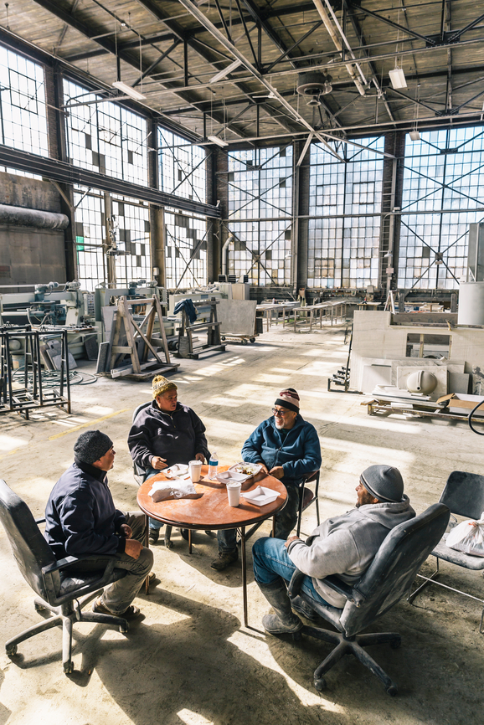
Local Investment Solutions in Alberta and BC

Slide 2
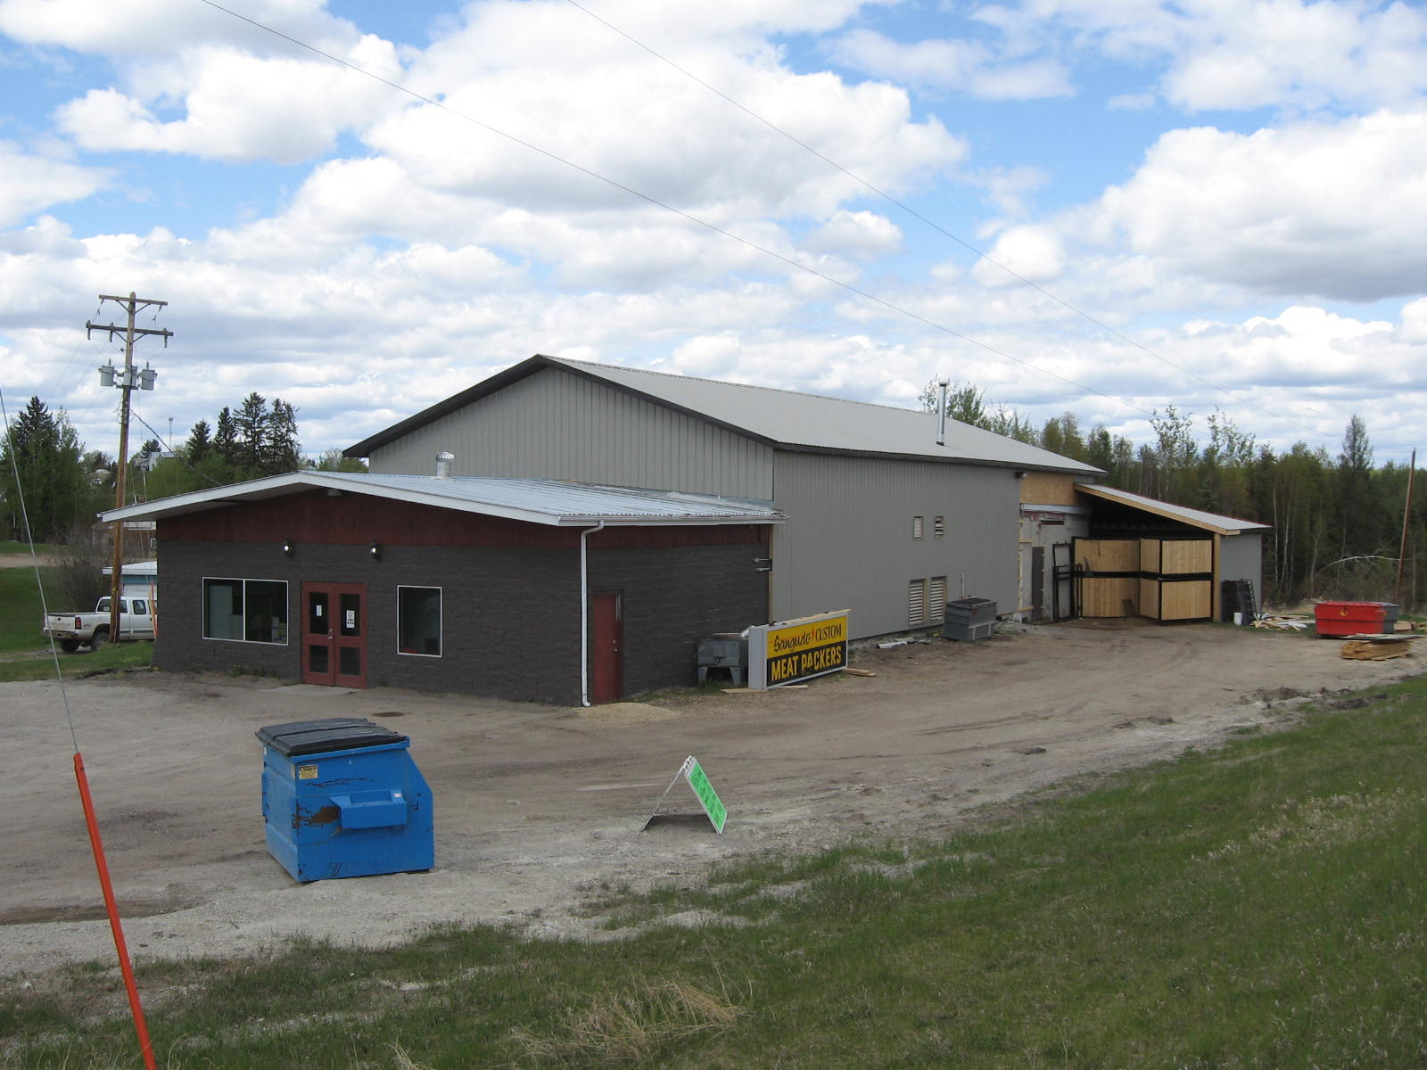
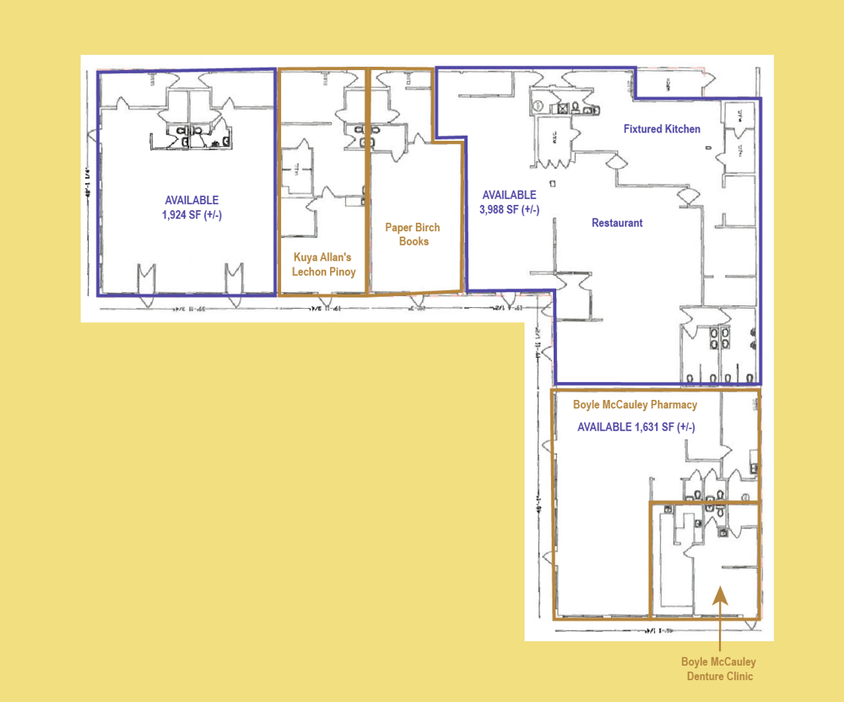

Slide 3
Overview Investment Co-ops
How might individuals easily invest where they work and live to create better economic development outcomes?
Co-op structure and Stewardship
Pool capital through the sale of RRSP and TFSA eligible shares to invest in local businesses within a designated region to create
Identify and assess capital needs of local opportunity
Debt, equity, real-estate
Terms, amount
Raise capital and invest within the region
Identify other capital if needed (grants, vendor take-back, debt-financing)
Maintenance/administration
Long-term strategy
Multi-year investing

Slide 4
Co-operative: Advantage
Minimizes costs
Local knowledge>Professional due-diligence and search
Volunteer boards (restrictions on commission)
Expenses
Administrative
Legal and accounting
Account maintenance fees
Marketing
Revenue
Interest or dividends from investments
Returned to members
Additional investors benefits (customer, etc.)

Slide 5
Opportunity Development Co-operative: How
Get the right people on the bus and build capacity
Invitation
Assessment
Build Skills
Planning
Mission-Vision-Values
Investment Strategy

Slide 6
Opportunity Development Co-operative: How
Governance Team
Long-term strategy/succession
Recruitment
Policy
Incorporation/Bylaws/AGM
Investment Team
Search Criteria
Initial due-diligence
Finance Committee
Feasibility of the co-operative
Reporting and admin
Member Engagement
Communications

Slide 7
Local Investment Solutions

Slide 8
Seth Leon
587-216-2144
devdirector@acca.coop
www.acca.coop

