Slide 1


Amplifying Rural Communities’ Voices
Effective Communications with Decision-Makers & Officials
SEDA PATH TO PROSPERITY
JUNE 13, 2024
Lindsay Brumwell, CEO & Founder

Slide 2
“If you can’t explain it simply, you don’t understand it well enough.”
~Albert Einstein

Slide 3
AGENDA
Introductions
Importance of Rural Voices
Start with your WHY
Identifying key stakeholders and securing a meeting
Developing a focused agenda
Crafting concise messages and a clear ‘ask’
Streamlining advocacy efforts
Questions

Slide 4

NICE TO MEET YOU.
CEO & Founder
Lindsay Brumwell
18+ years of experience in corporate, government, and public affairs.
Legislative and regulatory amendment changes at all levels of government.
Enabled the movement of hundreds of millions of dollars through various means - investment attraction, regulatory amendments, policy change, etc.
Trusted strategist.
Stakeholder relations specialist.
Spoke person, negotiator, coach.
Her unique insights and experience will elevate your government relations game without breaking the bank.

Slide 5

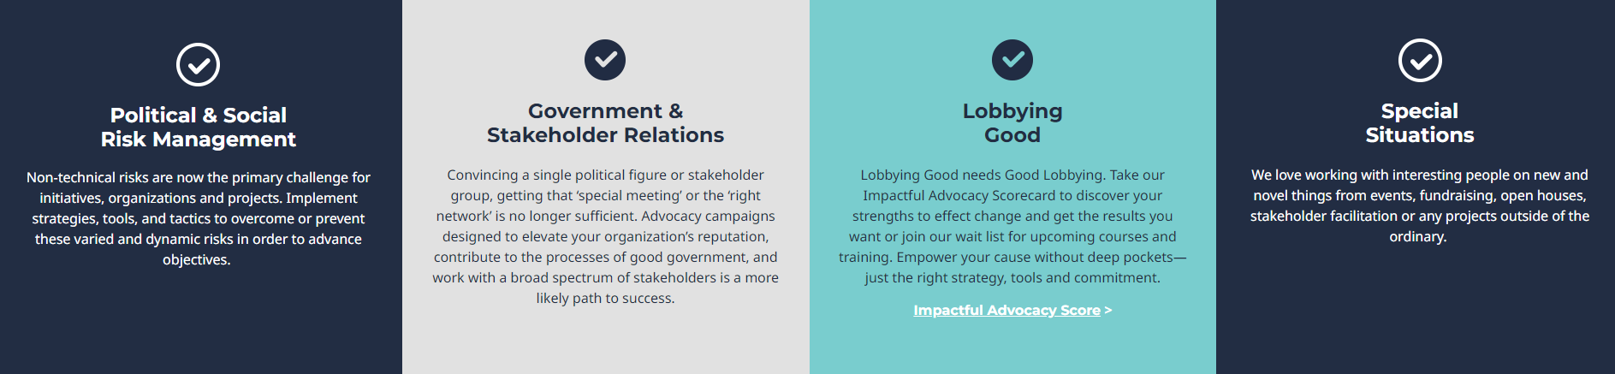
LB STRATEGIES | OUR MISSION
To be partners in change management, problem-solving, external risk mitigation, and opportunity and partnership creation.

Slide 6
IMPORTANCE OF RURAL VOICES IN ADVOCACY
Bridging the Urban-Rural Divide
Economic Development
Access to Services
There are differences between urban and rural areas in terms of resources, services, and opportunities. Advocacy helps bridge this gap.
There are more MLAs on a per capita basis in Saskatchewan in rural areas. Each rural based MLA represents ~19K residents.
Boosting Local Economies: Effective advocacy can attract investments, grants, and policies that support local businesses, agriculture, and tourism, driving economic growth.
Job Creation and Retention: Advocating for policies that support local industries can lead to job creation and prevent the outmigration of residents seeking employment elsewhere.
Improving Infrastructure: Advocacy efforts can lead to better infrastructure, such as roads, internet connectivity, healthcare facilities, and educational institutions.
Enhancing Public Services: Ensuring rural communities have access to quality public services, including healthcare, education, and emergency services, is vital for their sustainability.

Slide 7
THE GOLDEN CIRCLE BY SIMON SINEK*
WHAT
WHAT
Every organization knows WHAT they do. These are the products and services they sell or provide.
The WHAT is the result.
HOW
Most organizations know HOW they do it. These are the mechanics, things that make them different or set them apart from their competition.
The HOW is the process and actions taken.
HOW
WHY
Very few organizations know WHY they do what they do. The WHY is your purpose, motivation, belief.
Can you communicate your community’s purpose or objective simply?
WHY
*The Golden Circle - Communicating From the Inside Out.
Visit TED Talk: How Great Leaders Inspire Action

Slide 8


STAKEHOLDER MAPPING | THE BASICS
Define your objective / issue / priority
Identify your stakeholders (e.g. build a list)
Segment your stakeholders:
Tip:
Being very clear on your WHY before you start the HOW and WHAT.
It is crucial to attracting and
identifying the right stakeholders & advocates.
Political | Policy | Corporate | Industry | Region |
Jurisdiction | Other?
Prioritize your stakeholders
High | Medium | Low

Slide 9
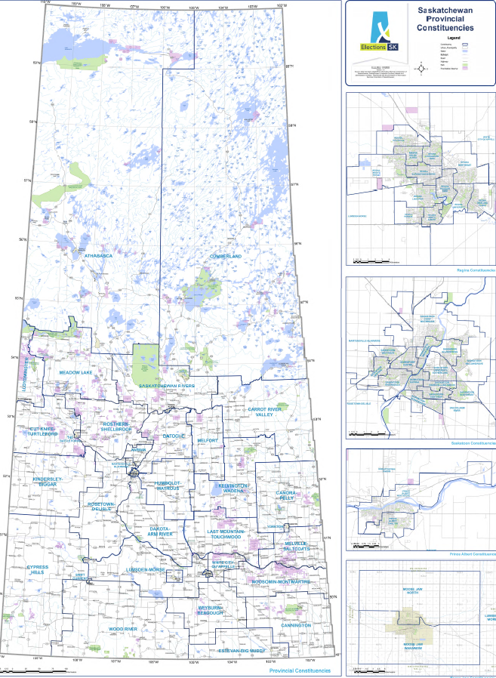
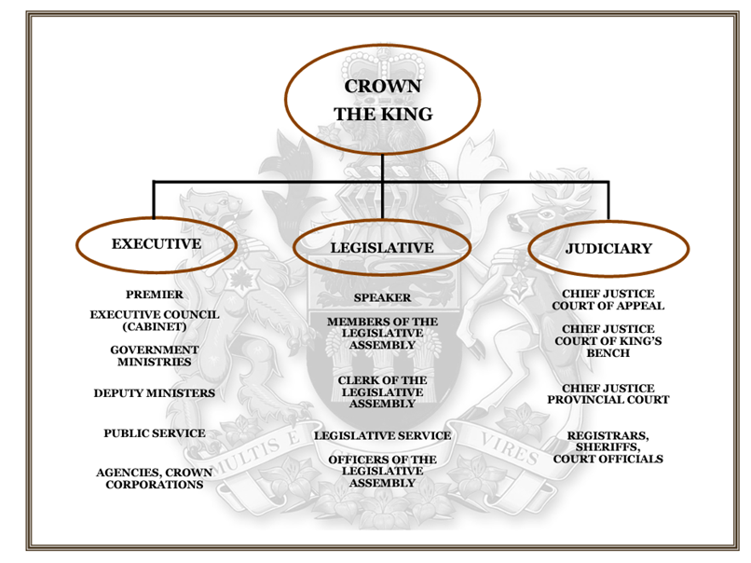
STAKEHOLDERS | PROVINCIAL GOVERNMENT
Legislative Assembly of Saskatchewan
61 Members of the Legislature (MLAs)
Branches of Government.

Slide 10
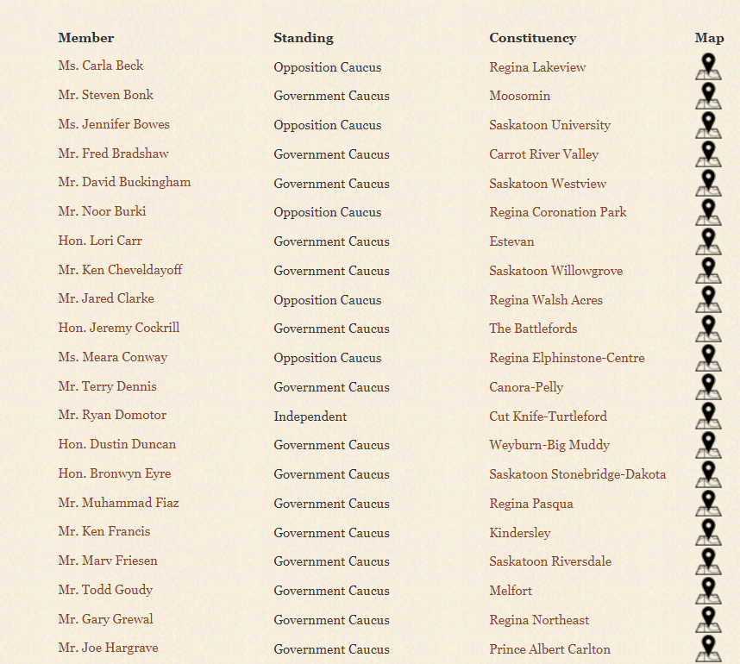
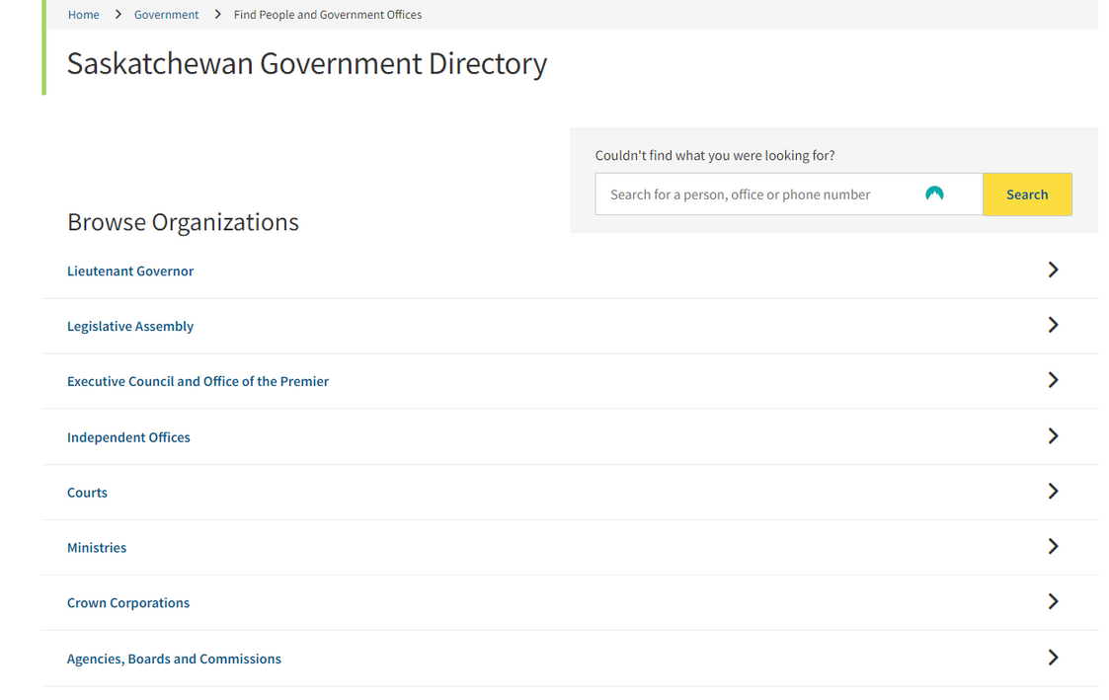
IDENTIFY KEY STAKEHOLDERS | PROVINCE
https://www.legassembly.sk.ca/mlas/
https://www.saskatchewan.ca/government/directory

Slide 11
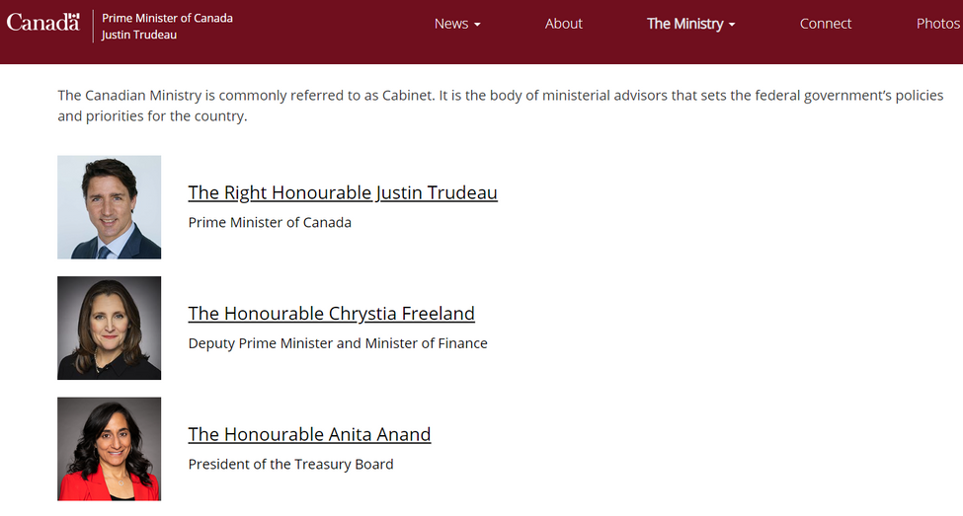
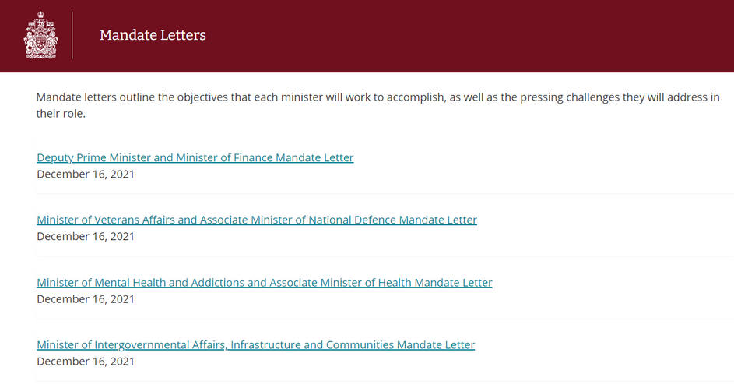
IDENTIFY KEY STAKEHOLDERS | FEDERAL
Cabinet, Parlimentary Secretaries, and Political Staff
https://www.pm.gc.ca/en/cabinet
Tip:
When identifying appropriate stakeholders, review Minister mandate letters.

Slide 12
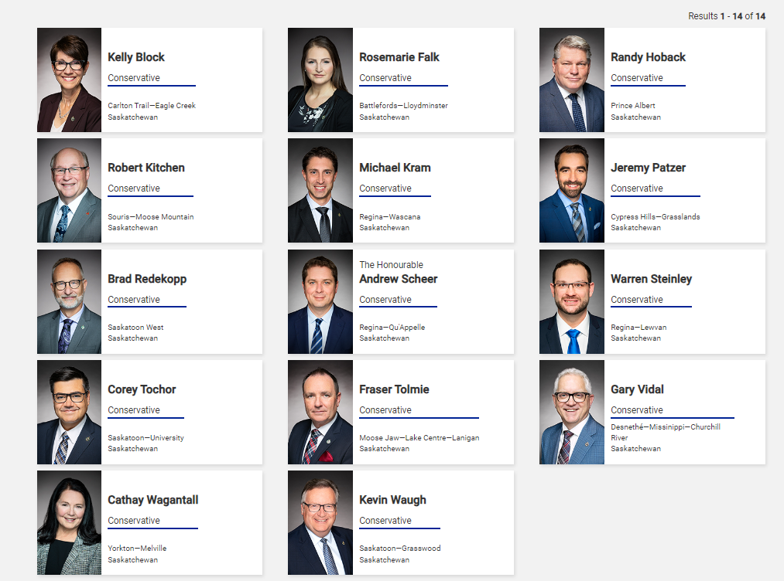
IDENTIFY KEY STAKEHOLDERS | FEDERAL
Tip:
Don’t forget about MPs that represent your community.
https://www.ourcommons.ca/members/en

Slide 13

There are~300,000 employees within the Canadian civil service.
Tertiary Stakeholders
United Nations
EU
Secondary Stakeholders
Federal level
Unions
Political Parties
Provincial / Indigenous Gov’t
Supreme Court
United States
Foreign Investors & Financial Markets
Primary Stakeholders
Academia / NGOs / think Tanks
Voters
Industry Associations
Outside The Organization
Agencies, Boards, Comissions
Employees
MPs
Security / National Defense
inside The Organization
Privy Council
Tip:
Don’t forget about engaging the civil service. They can be found at
https://geds-sage.gc.ca/
Professional Associations
Governor General
Public sector Unions
Contractors
Ambassadors & High Commissioners
Crown Corps
Partners
Suppliers

Slide 14

Timing is critical.
Governments of all levels have processes and cycles.
Watch for the scheduling of the Throne Speech.
SECURE A MEETING
January - March
March is usually budget month.
April - June
March to mid-May Spring Legislative Session. MLAs will be in Regina most of the time.
End of January to third week of June is Parliament session. MPs will mostly be in Ottawa.
July - September
Civil servants take holidays and bureaucracy slows down. BUT, department budgets are completed by mid-September.
BBQ circuit. Politicians are in their ridings.
October - December
Fall sitting of the House. Finalize budgets and priorities.
December politicians return to their ridings.

Slide 15

SECURE A MEETING
Research and Preparation: Tailor your request to highlight mutual interests and demonstrate thorough preparation on the issues you wish to discuss.
Leverage Networks and Relationships: Utilize existing connections and seek introductions from mutual contacts to increase credibility and likelihood of securing a meeting.
Demonstrate Community Support: Show that your issue has broad community backing by including endorsements from local organizations, businesses, and constituents, emphasizing the collective interest and impact.

Slide 16


DEVELOP A FOCUSED AGENDA
Federal
Provincial
Municipal
National Focus
Regional Focus
Local Focus
Criminal
Immigration
Indigenous Peoples
International Trade Agreements
Agriculture - CFIA
Taxation / CRA
Employment Insurance
Note: Federal Government writes criminal laws, but the enforcement & prosecution is responsibility of the province (except drug laws).
Labour and Employment (except for federal entities)
Childcare and Protection
Housing
Social Assistance (all social programming)
Education
Health
Transportation and Infrastructure
Community planning
Zoning
Property taxes
Local police
Waste - garbage, landfill management
Public transit
Local parks & recreation facilities

Slide 17

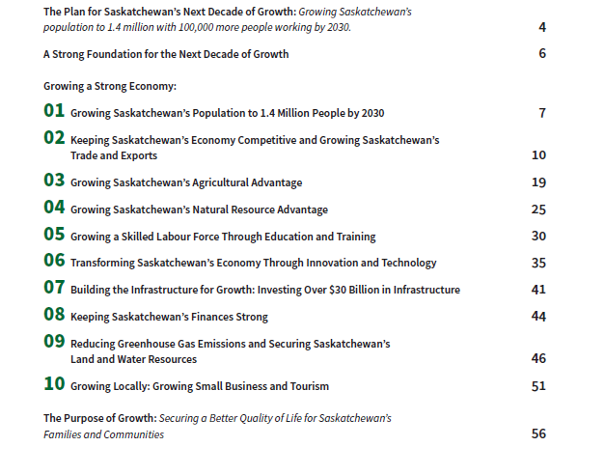
DEVELOP A FOCUSED AGENDA
Tip:
Link your ‘ask’ and messages to your audience. Provincially, the Growth Plan is like a federal mandate letter.
Prep for the meeting:
Read the plan.
Focus on only one ‘ask’ at a time.

Slide 18
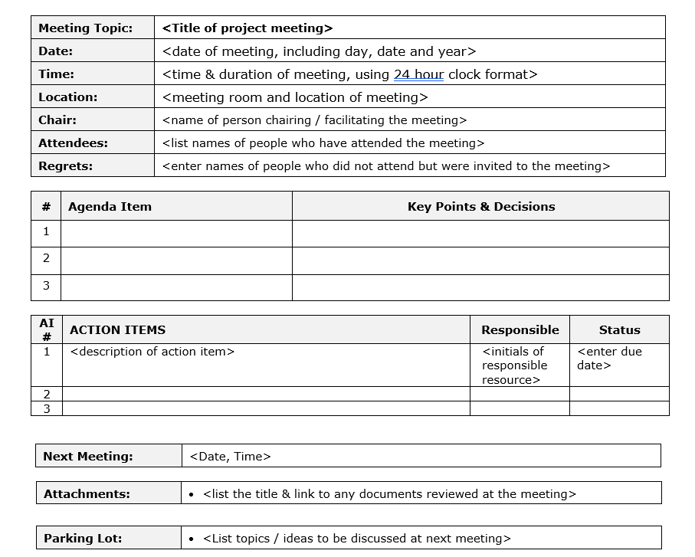
DEVELOP A FOCUSED AGENDA
Tip:
Develop a clear agenda for your internal / team members. This template can also be used to keep minutes from the meeting.
Prep for the meeting:
Send an agenda ahead of time.
Ask who will be joining the meeting.
Biographies, include a photo.
1 pager or 2 page briefs on the key issue.
Let your MLA or MP know what you’re doing, even if they aren’t invited.

Slide 19
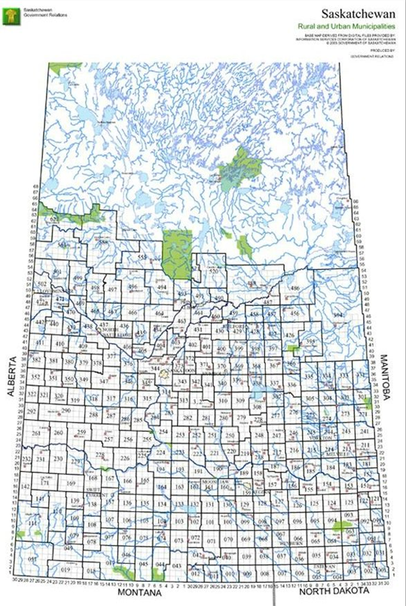
CRAFTING A CLEAR MESSAGE | DO YOU STAND OUT?
Tip:
Governments typically focus on the majority. If you can’t stand out, find friends and neighbours to align with your ‘ask’.
Should your neighbours be on your stakeholder or detractor list?
There are 774 municipalities across the province.
The two largest municipalities regions are home to ~50% of the province’s population: Saskatoon & Regina.

Slide 20
CRAFTING A CLEAR MESSAGE & “ASK”
Prep and Development, Prep, Prep, Prep...
What Officials Can Do In a Meeting?
What Officials Cannot Do?
Tailor your message to your audience.
Have data and evidence to back up your messages, including costs.
Have stories to make your ‘ask’ and messages compelling.
Refer to partners, other organizations or examples of successful collaboration.
Include what you want, are willing to do, etc.
Commit to Policy or Legislative Change or Amendment - alone.
Give Definitive Direction - typically requires coordination and approvals
Implement Major Ideas without Political and Procedural Approvals
Disclose Confidential Information
Guard Against Knee-Jerk Political Decisions
Take Decisions on Delegated Authority
Develop Options for the Minister or Cabinet to Consider
Give Cost Implications and a Proposed Implementation Plan
Champion Your Issue within the System
Provide Recommendations on Next Steps, Timing, Processes and Decision Makers

Slide 21


STREAMLINING ADVOCACY EFFORTS
Build a framework so you can see areas of overlap, gaps, respond quickly, etc.
Being able to communicate quickly and in a targeted way is essential when working with stakeholders.
Look at options for engagement options - a conference, a letter, community event, meeting, etc.
Issue
Communication Type
Engagement Type
Stakeholder #1
Stakeholder #2
Stakeholder #3
Stakeholder #4
Stakeholder #5

Slide 22
STREAMLINE ADVOCACY EFFORTS
Tip:
Take notes! Include any actions, decisions, and follow-up. Send a copy to all attendees at the meeting.
After the meeting or engagement:
Send a thank you note / email.
Put in writing any decisions or next steps.
Send any information requested.
Determine next steps - both internal and external.

Slide 23
Questions?

Slide 24
Thank you!
CONTACT
hello@lbstrategies.ca | lbstrategies.ca

Slide 25
SERVICES
Intergrated Corporate Affairs
Political and Social Risk
Government and Stakeholder Relations
Lobbying Good
Strategic Planning
Communications - internal & external
Marketing
Public Relations
Corporate Social Responsibility (CSR)
Sponsorship Management
Social Value Planning
Events Design & Management
Policy, Political and Social Risk Analysis
Stakeholder & Decision-maker Mapping
Research and Analysis
Advocacy & Lobbying
Message Development
Business Development
Grassroot Engagement
Reputational Management
Fundraising
Corporate Engagement
Government Relations Training
Media and Stakeholder Relations Training
Identifying allies and partners
Key Message Identification
Coaching
Customized workshops
Strategic planning and implementation
Action plans and metric development
Problem-solving
Prioritization
Workshops
Facilitation

Slide 26


WORD AROUND TOWN
hello@lbstrategies.ca | www.lbstrategies.ca

