Slide 1


Program Overview
Supported by the Saskatchewan Economic Development Alliance

Slide 2
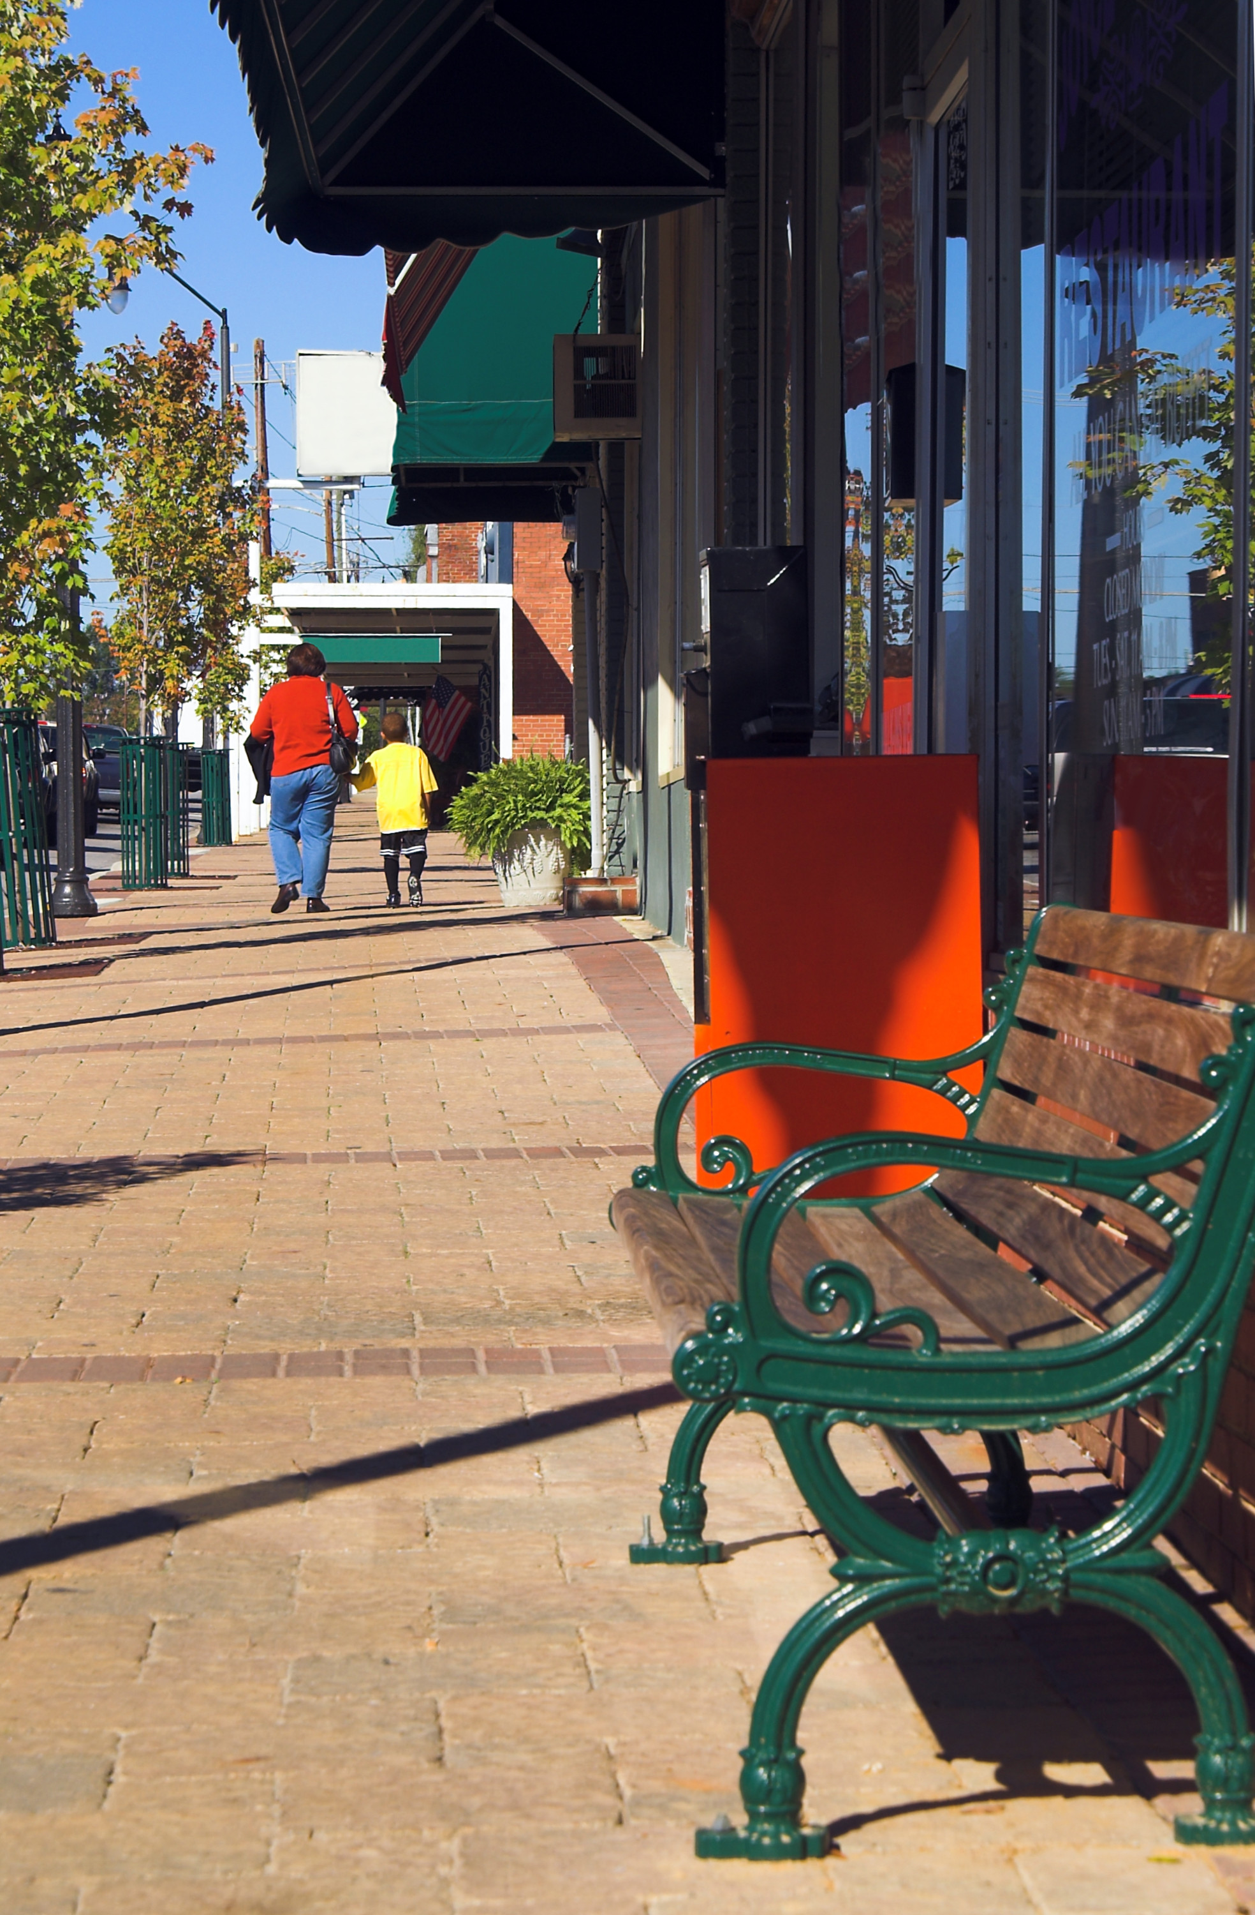
About the Program
Assists communities identify their strengths and shortcomings through the eyes of first-time visitors
Assesses:
Downtown appearance, amenities and services
Housing supply & quality
Tourism facilities / services
Infrastructure / transportation
Health & Education

Slide 3
About the Program
Community to Community exchange program.
Volunteer teams do a “mystery shopper” type assessment of the other community
Communities are matched, based on location, size, proximity to urban, economy, etc.
Generally communities are 2 to 3 hours apart by road.

Slide 4
Community Readiness Checklist
Accepting of Constructive Criticism
Community Commitment & Leadership
Human Resources: Coordinator, Visiting team volunteers
Financial resources: travel expenses, report preparation
Engaged in a forward-looking process (downtown revitalization, etc.)
Willing to do follow-up action

Slide 5
The Process
Pre-Visit
Recruit 5-6 members, varied backgrounds, ages, professions
Visit
One full day: Pre-visit meeting, half-day assessment + travel (Overnight stay optional)
Team starts with a drive-through…checking entrances & getting a “first impression”…
Team members role play and complete a questionnaire about the community

Slide 6
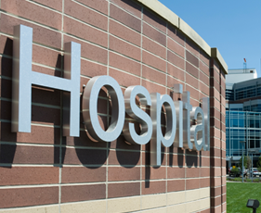
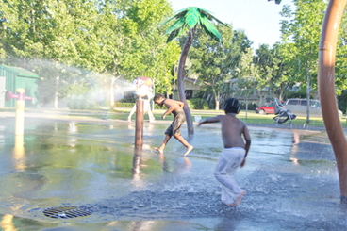

Scope of Assessment
Pre-Visit: view website & publications
• 5-Minute Impression
• Downtown
• Industry
• Housing
• Health Care
• Restaurants
• Public services
• Visitor information
• Residents’ perceptions
• Public Infrastructure
• Recreation/Tourism
• Faith, Culture and Heritage

Slide 7

Visiting Team
Uses a Visitation Questionnaire Booklet to record observations
Keeps a Photo Log
Uses Senses – taste, smell, sight
Obtains information from local residents on how they view their community
Role plays to obtain necessary information

Slide 8
Community Responsibilities
Identify a coordinator who:
Recruits & trains volunteers, plans visit, leads report preparation
Completes the Visit / Assessment
Enters into agreement with exchange community
Prepares / present a written report & slide presentation to exchange community
Hosts (public) report back from exchange community
Does action-planning

Slide 9
Timeline ( 3 to 6 months)
Program Orientation
Allow two weeks
Make decision to implement
Identify Local Coordinator
Identify Exchange Community
SEDA can assist in “match making” communities
Allow four to eight weeks
Recruit & orient visitation team
Pre-visit preparation
Visit to Exchange Community
Allow four weeks
Set dates, review logistics, equipment, visitation questionnaire

Slide 10
Timeline
Visiting Team Prepares Assessment & Slide Show
Community Coordinator and 1-2 team members go to exchange community and present report
Community Hosts Report Back from Exchange Community
Community engages in action planning based on report
Allow three to six weeks
Allow three weeks
Both communities evaluate the program experience

Slide 11
Why do a
First Impressions Exchange
Provides a fresh, objective perspective
Identifies community assets to develop
Identifies shortcomings that may negatively affect visitors and potential investors
Helps prioritize issues and develop strategies
Builds relationships with other communities
Cost effective (avg. $500)
Short time commitment
Easy to implement
Fun

Slide 12
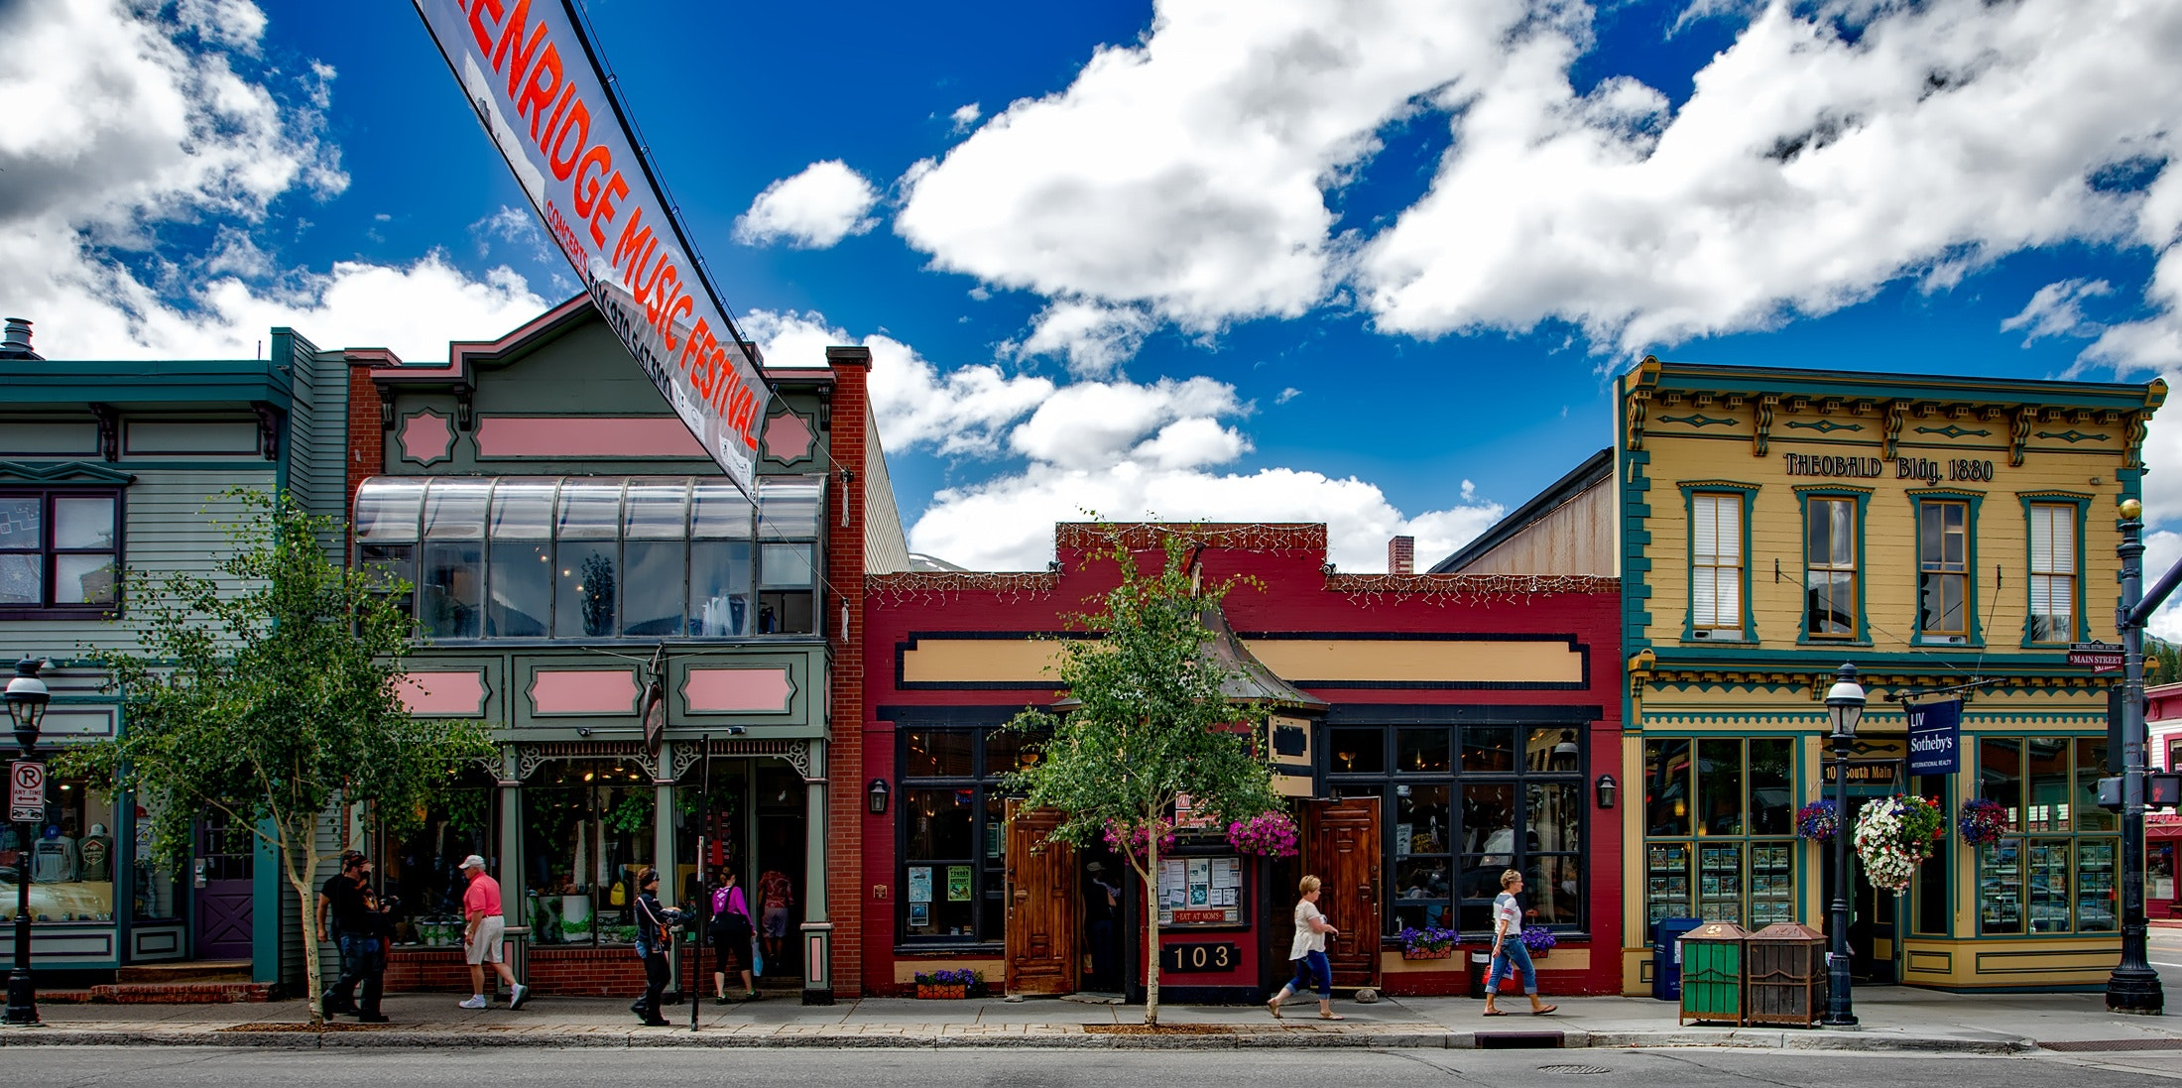
Examples of potential results and action plans
Building / facade improvements
Improved gateway, directional & tourism signage
New recycling bins
New community brand & marketing materials
Partnerships between communities (e.g. Festival of Lights, Communities in Bloom)

Slide 13

First Impressions Support
SEDA Resources and Service OPTION 1 (FREE TO SEDA MEMBERS)
Electronic copies of all Program Information
Coordinators Guide
Team Visit Guide Booklet
Program Overview Powerpoint
Template: Visitation Team Orientation Powerpoint
Template: Exchange Visit Report Back Powerpoint
Assists with Community Match Making

Slide 14
First Impressions Support
SEDA Resources and Service OPTION 2 (Fee for Service – hourly rate or project based)
SEDA will:
broker a terms of reference between the two exchange communities
coordinate participating communities to complete an exchange
provide of all project materials
facilitate final report meetings
support action planning based on the outcomes of the exchange and final reports.

Slide 15

Contact seda for more information at 306-242-2752
Or email seda@seda.ca

